Slide 1
Russia 1990s –mid 2000s
HW: LAST OUTLINE OF THE YEAR ☺
“New Challenges in the Twenty-First Century” (p. 1051 – 1061)
*Chapters 30, 31 outlines due Wednesday 4/20 (day of the test)

Slide 2
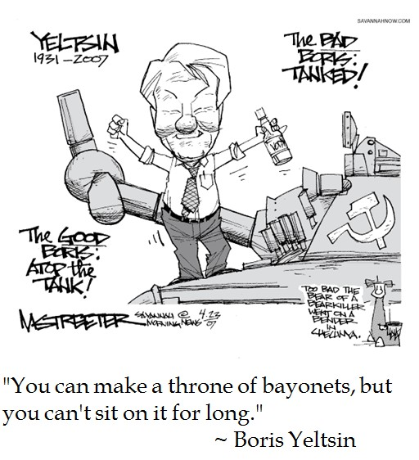
Economic reforms
Macro-economic stabilization
structural adjustment
cut state spending
increase taxation
end price controls
open trade
“shock therapy”
all “shock” but no “therapy”
Privatization

Slide 3
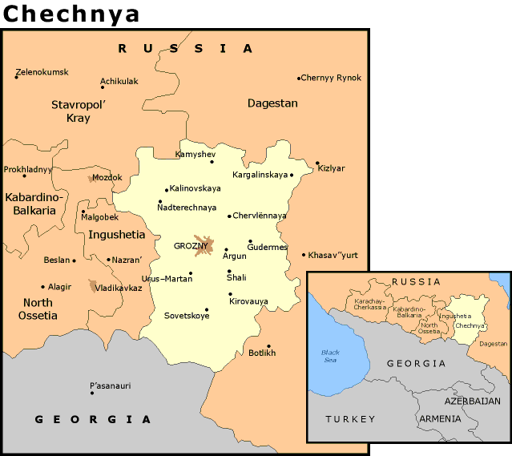
Conflict in Chechnya - History
Surrounded by vastly different ethnic groups Chechens have long sought their own national identity.
In the 15th Century the inhabitants were mostly converted to Islam, by Invading Turks from the Ottoman Empire.
In the 1700’s Russian influence began to seep into Chechnya, this was heavily resisted.
Conflict against Russian occupation was sporadic, but lasting for over 20 years.

Slide 4
Yeltsin’s Three Points
When the Soviet Union broke up in the early 1990s several Republics gained their independence. An independence movement started in Chechnya but was opposed by Boris Yeltsin who argued:
(1) Chechnya had not been an independent entity within the Soviet Union – as the Baltic, Central Asian, and other Caucasian States had – but was a part of the Russian Soviet Federal Socialist Republic and hence did not have a right under the Soviet constitution to secede;
(2) Other ethnic groups inside Russia, such as the Tatars, would join the Chechens and secede from the Russian Federation if they were granted that right; and
(3) Chechnya was at a major chokepoint in the oil-infrastructure of the country and hence would hurt the country's economy and control of oil resources

Slide 5
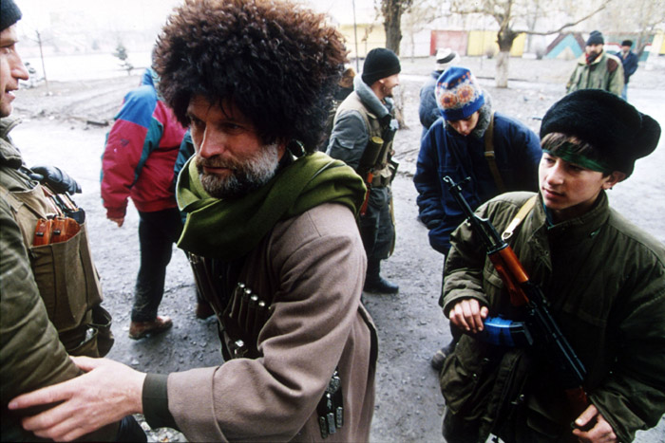
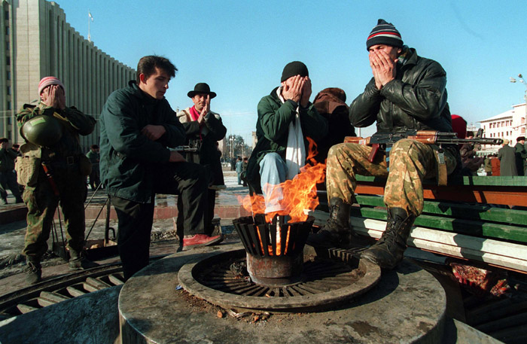
Independence
Dzhokhar Dudayev declares Chechnya independent.
Chechnya turns to chaos, new government unable to govern efficiently amidst corruption.
Slave trade, widespread murder, and terrorism run rampant.
Boris Yeltsin orders 40,000 troops to retake Chechnya. Advisers tell him it will be a short victorious war that will help him in the 1996 elections. This conflict continues through Putin’s terms.

Slide 6
The turn: 1998-2000
1998
August: Russia defaults on its loans. The financial crisis is regarded as collapse of Western-led economic reforms
1999
February-March: Boris Yeltsin’s authority is seriously challenged by opposition forces
March: Poland, Czech Republic and Hungary become members of NATO
March-April: NATO’s war on Serbia over Kosovo demonstrates that Russian opposition to NATO can be ignored
August: President Yeltsin appoints Vladimir Putin Prime Minister
October: Russian army moves into Chechnya to restore Moscow’s control
December: Putin’s supporters win majority in Duma elections, Yeltsin resigns, appoints Putin Acting President
2000
March: Vladimir Putin is elected President of Russia

Slide 7
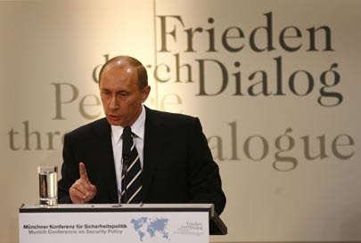
Putin and Stability
Popular and effective politician
Has strengthened institutions despite lingering social economic problems
Has built up the power of the Kremlin and other parts of the central government
Has undermined aspects of democracy without removing basic freedoms or eliminating competitive elections.

Slide 8
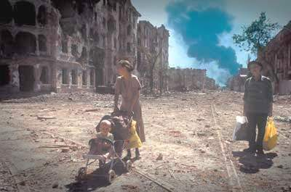
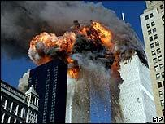
War on Terror
After the September 11 Attacks Vladimir Putin, began to associate the Chechen conflict with the War on Terror.
This has had some degree of success, as of 2006 no country, nor the United Nations has accepted Chechnya’s claim to independence.

