Slide 1
Chapter 28 – Age of Anxiety
Discuss Philosophy, Science, and Search for Peace and Political Stability
HW: Finish Chapter 28 outlines for Monday

Slide 2
Chapter 28 – Age of Anxiety
Philosophy & Science

Slide 3
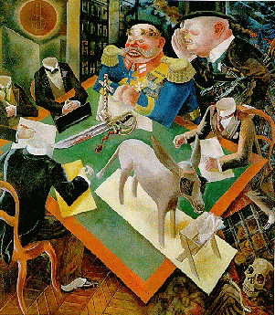
Chapter 28: The Age of Anxiety 1919-1939
George Grosz: Eclipse of the Sun, 1926. "Since the politicians seem to have lost their heads, the army and capitalists are dictating what is to be done. The people, symbolized by the blinkered ass, simply eat what is put before them."

Slide 4
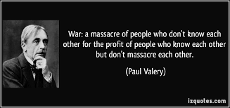
“Crisis of the mind”
Paul Valéry was French poet and critic ultimate pessimist. He
Compared the war to a storm which has died but has left people
Anxious and uncertain.

Slide 5
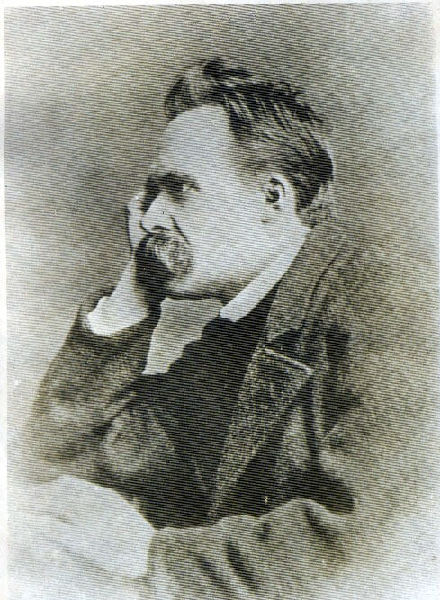
Modern Philosophy
“After coming into contact with a religious man I always feel I must wash my hands.”
“A casual stroll through the lunatic asylum shows that faith does not prove anything.”
Friederich Nietzche called for superior individuals to recognize the emptiness and meaningless of life. “There is no God”

Slide 6
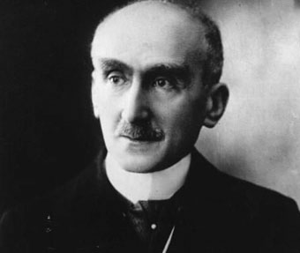
Modern Philosophy
“Think like a man of action, act like a man of thought.”
“To perceive means to immobilize. We seize, in the act of perception, something which outruns perception itself.”
Henri Bergson believed that experience and intuition are as important as rationale thinking and science.

Slide 7
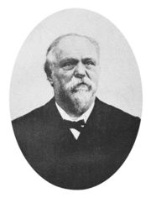
Modern Philosophy
“Hate is able to provoke disorders, to ruin a social organization, to cast a country into a period of bloody revolutions; but it produces nothing.”
George Sorel ( a French Socialist thinker) believed the Marxian Socialism would end up with a small revolutionary elite running society.

Slide 8
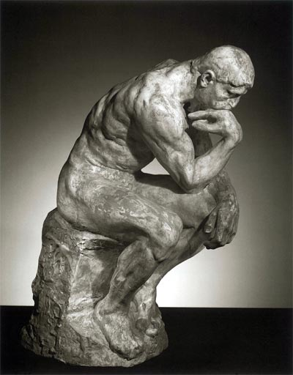
Philosophy splits due to World War I
Logical Epiricism (positivism) takes hold in English Speaking countries.
Ludwig Wittgenstein reduced philosophy to language, arguing that philosophers could not rationalize God, freedom, morality. (To think about thing you need empirical proof, not metaphysical theory)

Slide 9
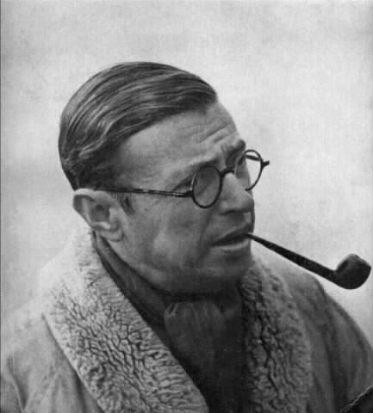
EXISTENTIALISM - In Europe were basically atheists who were searching for morals. (We exist, then we die)
Jean Paul Sarte argued that human beings are defined about making choices of the conscious, not in faith. Wrote literary works

Slide 10
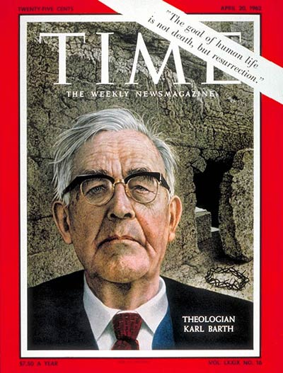
Revival of Christianity
“The goal of human life is not death, but resurrection.”
Soren Kierkegaard believed in Christian ethics rather than organized religion. “Father” of (Christian) existentialism and argued that actions bring meaning to life
Karl Barth and Gabriel Marcel were top leading theologians who turned to having faith in God. Spiritual revival transitioned into a moral revival, reverting back to the fundamentals of Christian teaching.
Loss of faith in human reason and progress led to renewed interest in Christianity for some.

Slide 11
The New Physics
Research of Marie Curie and Max Planck discovered radium emits subatomic particles. The atom is discovered! (not “little hard balls” Atoms do not have a consistent atomic weight (uncertainty) and subatomic energy (quanta) is emitted inconsistently as well.
Ernest Rutherford – split of an atom, identification of neutron, could be harnessed in bomb form

Slide 12
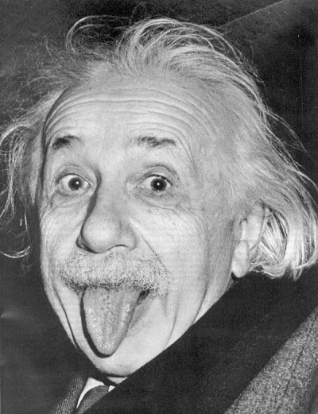
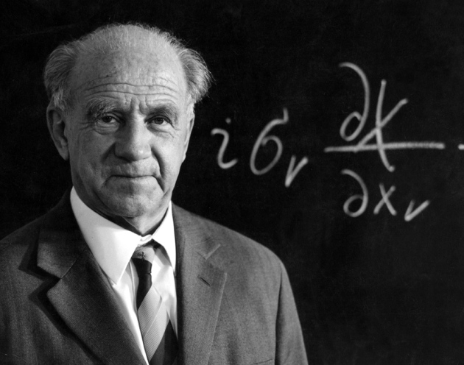
The New Physics
“heroic age of physics”
Werner Heisenberg - principle of uncertainty which states that it is
impossible to predict the position and speed of an electron
Albert Einstein undermines Newton by stating that matter and energy are interchangeable and that even a particle of matter contains energy. Time and space only relate to the viewpoint of the observer. Only the speed of light is a constant.

Slide 13
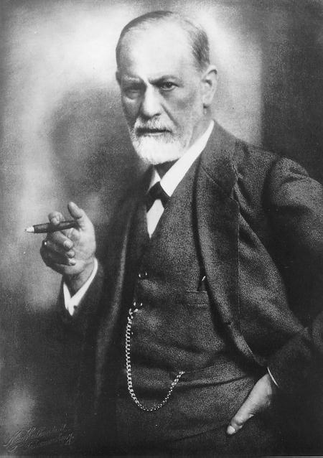
Psychology
Sigmund Freud believes the unconscious is driven by sexual, aggressive, and pleasure seeking desires locked in a constant struggle with the rationale mind. – the ego (sex is good for mental health)
Before Freud the belief was that human behavior was the result of rationale calculations by the conscious mind.
Freud believes that behavior is irrational and unconscious; primitive like. – the id
Freud believes that the id and ego are also persuaded by moral values on what a person should do – the superego
Instinct versus morals

