Slide 1
Chapter 29 - Germany after WW1 and the Rise of Nazism
Today – Rise of Hitler
Tomorrow – The Holocaust
Monday – WWII (Battles, etc)
Tuesday, Wednesday – Review
Thursday – Chapters 28, 29 MC Exam
Friday – go over test
HW: outline – “Nazi Expansion and the Second World War” (up to “The Grand Alliance”) (p. 975 – 980)

Slide 2
Germany
Condition of Germany
High Inflation
High Unemployment
People were desperate and wanted a solution.
After WWI, the Weimar Republic was established in Germany. This was a parliamentary system of government.

Slide 3
Hitler’s Beginnings
Born Austria, 1889
HS dropout
Study art in Vienna (rejected)
Vienna- Jews among intellectual, financial leaders
Beginning of hatred for Jews

Slide 4
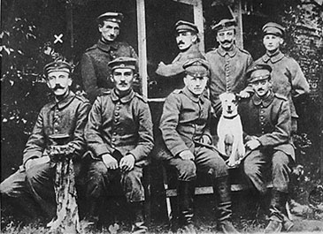
Hitler in WWI

Slide 5
Adolf Hitler
The National Socialists (Nazis), were strongly opposed to the Weimar Republic and wanted to overthrow them.
They were against them because they signed the Treaty of Versailles.
The Nazis’ leader, Adolf Hitler, believed that this was the main reason for Germany’s downfall and current state.

Slide 6
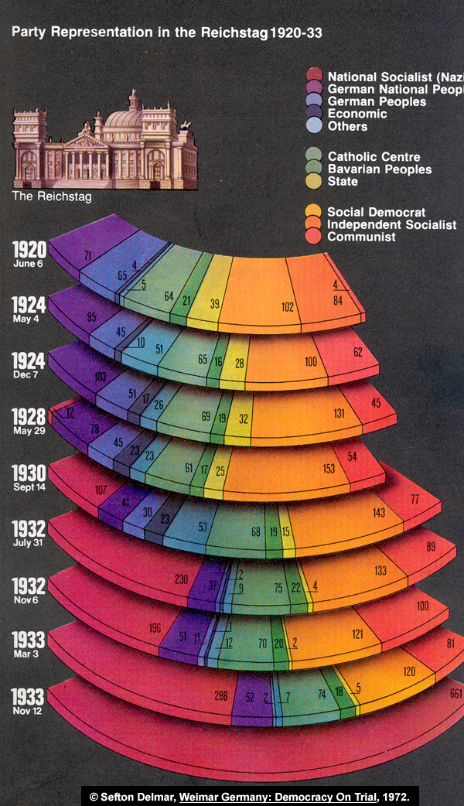

Slide 7
Mein Kampf
Mankind consists of two groups: the Aryans (the master-race) and the non-Aryans (the slave races).
Germans (Aryans) destined to rule the world.
The Jews were responsible for Germany’s defeat in WWI by encouraging the socialists to make the November Revolution in 1918.

Slide 8
Mein Kampf
If Germans wanted their nation to be strong again, they had to believe in the Führer (Hitler himself).
The Führer would exterminate the Jews from Germany so that they would not pollute the German blood by intermarriage.
The government would be run by the rule of an elite who accepted orders from Hitler alone.

Slide 9
Hitler’s Plan for Germany
nationalize the big business
provide employment for all workers
implement land reforms for peasants
destroy the chains of department stores controlled by the Jewish capitalists.
Germany would become economically self-sufficient by conquest abroad.
Abolish the Treaty of Versailles
union of all Germans in a single German state
conquer Eastern Europe to provide living space for the future generations

Slide 10
Reichstag Fire
February 27, 1933
The Reichstag, Germany’s equivalent to the U.S. capital building is set on fire.
Hitler blames the Jews and Communists for it.
Proposes the removal of all checks and balances in the government .
Out of fear, the Republic approves this measure, Hitler’s power becomes absolute.
Germany will never be the same again.

Slide 11
March 23, 1933 - Enabling Act pushed through the Reichstag - Gave Hitler complete dictatorial powers. Due to a brilliant propaganda campaign, Hitler is the democratically elected Chancellor of Germany

Slide 12
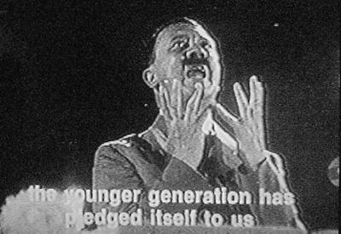

Slide 13
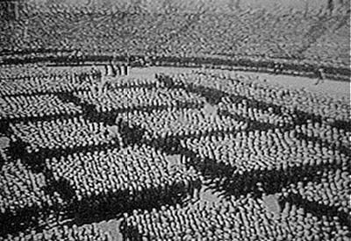
Hitler Youth Rally in Nurmeberg

Slide 14
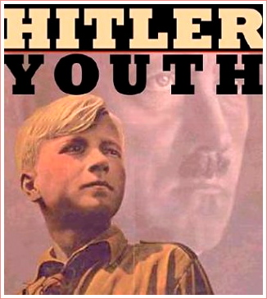
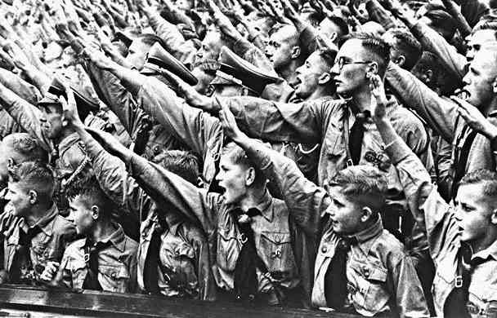
How did Hitler become so powerful?
http://www.youtube.com/watch?v=eGhdX1SI3KY&bpctr=1364318787 Speech
http://www.youtube.com/watch?v=Nu-ZB-yoPyY 22 min. doc.
http://www.youtube.com/watch?v=PYFIbcSPgIg Hitler youth video http://www.youtube.com/watch?v=JB45qymNQEo Hitler’s Children part 1

Slide 15
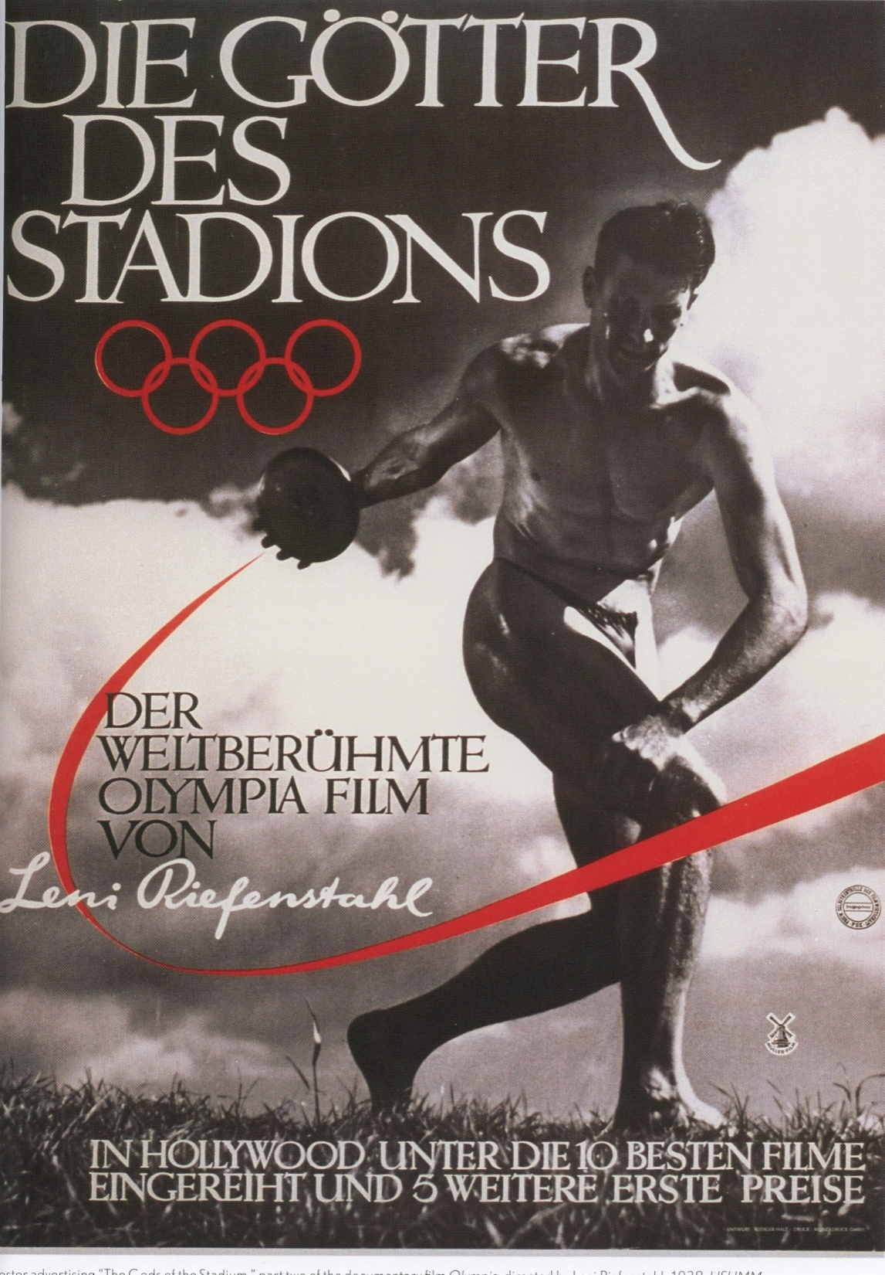
1936 Olympics in Berlin
Advertising poster for “The Gods of the Stadium”, part of a documentary series called Olympia, by Leni Riefenstahl.
https://www.youtube.com/watch?v=Qix2oiw9px4

Slide 16
Hitler’s Early Policies
Trade unions banned
Political parties eliminated
Army and secret police
Brown Shirts (SA)- Hitler’s personal army (early 1920’s)
Gestapo- secret state police
SS-Hitler’s body guard (1925)

Slide 17
Early Policies cont…
Nuremberg Laws
Anti-Semitism- became official govt. policy
Jews lost citizenship
1933- Jews forbidden from holding govt. jobs or owning businesses

Slide 18
ANTI-JEWISH LEGISLATION IN PREWAR GERMANY 1935

Slide 19
Nuremberg Laws
German Jews no longer citizens, cannot vote, and cannot hold public office.
cannot be treated in German municipal hospitals
Jewish officers were kicked out of the army
Jews not allowed to marry persons of “German or German-related blood”.

Slide 20
“Nuremberg Laws”
Defined anyone who had three or four Jewish grandparents as a Jew.
People with Jewish grandparents who had converted to Christianity could be defined as Jews.
Even if one was a Christian, they could be considered a Jew if they met the guidelines above.

Slide 21
German authorities intended to "Aryanize" all Jewish businesses, a process involving the dismissal of Jewish workers and managers, as well as the transfer of companies and enterprises to non-Jewish Germans.
This “Aryanization” effectively reduced the number of Jewish-owned businesses in Germany by approximately two-thirds.

Slide 22
In August 1938, Jewish men and women bearing first names of "non-Jewish" origin had to add "Israel" and "Sara," respectively, to their given names.
Required to carry identity cards that indicated their Jewish heritage.
In 1939, all Jewish passports were stamped with an identifying letter "J".

Slide 23
Following the Kristallnacht ("Night of Broken Glass"), an organized destruction of Jewish businesses on November 9-10, 1938 the Nazis. . . .
Barred Jews from all public schools, universities, theaters, and sports facilities.
In some places Jews were forbidden to enter designated "Aryan" zones.

Slide 24
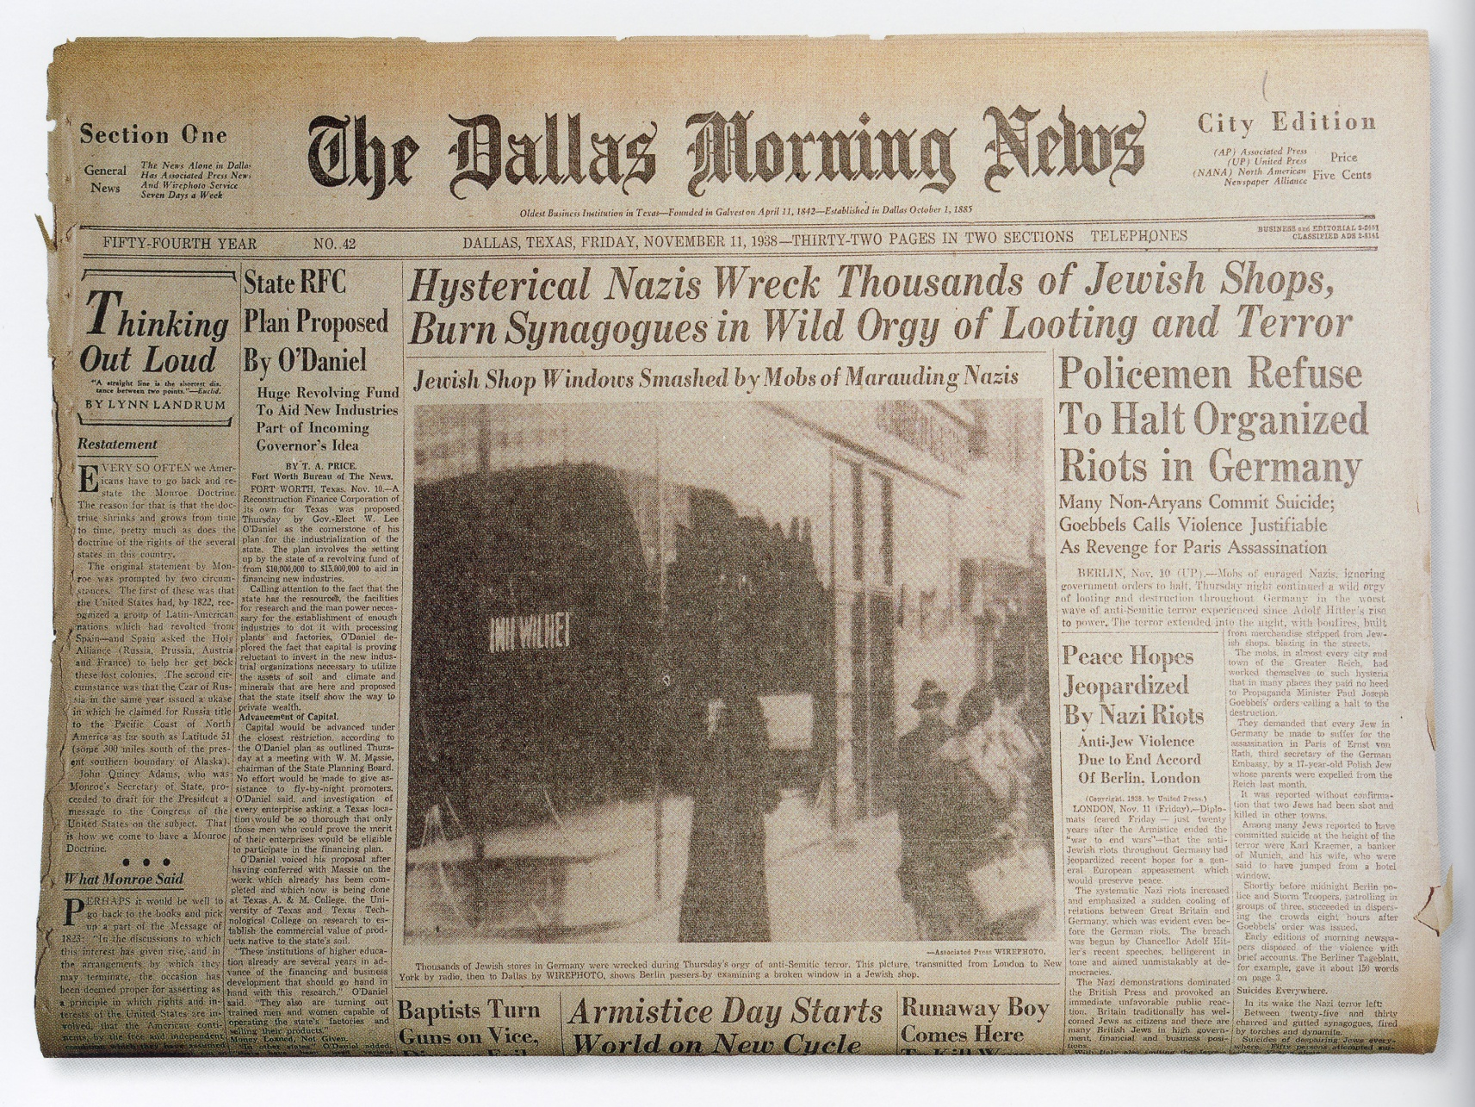

Slide 26
From a German children’s book, where a Jewish man is depicted as a child molester going after German Children

Slide 27
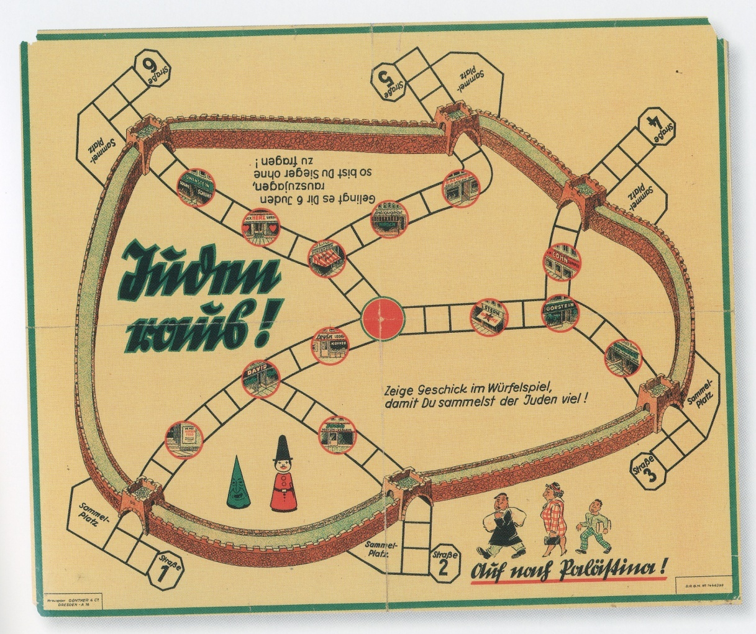
German board game titled “Jews out!”

Slide 28
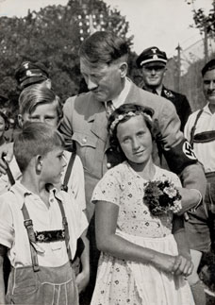
Paths to War
Hitler led the German people to believe that the Aryan race was the master race and that they needed more land in order to become the great power that they truly were
Germany withdraws from League of Nations in 1933
Hitler began occupying the Rhineland ( a territory that France insisted on as a buffer between France and Germany) (1936)
http://www.youtube.com/watch?v=9eY698MGSGI&NR=1

Slide 29
Paths to War
Hitler complained that the treaty of Versailles was too harsh and needed to be revised, peacefully. However, as he spoke of peace he began creating a German air force and instituted a military draft (raising the army from 100,000 to 500,000) both in violation of the treaty (1935)
When western nations did not take action Hitler was convinced they would let him go even further

Slide 30
Paths to War
The western powers practiced what they called a policy of APPEASEMENT (satisfying the reasonable demands of a dissatisfied state to avoid war)
Hitler makes a pact with Mussolini in Italy called the Rome-Berlin Axis in 1936 (both countries participate in the Spanish civil war, a dress rehearsal)

Slide 31
Paths to War
Hitler signs a pact with Japan to fight communism and to cooperate with each other, this is known as the Anti-Comintern Pact
Austria invites German troops in. Austria is annexed in 1938

Slide 32
Paths to War
Czechoslovakia (or the Sudetenland to Germans) was occupied by mostly German speaking people, so Hitler argued that they should be part of Germany

Slide 33
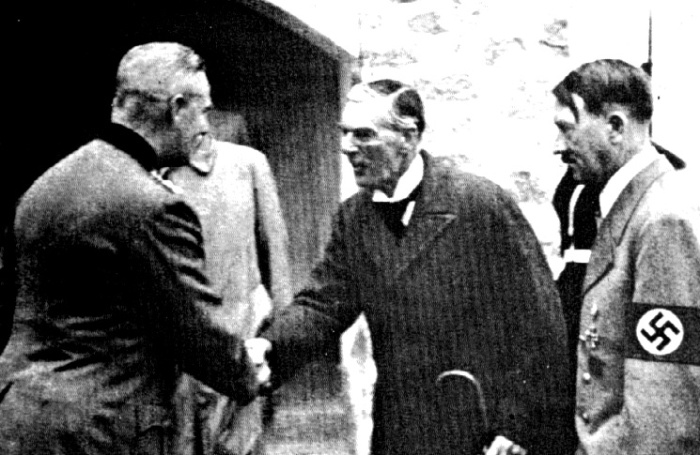
Paths to War
http://www.youtube.com/watch?v=kmH5A6QsqRY&feature=related
This time the west responded and at the Munich Conference they (Great Britain and France) agreed to let the Sudetenland become part of Germany, but only on the condition that Hitler would go no further and have no further demands
The British Prime Minister Neville Chamberlain proclaimed “peace in our time”
http://www.youtube.com/watch?v=kmH5A6QsqRY&feature=related

Slide 34
Paths to War
Hitler then tested the west by invading the rest of Czechoslovakia in 1939
When Hitler began to mass troops on the Polish border the world realized he was a liar

Slide 35
Paths to War
Hitler quickly and secretly made a deal with Joseph Stalin of Russia, if Russia would not interfere with German ambitions in Eastern Europe specifically Poland Hitler would give control of Eastern Poland to Stalin. This was the Nazi-Soviet Nonaggression Pact

Slide 36
Paths to War
On September 1, 1939 (2 days later) Germany invaded Poland which begins WWII
http://www.youtube.com/watch?v=8ha0qKquG2E&feature=related

Slide 37
“Education for Death”
https://www.youtube.com/watch?v=l14WDZCnz-w

