Slide 1
Decolonization

Slide 2
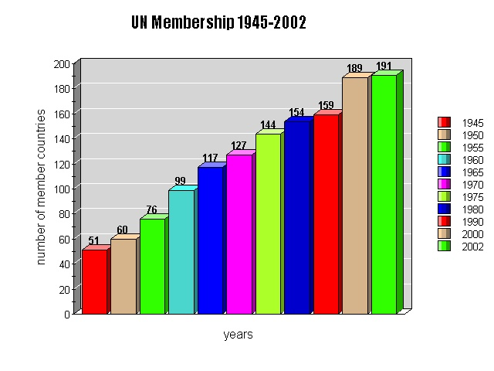
Decolonization of Asia & Africa Changed the Makeup of the UN

Slide 3
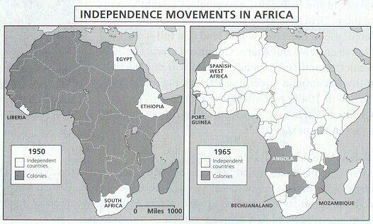
Africa Produced Many Newly-Independent Nations in a Very Short Time

Slide 4
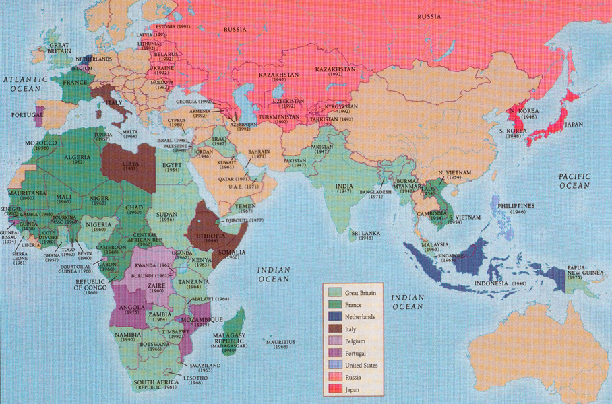
British Colonies Were Some of the First to Seek Independence because
Britain felt hypocritical about colonialism.
War left her weak and unable to afford colonies.
A New African educated middle class began to emerge in the cities.
The British and French try to keep special relations with former colonies without direct control.

Slide 5
Indian National Congress
1885 → The Indian National Congress was founded in Bombay.
swaraj → “independence.” * the goal of the movement.
Later led by Gandhi

Slide 6
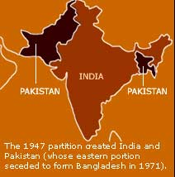
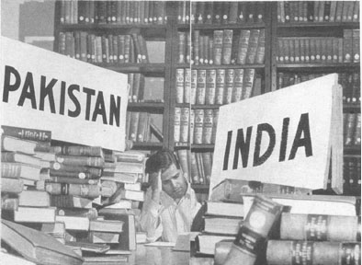
Partition!

Slide 7
China since 1945
From 1945 to 1949 China was involved in a civil war. National People’s Party, led by Chiang Kai-shek and the radical Mao Zedong.
In , these two split and Mao triumphed, establishing the People’s Republic of China
Mao Tse-tung (Zedong)

Slide 8
China Becomes Communist
Zedong’s Communist People’s Liberation Army takes control. They marched 5,000 miles to Northern China to set up a base . Mao’s army was supported by the Soviets.
Mao won the support of the rural workers, thus winning the war and unifying China as a Communist state. This reinforced U.S. fears of communist expansion in Asia

Slide 9
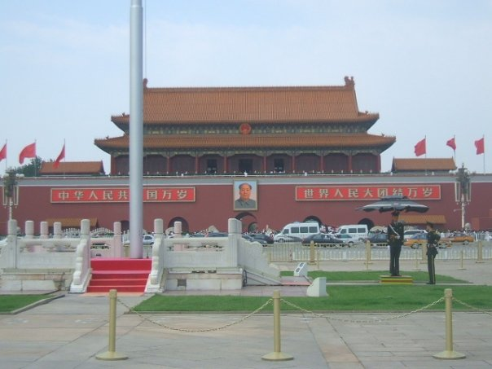
Tiananmen Square, Beijing

Slide 10
Mao’s Plans For China
The Great Leap Forward
Created communes (self-sufficient settlements containing farms and industries)
They did not work at all: production fell, life was difficult, China experienced bad weather, rewards were limited
The plan was abandoned after two years
Cultural Revolution
The revolution was to destroy the four olds: old ideology, old thoughts, old habits and old customs
Those who opposed Mao were publicly punished
Farm production fell, factory work stopped and schools closed
As a result there was no economy, many people had left and there was no education
It was an enormous failure and Mao ended it in 1969

Slide 11
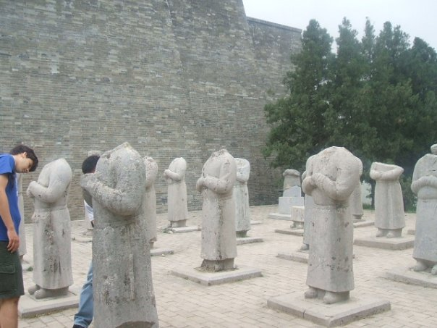
Effects of the Cultural Revolution in China

Slide 12
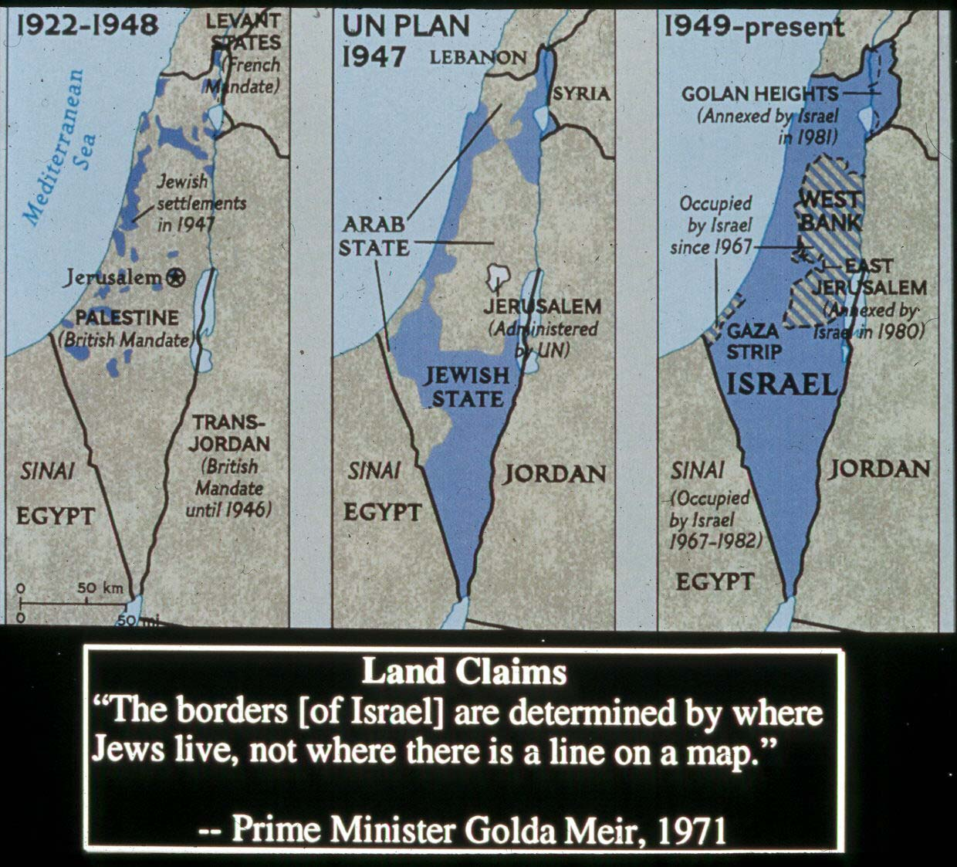
Creation of Israel - The Question of Palestine
Palestine was the home land of the Jews in antiquity till their exile in the 1st century (but a Jewish presence remained)
Arabs made up 80% of the population
The Zionist movement wanted Palestine to become the Jewish State, Arabs pointed out that their ancestors had lived in Palestine for centuries too

Slide 13
The Question of Palestine
The Zionists still wanted Palestine as a home for the Jews.
The Holocaust caused sympathy for the Jewish proposal for an independent Jewish state in Palestine.
In 1948, the UN divided Palestine into two states – an Arab state and a Jewish state, Israel.

Slide 14
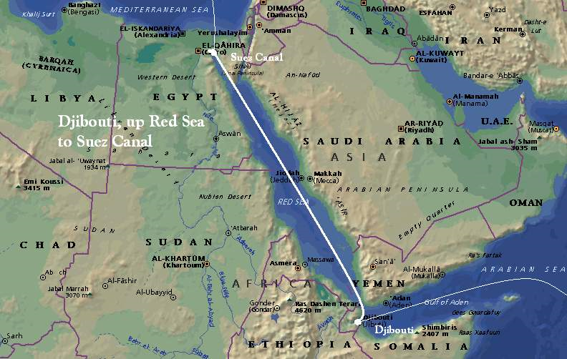
Nasser and Pan-Arabism
In the early 1950s, Colonel Gamal Abdel Nasser took control of Egypt’s government.
In 1956, Nasser seized the Suez Canal Company, and nationalized the canal, which had been under British and French administration.
Great Britain, France, and Israel attacked Egypt, starting the Suez War of 1956.
The United States and the supported Egypt and opposed this action as a violation of the principle of self-determination; Britain, France, and Israel were forced to withdraw.

Slide 15
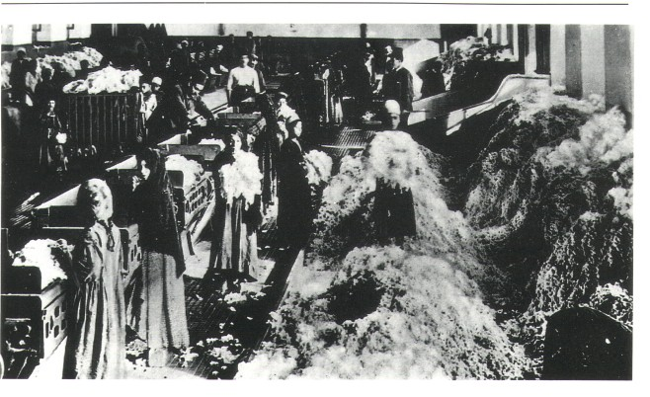
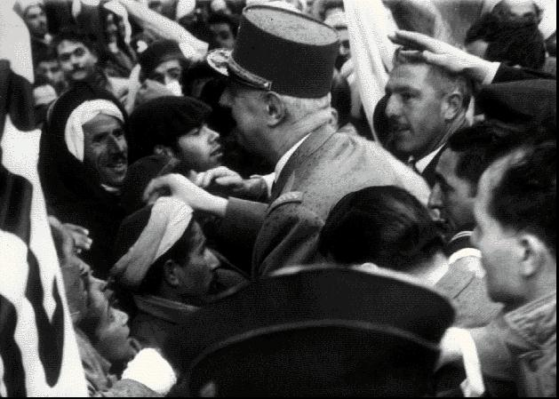
France & Algeria:
Government imposed higher taxes on Muslims than on Europeans
Muslims = 90% of population
Muslims earned 20% of Algeria’s income
Muslims paid 70% of Algeria’s direct taxes
French sought assimilation
Mission to civilize the Muslims
Established French schools with entirely French curriculum (no Arabic)
Only a small number of Algerians fought back

Slide 16
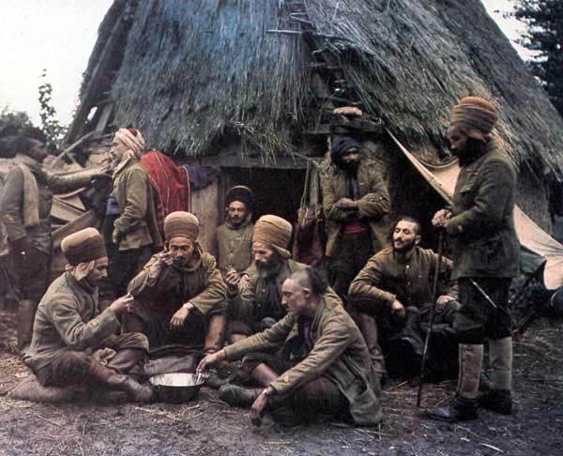
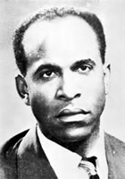
Algeria: Nationalist Leaders & Groups
WWI
Many Algerians fought in France
Many stayed in France after war
Noticed unequal standards of living
Inspired by European Enlightenment
WWII
Many Algerians fought for France again
After WWII
French fight to re-establish colony by attacking any protestors
In response, a more radical Algerian independence movements rise
Groups
Revolutionary Committee of Unity and Action (CRUA) = main group
Front de Leberation National (FLN)
Leaders:
Ahmed Ben Bella, Frantz Fannon

Slide 17
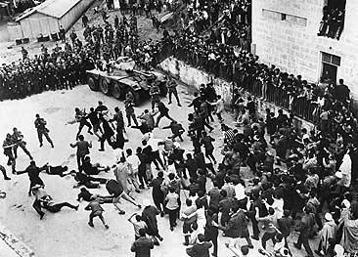
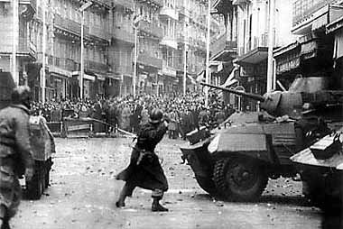
Algeria:
Year of Independence = 1962
Methods of Gaining Independence
Guerilla tactics
Hit and run
Sniping
Bombing of French police and civilians
Café wars

Slide 18
“Common Market”

Slide 19
European Economic Integration
1947 → General Agreement on Tariffs and Trade [GATT]
23 nations.
Became the foundation of postwar global commerce.
It set up procedures to handle commercial complaints.
It provided a framework for continuing negotiations [“rounds”].
By 1990, 99 nations were participating.

Slide 20
European Economic Integration
1952 → European Coal & Steel Community [ECSC].
HQ in Luxembourg.
“Inner Six” → Benelux nations, France, Italy, W. Germany.
Placed their coal and steel industries under a form of supranational authority.
Eliminated tariff duties and quotas on coal and steel.

Slide 21
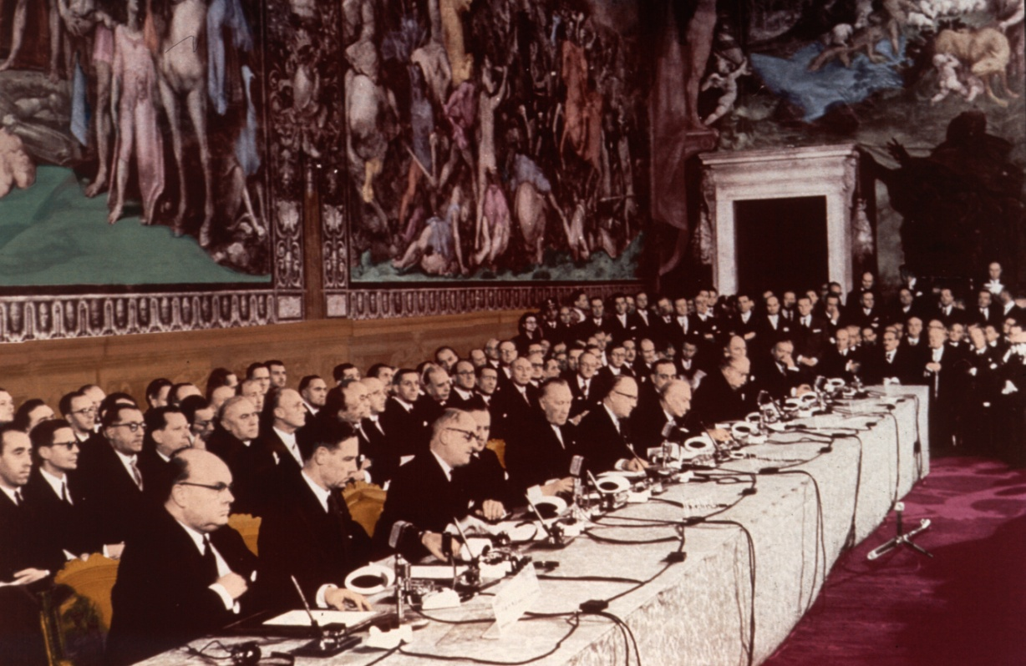
European Economic Integration
1957 → European Economic Community [EEC] “Common Market”
HQ → Brussels.
Treaty of Rome.

Slide 22
European Economic Integration
1957 → European Economic Community [EEC]
France, W. Germany, Italy, Benelux.
Created a larger free trade area, or customs union.
Eliminate all trade barriers.
One common tariff with the outside world.
Free movement of capital & labor.

Slide 23
European Economic Integration
1967 → combined the ECSC & EEC to form the European Community [EC].
HQ → Brussels.
European Parliament.
“Eurocrats.”
518 members [elected by all voters in Europe].
Only limited legislative power.
Court of Justice.

Slide 24
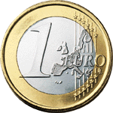
European Economic Integration
1991-92 → Maastricht Agreements
European Union [EU] created from the EC.
One currency, one culture, one social area, and one environment!
Create a “frontier-free” Europe → a common EU passport.
One large “common market.”
Goods coming into the EU would have high tariffs placed on them.
2002 → a common currency [Euro]
2003 → 60,000 men EU rapid defense force was created.

