Slide 1
Chapter 29 - WWII
Finish WWII discussion
HW: Begin reviewing for Chapters 28, 29 test (Thursday)

Slide 2
World War II
Europe at War

Slide 3
Spanish Civil War
Republican govt. replaced monarch
2 sides: (war between ideologies)
Falangists (Fascists) under Franco
Republicans (anti-Fascists)
Hitler and Mussolini aid Fascists
Stalin and volunteers from US, France, England aid Republicans
1939- Franco becomes dictator

Slide 4
Munich Peace Agreement
Issue= Sudetenland (3 million Germans live here)
Mussolini, Chamberlain, Daladier meet with Hitler
Give Hitler Sudetenland if he would stop expansion
Student becomes teacher
Result- Hitler not satisfied and takes all of Czechoslovakia
Chamberlain no “Peace in out time”

Slide 5
The Sides
Allies
England
France
Poland
Later USA
Later USSR
Axis
Germany
Austria
Italy
USSR
Japan

Slide 6
Europe at War
The 1939 invasion of Poland by Germany took just four weeks.
Called blitzkrieg (“lightning war”), the Germans used panzer divisions (strike forces of about 300 tanks and soldiers) that were supported by airplanes.
On September 28, 1939, Germany and the Soviet Union divided Poland.

Slide 7
Poland Captured
Soviets in Poland- carried on programs of murder and terror
1 million sent to forced labor camps
Any threats to Stalinist rule eliminated
Germans in Poland- concentration camps used for political prisoners
Farm families relocated to make room for Germans

Slide 8
Life in Death Camps
Methods of killing:
Gas chambers, torture, starvation, beatings
Medical experiments
6 million Jews killed
Auschwitz (Poland)- 2 million died here

Slide 9
Europe at War
In May 1940, Germany attacked the Netherlands, Belgium, and France.
The German armies broke through French lines and moved across northern France.
The French had fortified their border with Germany along the Maginot Line, but the Germans surprised them by going around it.

Slide 10
Invasion of France
Maginot Line
Germany attacks through Belgium
Divides the Allies (Paris and coast)
Dunkirk- 300,000 Allies retreat, all available vessels sent to rescue troops
GB united against Hitler
Germans continue through France

Slide 11
France is Conquered
June 10, 1940- Mussolini declares war on France
June 14- Germans march on Paris
France surrenders to save Paris from destruction
French sign armistice where Germany surrendered WWI
Germany occupied N. France
Puppet Govt. est in S. France= Vichy Govt. (Petain’s govt.)
On June 22, the French signed an armistice with the Germans, who occupied three-fifths of France.

Slide 12
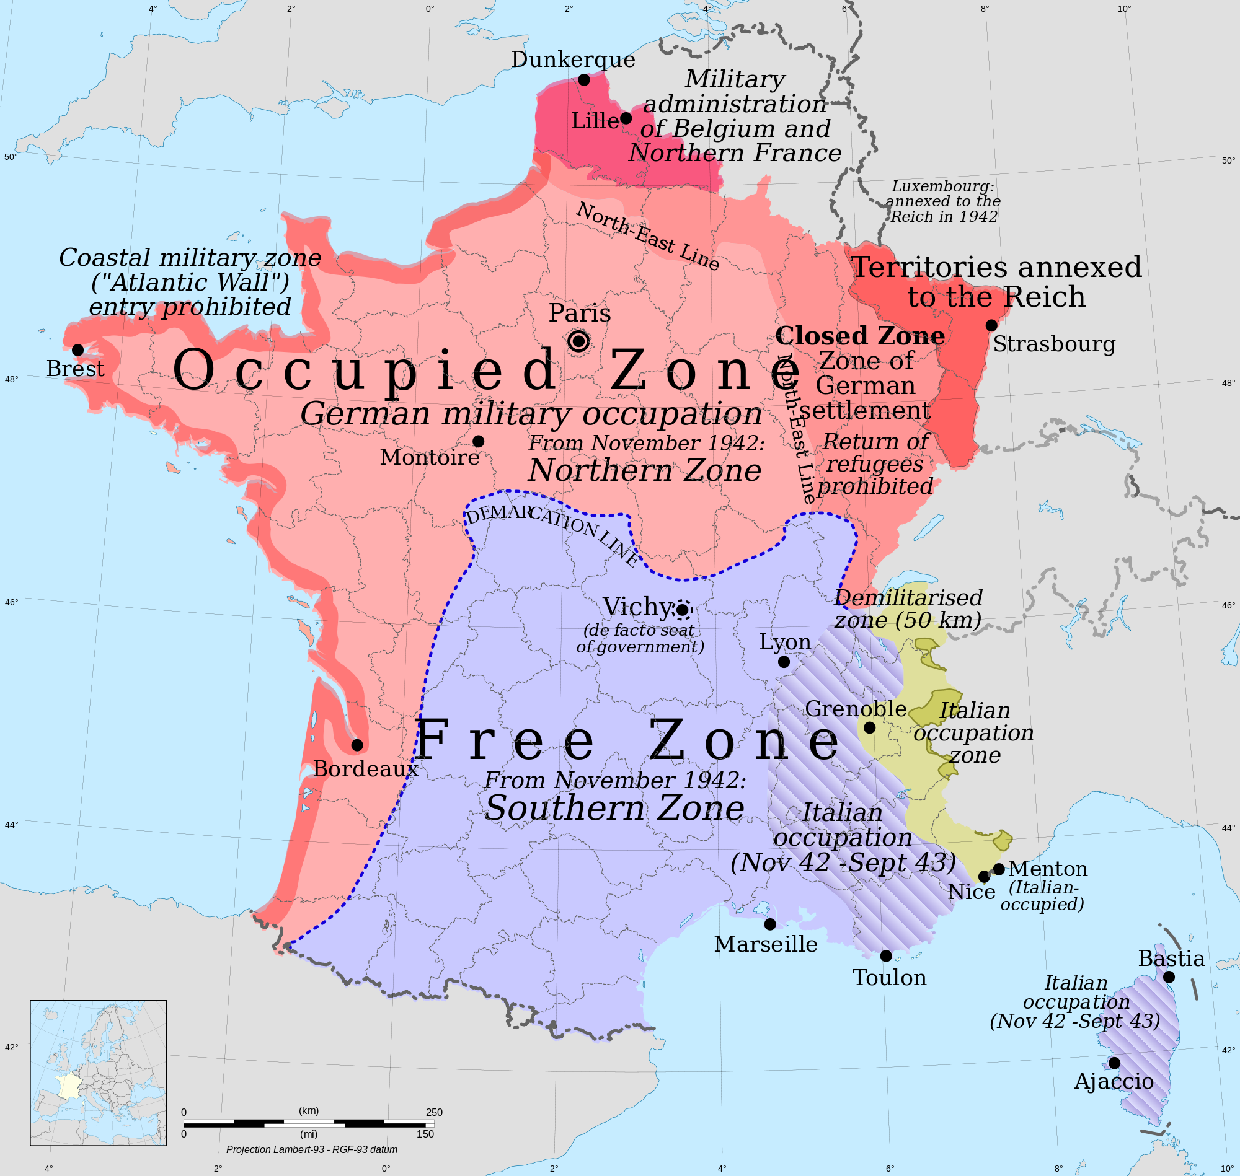

Slide 13
Europe at War
By August 1940, Great Britain was the only place left undefeated.
They asked the United States for help – policy of isolationism.
Roosevelt wanted to repeal the neutrality acts and help Great Britain.
Over time, the laws were slowly relaxed, and the United States sent food, ships, planes, and weapons to Britain.

Slide 14
Europe at War
Battle of Britain or British Blitz
In August 1940, the Luftwaffe–German air force–began a major bombing offensive against military targets in Britain by carpet-bombing.
In September, Hitler retaliated to a British attack on Berlin by shifting attacks from military targets to British cities.

Slide 15
Europe at War
He hoped to break British morale. However, the shift in strategy allowed the British to rebuild their air power and inflict crippling losses on the Germans.
Having lost the Battle of Britain, Hitler postponed the invasion of Britain indefinitely at the end of September.
http://www.youtube.com/watch?v=KwiXruIWGLw&feature=PlayList&p=EC35D24D149FB715&playnext_from=PL&playnext=1&index=20

Slide 16
Meanwhile in the Pacific
Dec. 7, 1941 – Attack on Pearl Harbor
Dec.8 1941-US,GB declare war on Japan
Germany, Italy declare war on US

Slide 17
Europe at War
Then Hitler invaded the Soviet Union in June 1941.
The attack on the Soviet Union stretched out for 1,800 miles.
German troops moved quickly and captured two million Russian soldiers by November.
The Germans were within 25 miles of Moscow.

Slide 18
Invasion of USSR
June 22 1941 Hitler invades
Why USSR?
Hates Communism
Land for German settlers
Grain for Germans
Oil, coal, iron ore for war effort
GB and US immediately help
Offer Lend-Lease Act (US could sell, lease or lend military equipment to countries whose defense was vital to US security)

Slide 19
Seize of Leningrad
Russia initially devastated
2 year siege, 3 million trapped
1 million die of disease and starvation
First year: 2.5 million soldiers lost
“Scorched-earth”- withdraw from Germans destroying fields and equipment
Winter helps Russians win- troops from Siberia arrive

Slide 20
Tide Turns in Russia and Italy
In December, the Soviet army counterattacked.
At the battle of Stalingrad Russian forces encircled the German 6th army and without supplies and no winter gear they surrendered (this was considered Hitler’s best troops)
As Allied troops fought a bloody battle for Italy, a second front was created in the west with the D-Day invasion

Slide 21
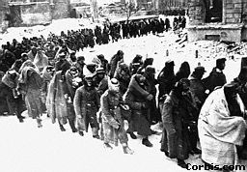
POWS in Stalingrad
Feb. 1943- last German surrenders against Hitler’s order
**Turning point in Eastern Europe**
Soviets begin push toward Berlin

Slide 22
North African Campaign
First year of war- Mussolini works to est. control of Mediterranean
Libya (Italian colony) unsuccessfully invades Egypt trying to take control of Suez Canal (from GB)
Germany sends Afrika Corps led by Field Marshal Erwin Rommel to protect Libya

Slide 23
Africa cont…
Rommel battles GB for more than a year
1942 GB sends Field Marshal Bernard Montgomery to block Rommel’s advance to the Suez
El Alamein- retreating GB begins counterattack
Rommel driven from Africa
First major British victory

Slide 24
Results in Africa
May 1943- Allies held all N. Africa
Allies control Suez Canal
Africa would serve as a base to launch attacks into Southern Europe

Slide 25
Operation Mincemeat
An invasion of Italy was planned to chase the Germans back up the boot that is Italy
German forces suspected the invasion would come from Sicily
The Allies Used deception to make the German’s believe the invasion would come from Greece

Slide 26
Operation Mincemeat
The body of a homeless man who committed suicide was used to deceive the Germans
His body was purposely washed up in the Spanish coast, attached were secret documents indicating an invasion from Greece

Slide 27
Victories for the Allies
End of 1942- Allies on offensive in Asia and Europe
The surrender of Italy
Italy attacked from North Africa
July 1943- GB, US land in Sicily, later in month Mussolini overthrown
Rome captured in 1944 (Italians helped)

Slide 28
The Big Three
“Big Three” – Franklin Roosevelt, Joseph Stalin and Winston Churchill meet in Tehran, Iran. Topics during the four-day conference included: Confirmation of the decision to invade Western Europe in the Spring of 1944; Plans for the invasion of Southern France; and a promise by Stalin to join in the war against Japan when Germany was defeated.

Slide 29
D-Day Invasion – Creates a Second Front
Supreme Allied Commander U.S. Gen. Dwight Eisenhower planned and coordinated an air, sea, and land invasion of the Normandy coast in France
It was the largest invasion in history

Slide 30
Invasion of France
Operation Overlord
Hitler knew of preparations, but NOT where invasions would take place
Allies use phantom army, radio messages that could be decoded
June 6, 1944 D-Day- Allies land in Normandy

Slide 31
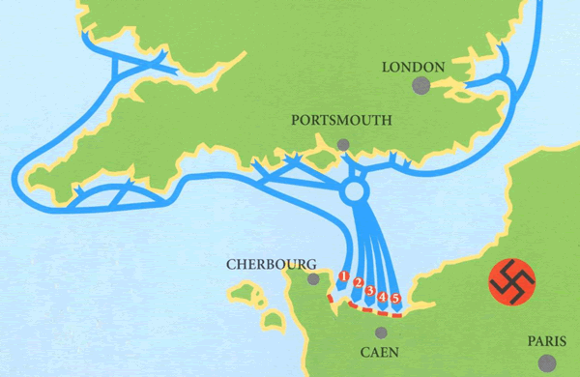
D-Day Invasion – June 6, 1944
Preparation: Beach survey air/ground, phantom army, 11,000 panes fly 200,000 missions and drop 195,000 tons of explosives (2/3 outside landing zone, mass troops and vehicles in Britain, build Mulberry piers, train troops on the cliffs of Ireland and Scotland, break German code (enigma)

Slide 32
Invasion of France
150,000 landed at 5 beaches
Omaha, Juno, Sword- major
Germans caught off guard
1 million Allied troops in France within month
End of August- Paris freed
Free French join Allies

Slide 33
Battle of the Bulge
Mid Dec. 1944
Germans attack US soldiers at German border near Belgium, Luxembourg
Germans break through lines
US holds key towns and roads
Germans halt offensive- ran out of gas, unable to crush US

Slide 34
The End
Jan. 1945- Allies take German gains
April 1945- US and Soviet troops meet in Eastern Europe
April 30,1945- Hitler commits suicide in underground quarters in Berlin
May 8, 1945 VE Day- Germany surrenders unconditionally

Slide 35
War Crime Trials
Nazi leaders arrested and charged with “crimes against humanity”
Nuremberg Trials- Nov. 1945
World learned of Nazi horrors
½ of officers tried were sentenced to death
Japanese officers also tried

Slide 36
Postwar Europe
Allies held 3 summits (meetings between top govt. officials) during the war
Tehran, Iran (1943)
Yalta, USSR
Potsdam, Germany

Slide 37
Yalta
Feb 1945 the “Big Three” meet
Stalin agrees to free elections in Soviet occupied Eastern Europe
Puppet govts. had already been est.
Stalin agrees to declare war on Japan when Germany defeated (for land in Asia)
United Nations developed
Division of Germany into temporary occupation zones

Slide 38
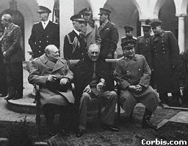
"Big Three," Yalta

Slide 39
Potsdam
July 1945
Present- Stalin, Churchill, and Truman
Stalin refuses to hold free elections
It would be “anti-Soviet”
Disagreements over Eastern Europe would split Allies
Raise fears of another world war

