Slide 1
Unity and Identity in Western Europe

Slide 2
European Unity
Single European Act – 1986 – established a single market of free movement of labor, capital, and services
European Union (renamed from European Community) goes into effect in 1992, led by France and Germany through the Maastricht Treaty (creation of the Euro as currency going went into effect in 1999).

Slide 3
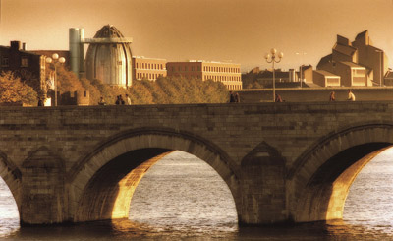
THE EUROPEAN UNION
1992: the Maastricht Treaty was ratified, which rechartered the EC as the European Union.

Slide 4
The EU is run by five institutions, each playing a specific role:
European Parliament
elected by the peoples of the Member States
Council of the Union
composed of the governments of the Member States
European Commission
driving force and executive body
Court of Justice
compliance with the law
Court of Auditors
sound and lawful management of the EU budget

Slide 5
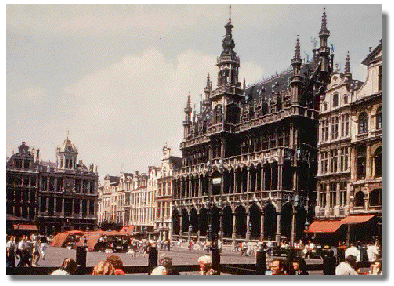
The EU Headquarters
Brussels, Belgium
Selected as the headquarters of the European Union because of its centralized location in Europe.
Any country that satisfies the conditions for membership can apply. These conditions are known as the ‘Copenhagen criteria’ and include a free-market economy, a stable democracy and the rule of law, and the acceptance of all EU legislation, including of the euro.

Slide 6
Lithuania (2004)
Luxembourg (1958)
Malta (2004)
Netherlands (1958)
Poland (2004)
Portugal (1986)
Romania (2007)
Slovakia (2004)
Slovenia (2004)
Spain (1986)
Sweden (1995)
United Kingdom (1973)
EU MEMBERS
Austria (1995)
Belgium (1958)
Bulgaria (2007)
Croatia (2013)
Cyprus (2004)
Czech Republic (2004)
Denmark (1973)
Estonia (2004)
Finland (1995)
France (1958)
Germany (1958)
Greece (1981)
Hungary (2004)
Ireland (1973)
Italy (1958)
Latvia (2004)
On the road to EU membership
Candidate countries
Albania
Iceland
Montenegro
Serbia
The former Yugoslav Republic of Macedonia
Turkey
Potential candidates
Bosnia and Herzegovina
Kosovo*

Slide 7
New Germany

Slide 8
West Germany
1982 Helmut Kohl- closer ties with US
Convince- new Germany not threat
1990 plans reunification of Germanys
Agreement with Gorbachev in 1990 for nuclear dismantling
Paris Accord – involved US and other nations

Slide 9
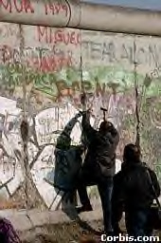

Slide 10
New Germany
E. Germany in ruins
Not modernized since WWII
Rebuilding
$100 billion in early 1990s (taxes)
1994 3 million jobless (inefficient factories)
Central Europe’s largest, wealthiest country
Two countries officially unify with the in 1990

Slide 11
Neo-Nazi Violence
Early 1990’s refugees from Yugoslavian wars
Constitution guaranteed refuge
Unemployed Germans angered- job stealing
Kohl- “This republic is not Weimar”

Slide 12
France
1969 de Gaulle resigns
Minor constitutional changes rejected
1981 Socialist President Francois Mitterrand elected
1993 – Conservative Jacques Chirac elected president; cut health benefits and transportation budget
This ignited worker strikes and the voters elected a Socialist majority to the National Assembly, enabling socialist reforms once again.

Slide 13
The United Kingdom
Britain was destroyed in WWII
Labour Party calls for welfare state
Govt. takes strong hold
1951 problems persist- Conservatives win office
Industry back to public
1979 Conservative Margaret Thatcher (replaced by Major)
Encouraged private enterprise
Social Service decreased

Slide 14
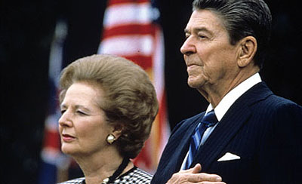
Conservative Party
Dominant party in Great Britain between WWII and late 1990s
Main party on the right
Traditionally pragmatic as opposed to ideological
Historically has supported a market controlled economy, privatization, and fewer social welfare programs – symbolized by Margaret Thatcher in 1980s
Under Prime Minister John Major (1990-1997) gravitated towards center and away from Thatcherism

Slide 15
Thatcherism
Rightist reforms instituted by Margaret Thatcher in 1980s
Privatized business and industry
Cut back on social welfare programs
Strengthened national defense (staunch anticommunist)
Got tough with labor unions in response to Labour Parties distinct movement left, which had strengthened labor unions politically
Returned to market force controls on the economy
Resisted complete integration into the European Union
Replaced property tax on houses with a poll tax on individual adults
Froze income tax increases
Foreign policy dominated by securing British interests internationally

Slide 16
Voting Patterns
Conservative Party
Middle and upper classes
Educated
Residents of England, mostly rural and suburban areas
Labour Party
Traditionally supported by working class
Residents of urban and industrial areas (Manchester, Liverpool, Newcastle)
“Third Way” centrist policies have made Labour Party appealing to Scots, Welsh, and the poor

