Slide 1
The Renaissance
Go over thematic review for Middle Ages
Discuss Renaissance
Outcome: Students will know the main characteristics of
the Renaissance and will be able to contrast it with the
Time of the Middle Ages.

Slide 2
Preview
Read “The Italian Renaissance” pp. 157-158 in your textbook
Identify and describe the three characteristics of the Renaissance.

Slide 3
The Renaissance was a time of renewal
Renaissance means rebirth and Europe was recovering from the Dark ages and the plague.
People had lost their faith in the church and began to put more focus on human beings.

Slide 4
Renaissance Timeline
500 AD
Renaissance
Middle Ages
Rediscovery of knowledge
and culture
Greek and Roman
Loss of knowledge
and culture (due to wars,
famine, and disease
Increase in knowledge and culture
1350-1450

Slide 5
REASONS WHY THE RENAISSANCE BEGAN
Reason #1
Renaissance Italy was largely urban society
Powerful city states became centers of Italian political, economic, and social life
Secular (worldly, non-religious) viewpoints and hobbies emerged as increasing wealth among the lower class created new possibilities

Slide 6
Reason #2 – The Classics
Italians became aware of their Roman pasts in which they were surrounded
Interest in culture that had dominated the Ancient Mediterranean world remerged
Notes:
Italian countryside with ruins of roman bridge and aqueduct
They built things to last

Slide 7
Reason #3 - Humanism
New view of human beings emerged as people started to emphasize individual ability
“Men can do all things if they will” – ~Leon Bottista Alberti ~ 15th Century Italian
Valued well rounded individuals who were capable of achievement in many areas of life
Leonardo Da Vinci
Painter Scupltor, architect, inventor, and mathematican
Notes:
High regard for human worth and realization of what individuals could achieve created a new social ideal
Not all parts of Italian society were directly affected by these ideals
The wealthy upper class who made up a small percentage of the population more actively embraced the new Ideas and activities
Indirectly the ordinary people were affected because intellectual and artistic achievment of the times were hard to ignore
Churches, wealthy homes, and public buildings were decorated with art celebrating religious and secular themes, the human body, and an appreciation of classical antiquity

Slide 8
How did the Crusades contribute to the growth of the Renaissance?
• Increased demand for Middle Eastern products = trade
• Stimulated production of goods to trade in Middle Eastern markets
• Encouraged the use of credit and banking
• New accounting and bookkeeping practices (use of Arabic numerals) were introduced.

Slide 9
Italian City-States
The civilization of the Italian Renaissance was urban, centered on towns that had become prosperous from manufacturing, trade, and banking.
Italians had acquired considerable wealth, and some of this wealth was used to support writers, scholars, and artists.

Slide 10
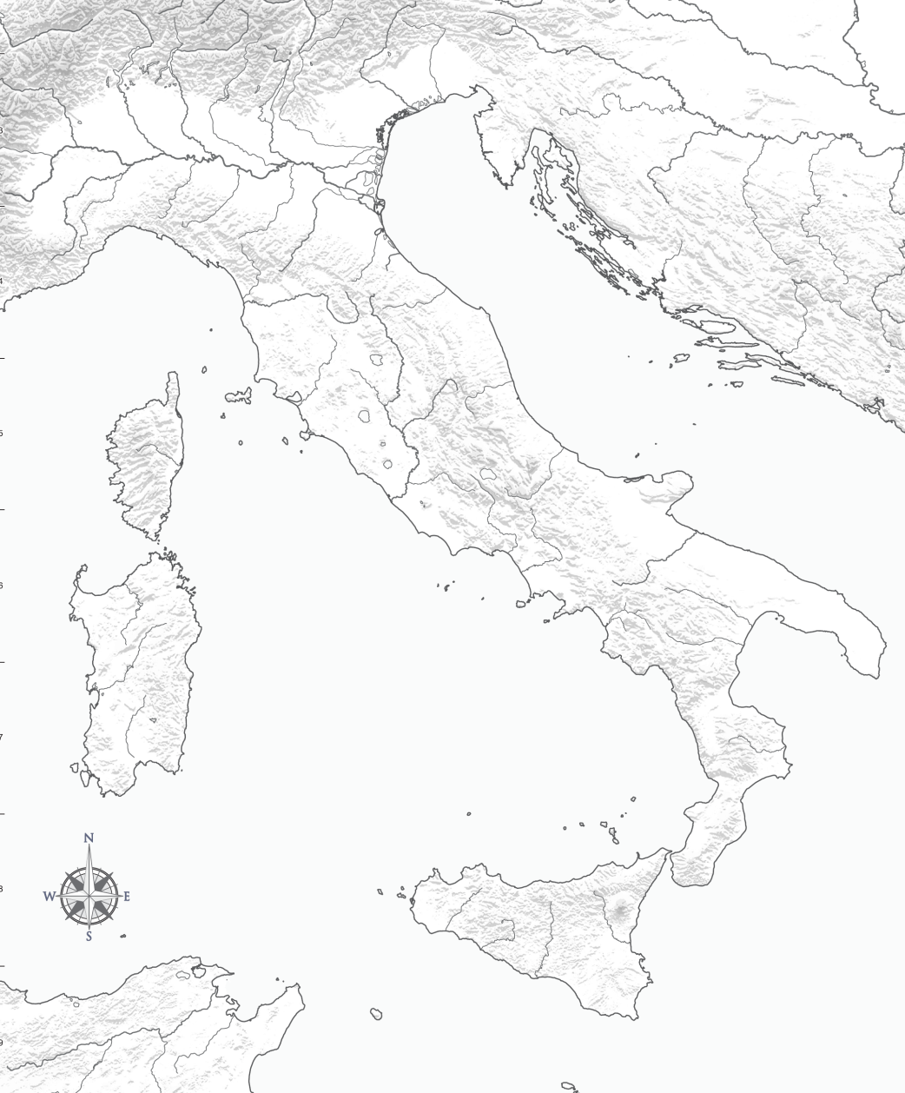
Major Italian Cities
Milan
One of the richest cities, it controls trade through the Alps.
Venice
Sitting on the Adriatic Sea, it attracts trade from all over the world.
Milan
Venice
Florence
Controlled by the De Medici Family, who became a powerful banking family and great patrons of the arts.
Genoa
Florence
Adriatic Sea
Genoa
Had Access to Trade Routes
All of these cities:
Had access to trade routes connecting Europe with Middle Eastern markets
• Served as trading centers for the distribution of goods to northern Europe
• Were initially independent city-states governed as republics
Tyrrhenian Sea

Slide 11
Primary Italian States
Florence
Oligarchy
Medici family
Savonarola
Milan
- Oligarchy – Sforza family
Venice
Oligarchy
Monopoly on spice and luxury trade
Papal States
Popes & Borgia family
Naples/ Kingdom of the Two Sicilies
Poor land
- French & Spanish conflict …absorbed by Spanish empire

Slide 12
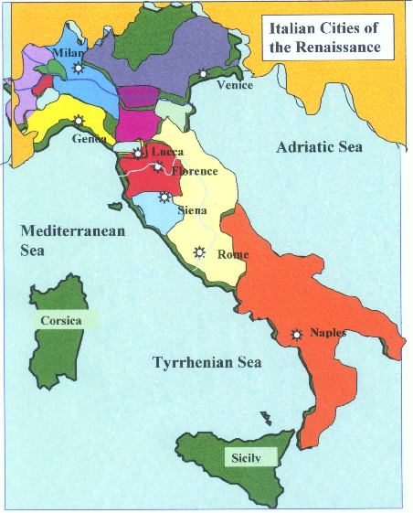

Slide 13
The Renaissance
Discuss/finish Renaissance
Renaissance section 1 review sheet (multiple choice)
Outcome: Students will know the main characteristics of
the Renaissance.

Slide 14
Characteristics of the Renaissance

Slide 15
New Interests
Humanities/Humanism- subjects concerned with culture and humankind (art, literature, poetry, music)
Secularism- science, rationality and individualism (non-religious)
Classicism - People imitated language, customs, ways of ancient Romans & Greeks

Slide 16
Humanism
Learning for the sake of learning
Liberal Arts- grammar, rhetoric, history, politics, moral philosophy
celebrate humankind and the present

Slide 17
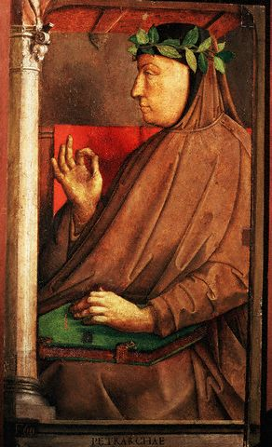
Petrarch
Pioneer of early humanism (early-mid 14th c)
Italian born poet & scholar
Spent almost his entire life transcribing the Latin letters and writings of ancient Romans into the Italian vernacular.
Encouraged study of Roman philosophy and literature

Slide 18
Fill out 3 contrasting characteristics for each time period (3-4 min.)

Slide 19
Contrast
Middle Ages
Church-centered
Life was preparation for afterlife
People weren’t necessarily seen as individuals, just part of collective society
Renaissance
Human-centered
Live life as fully as possible
Focus on individual talent

Slide 20
What helped contribute to the spread of the Renaissance?

Slide 21
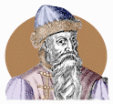
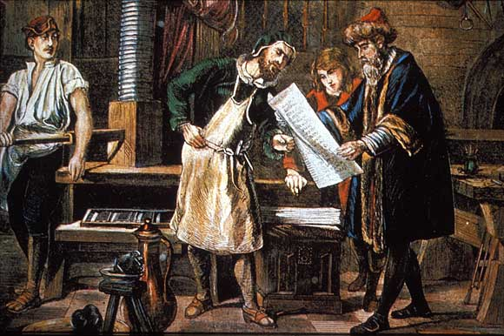
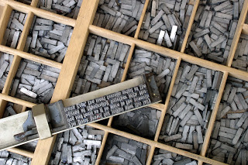
Johannes Gutenburg – inventor in Germany

Slide 22
Printing Press
Gutenburg’s Bible (printed around 1455) was the first European book printed using moveable type- the printing press
Printing encouraged literacy and scholarly research and increase desire of the public to gain knowledge (access to works of the past)
Ideas of the Renaissance and Reformation could not have spread like they did without the printing press
Allowed Europe to compete with China who had invented printing much earlier
Notes:
Do family and marriage differentiated instruction outline from book on pg 162 of teacher addition

Slide 23
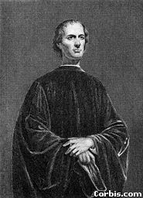
Niccolo Machiavelli

Slide 24
Niccolo Machiavelli
Diplomat of Florence (1469 – 1527)
Wrote The Prince (1513)
guidelines for rulers of time (lion & fox)
People selfish, fickle, corrupt
Ruler should do anything necessary to keep power (politically effective)
Rulers lied, broke treaties, killed as people can’t be trusted
Rule should be judged by results of actions
It is better to be _____________than _____________.

