Slide 1
The Protestant Reformation
Finish art discussion
Protestant Reformation notes
Videos
Outcome: Students will be able to explain Martin Luther’s reasoning for writing his 95 Theses.

Slide 2
Three disorders of the Catholic Church (which had existed since the Middle Ages) :
1. immorality – non-practitioners of celibacy; drunkenness, gambling, etc
2. ignorance – uneducated, could not read
3. pluralism / absenteeism – holding many positions at once, collecting incomes for all, and being absent from parishes/jobs.
*The mixing of civil service / clerical jobs – treasurers, royal councilors, diplomats, judges

Slide 3
Money Problems
The Church became increasingly corrupt and interested in maintaining wealth.
Donations and church taxes were not enough to pay for their luxurious lifestyles

Slide 4
Sale of Indulgences
Indulgences= Church pardons
Sold for profit (fundraising)
Took the place of good works for forgiveness of sin
People believed they were guaranteed entrance into heaven
Began as reward for service in the Crusades

Slide 5
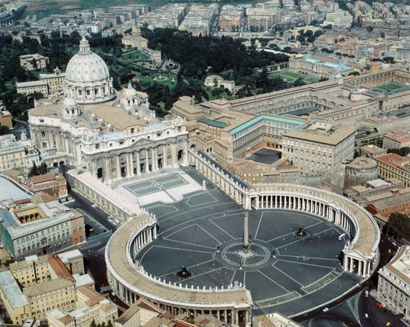
St. Peter’s Basilica

Slide 6
The Protestant Reformation

Slide 7
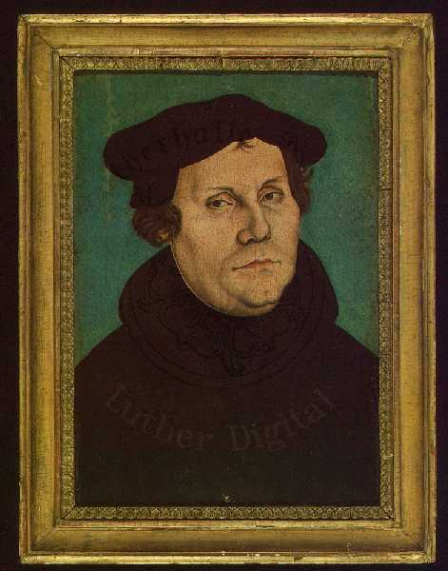
Martin Luther
German, Monk and professor
Studied Bible to justify indulgences, found no support
Grew tired of Catholic church
October 31, 1517
He posts the 95 theses on a church door in Wittenberg, Germany

Slide 8
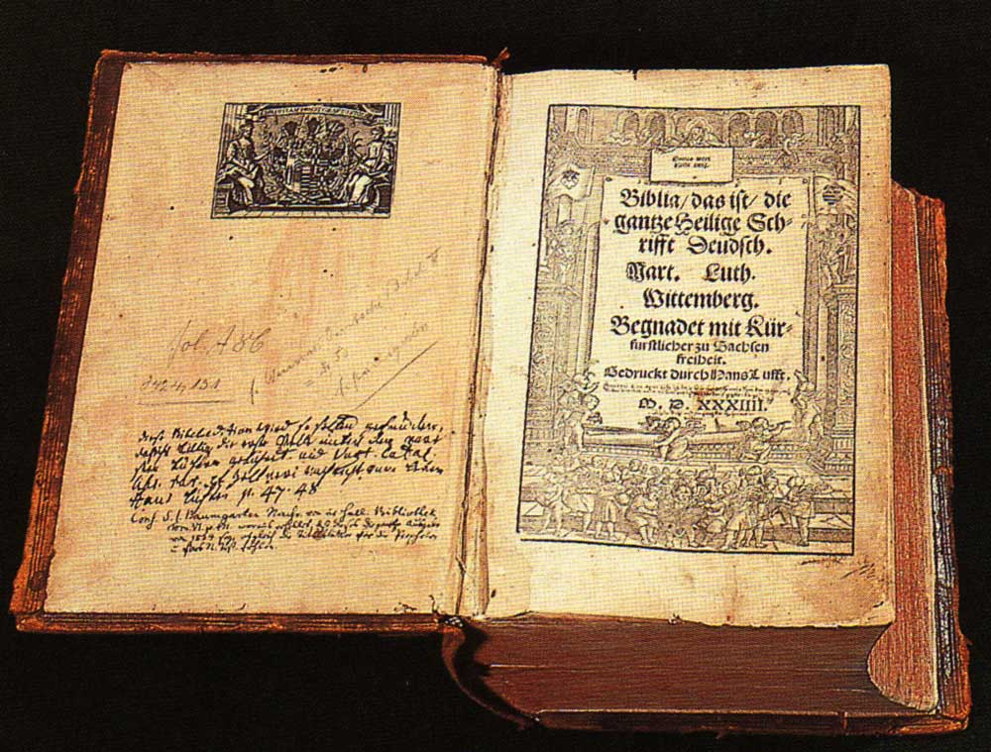
Luther’s Opinions
The Bible is the only source of truth.
People can read and understand the Bible themselves.
Salvation comes only through faith in Christ.
Luther’s Bible
Notes:
Luther’s Bible; source: http://upload.wikimedia.org/wikipedia/commons/0/03/Lutherbibel.jpg

Slide 9
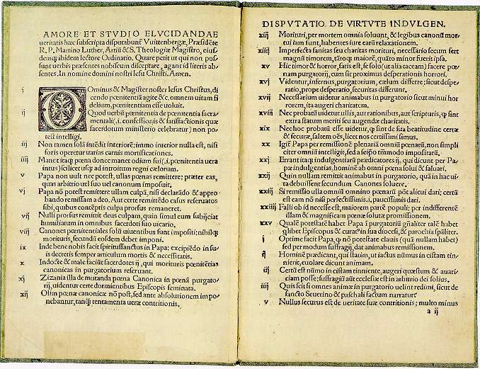
95 Theses and the Printing Press
Thousands of copies of the 95 Theses were copied and spread throughout Germany
How did the Printing Press help or hurt Martin Luther?

Slide 10
Luther Excommunicated (kicked out of the Catholic Church)
In Luther’s view, faith alone could bring you to salvation. He
refused to stop spreading his ideas.
Unable to accept this, the Church excommunicated him.
Charles V (the Holy Roman Emperor) hoped to change his mind (wanted to preserve the empire through the unity of Catholicism). He summoned him before the imperial diet (legislative assembly).
The Diet of Worms declared him an outlaw and ordered all his works be burned.
Luther went into hiding until 1522. He was sheltered by the Duke of Saxony.

Slide 11
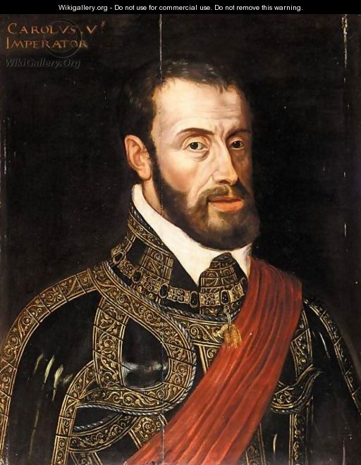
Charles V – Holy Roman
Emperor

Slide 12
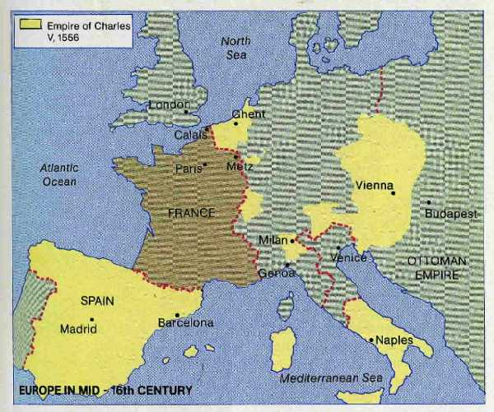
PLUS New World Possessions

Slide 13
Revolts in Germany
Luther urges German princes to revolt against HRE; princes use Protestantism as justification for rebellion against HRE
HRE Charles V uses military measures
Turns on Protestant German princes
Charles ultimately had no help from Catholic princes

Slide 14
Response to Protests
Charles needs the support of all of his princes to help in the fight against the Turks who invade Vienna in 1529.
In 1530, Charles V orders all princes to imperial Diet in Augsburg
People must revert back to Catholicism
Church will get land back
This is not ultimately obeyed
In 1555, Charles gives in and grants the Peace of Augsburg – “he who owns lands determines religion”
Lutheranism, Catholicism
Calvinism other forms of Prot. outlawed

Slide 15
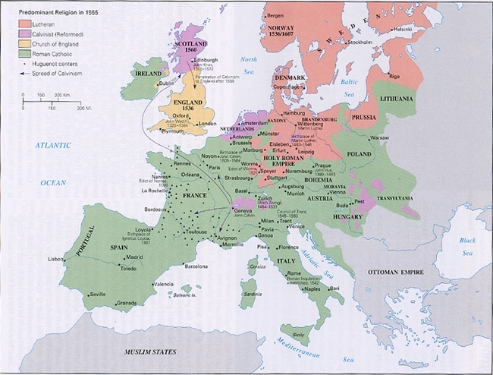

Slide 16
Luther’s Actions
95 Theses
Called for German Princes to establish a reformed German Church
Spread of Protestantism

Slide 17
https://www.youtube.com/watch?v=C4d_7dOC-GQ – Protestant Ref explained
https://www.youtube.com/watch?v=dt5AJr0wls0 – 95 theses rap

Slide 18
Response to Protests
Charles was not happy with peace
Wanted unity, not division
Attached to Middle Age ideas (feudalism, chivalry, Church)

Slide 19
The Protestant Reformation
Renaissance /Reformation groups & posters
Begin gallery walk / fill out chart
Outcome: Students will research and understand the key points of other reformed groups as well as the Northern Renaissance and the Catholic Reformation.

Slide 20
The Protestant Reformation
Finish Renaissance /Reformation groups & posters
3rd / 4th - gallery walk / fill out chart
2nd / 5th - presentations
Outcome: Students will research and understand the key points of other reformed groups as well as the Northern Renaissance and the Catholic Reformation.

Slide 21
Groups
Group 1 – “Northern Artistic Renaissance” pg 168-172
Group 2 – “The Zwinglian Reformation” pg 177
Group 3 – “Calvin and Calvinism” pg 178
Group 4 – “The Reformation in England” pg 179
Group 5 – “The Anabaptists” pg 180
Group 6 – “The Catholic Reformation” pg 182

Slide 22
Gallery Walk Posters
1. Key points from the reading
2. Key people/groups and why they are important
3. Critical Vocabulary - define
4. Illustration or symbol
**All information is fair game on the test

Slide 23
The Protestant Reformation
Finish Renaissance /Reformation groups & posters
3rd / 4th - gallery walk / fill out chart
2nd / 5th - presentations
Outcome: Students will research and understand the key points of other reformed groups as well as the Northern Renaissance and the Catholic Reformation.

Slide 24
The Protestant Reformation
1. 3rd / 4th - discussion/ fill out chart
2nd / 5th – finish presentations
2. Character maps
Outcome: Students will research and understand the key points of other reformed groups as well as the Northern Renaissance and the Catholic Reformation.

Slide 25
Zwinglian Lutheranism
Ulrich Zwingli - Led Swiss (Switzerland) Reformation, the “People’s Priest”
End celibacy, clergy had right to marry
Believe only what has Scriptural proof
Tradition and practices questioned
Transubstantiation (consubstantiation) - Eucharist
Sermon was most important part of service
Churches should not be decorated

Slide 26
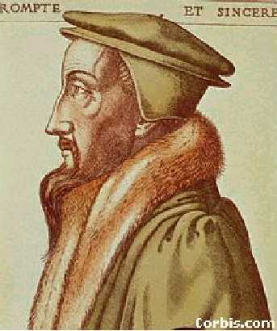
Calvinism-John Calvin
Geneva, Switzerland
Bible is the supreme authority in matters of faith
Men & women are insignificant and sinful by nature
Predestination- belief certain people are chosen by God for salvation, the “elect”
Only way to enter heaven
Hard work, devotion might be signs of
God’s grace
Salvation can not be earned
Role of government: Theocracy
Supervise people’s lives- live strictly

Slide 27
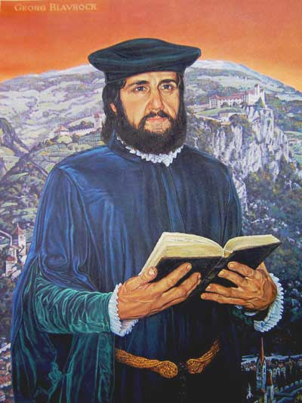
Anabaptists
Greek “to rebaptize”
Radical Protestant group originating in depressed urban areas (Germany)– pacifism
Ancestors of Quakers, Amish & Mennonites
NO infant baptism
Human freedom reflected in adult baptism; religious tolerance
Admitted women to ministry

Slide 28
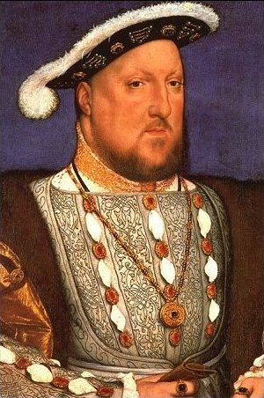
Henry VIII (1509-1547)
Second son of Henry VII
After his elder brother Arthur died, Henry became heir to the throne.
Spain and England wanted to keep their alliance, even w/ Arthur’s death, so Henry married Catherine of Aragon, Arthur’s widow
Henry claimed that God punished him by denying him a legitimate male heir – in Leviticus, God does threaten childlessness if a man marries his brother’s widow…so Henry came to see this marriage as cursed…

Slide 29
Around the Pope…
Ask Parliament to pass law taking away Pope’s power in England
Reformation Parliament- met only when King called
1533 King married Anne Boleyn
1534 Act of Supremacy makes King head of the Church of England
King collected Church moneys
Clergy appointed by king
King and Parliament gain power

Slide 30
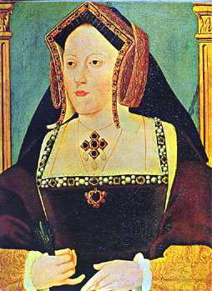
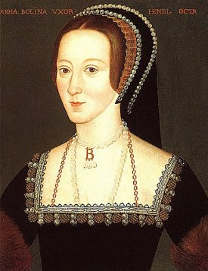
Henry’s Wives
#1 – Catherine of Aragon (divorced) – Originally married to Henry’s brother Arthur. 1 daughter (Mary)
#2 – Anne Bolelyn (beheaded) – Mistress – married after he got a divorce Catherine. 1 daughter (Elizabeth). She could not produce a
Male heir, so Henry looked elsewhere ….
*Divorce was illegal in the Catholic Church, so Henry banned the Catholic Church from England and started his own “Protestant” branch of Christianity (The Church of England)

Slide 31
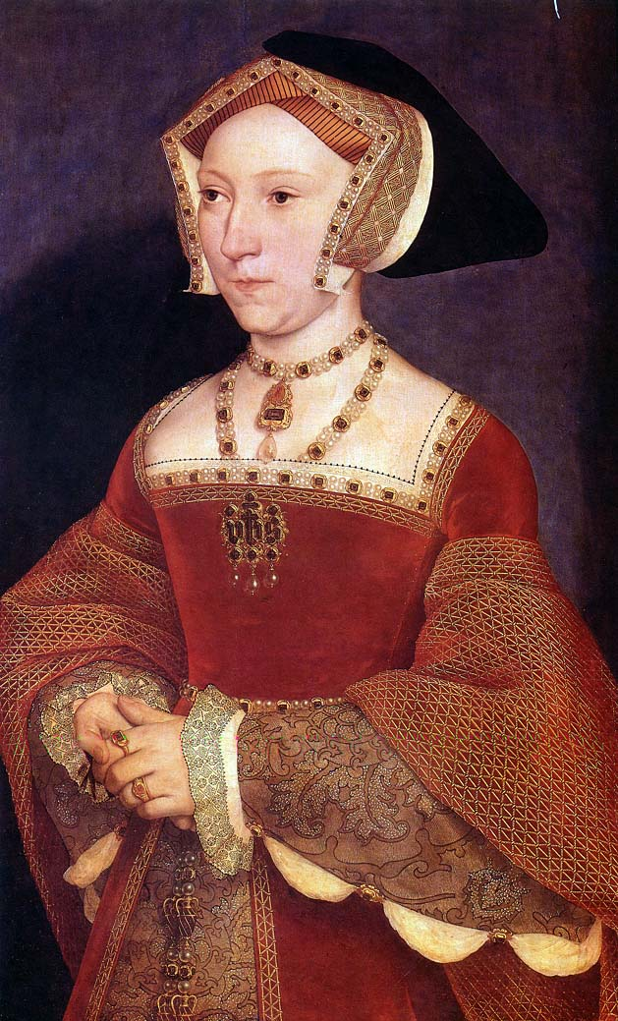
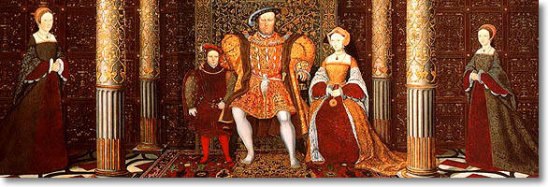
Henry’s Wives
#3 – Jane Seymour (died – natural causes) 1 son (Edward VI)

Slide 32
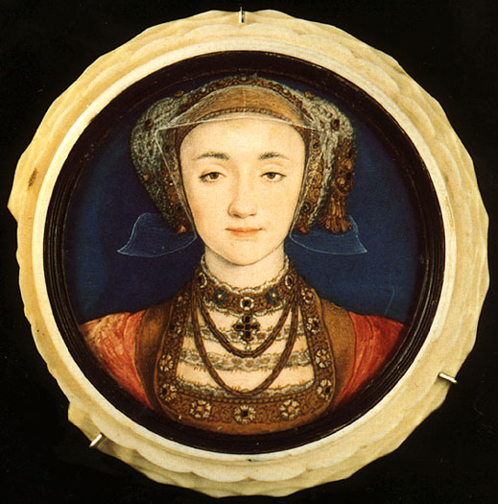
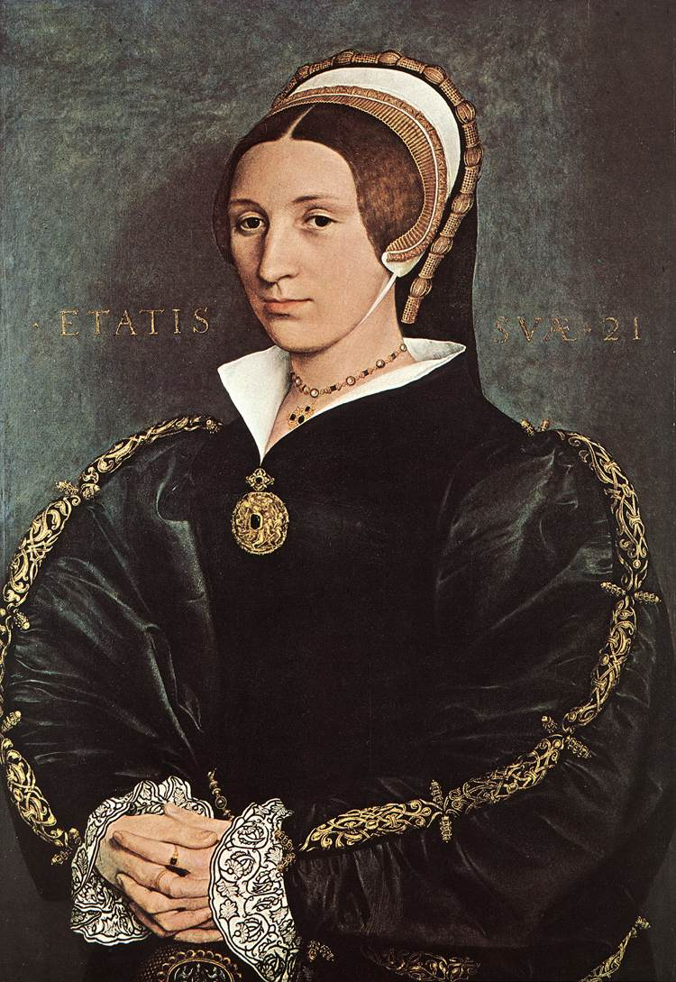
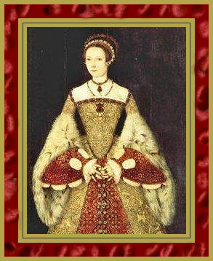
Henry’s Wives
#4 - Anne of Cleves –lasted 6 months
#5 - Catherine Howard, a 17 year old, who was beheaded for adultery
#6 - Catherine Parr – final wife - she got along well with all the children

Slide 33
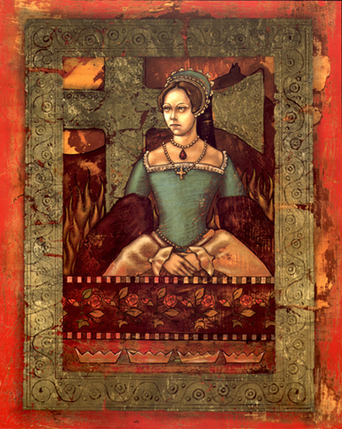
Mary I (Bloody Mary -1553-1558)
Mary was the daughter of Henry VIII and Catharine of Aragon.
As Queen she attempted to restore Catholicism, and she married the young Philip from Spain.
She also had more than 300 Protestants killed.
None of these actions was popular with the now firmly entrenched Protestant England

Slide 34
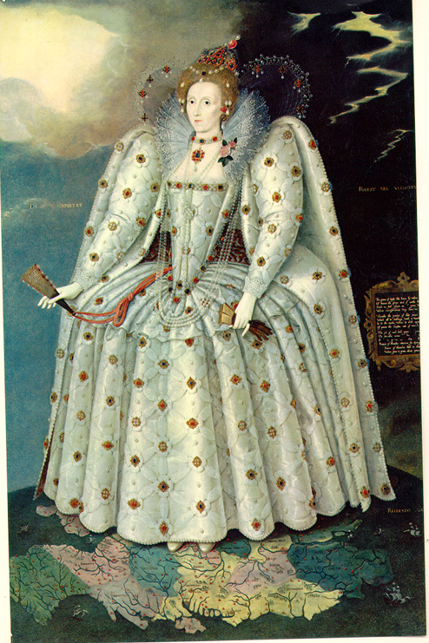
Elizabeth I (1558-1603)
The red-haired daughter of Henry VIII and Anne Boleyn, she became England’s greatest leader.
She kept control of England by refusing to marry anyone and playing one noble against another – many hoping to marry the Queen.
She kept religious wars down, advanced exploration, became a patron of the arts, and brought England to the position of world power with the defeat of the Spanish Armada

Slide 35
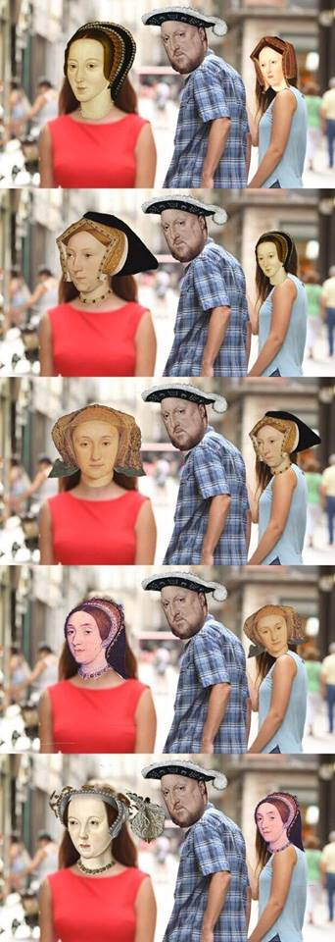

Slide 36
The Catholic Reformation: aka Trying to stay Relevant through “stimulation of new spiritual fervor” (reforms) AND The Counter-Reformation: aka The Church Strikes Back – reaction to Protestant Reformation, attempts to convince people to come back to the Catholic Church (punishments)

Slide 37
Counter-Reformation
Catholic Church began to reform and take action to spread Catholicism
Council of Trent, 1545-1563, convened by Pope Paul III, held in Italy
Established council to reform the church yet also established an Inquisition in papal states…..

Slide 38
Jesuits
Society of Jesus
Founded by Ignatius of Loyola in 1540
Duties:
Keep Catholics in Church
Persuade Protestants to return
Evangelical missions all over the world (Christian “soldiers”)

Slide 39
Council of Trent
Met intermittently between 1545 – 1563
Representatives from all nations invited
Reforms to correct abuses:
Sale of indulgences banned
Tightened discipline for clergy; suppressed pluralism
Only worthy people enter clergy
Seminaries established to train clergy
Encouraged reform of monasteries and convents
Encouragement and practice of lay literacy

Slide 40
Council of Trent
Continued beliefs:
Only Church could explain Bible
Faith and good works needed for salvation
Rejected Lutheran and Calvinist views on transubstantiation
Pope highest and final authority
Marriage as a sacrament but now more strict rules (public vows & witnesses)
No reconciliation with Protestantism

Slide 41
Overall Effects of Reformation
Religious unity of Europe gone
State strengthened at expense of Church
Spread of education
Printing Press, Jesuits, etc
Middle-class strengthened as Protestant work ethic virtue spread
Catholic church reformed from a corrupt institution to more of an emphasis on mission and evangelical work

Slide 42
The Protestant Reformation
Review multiple choice (participation points) quiz
Character maps
Thematic review for Ren/Ref
Outcome: Students will review information from the Middle Ages, Renaissance, and Reformation.

Slide 43
Review geography & world religions
6 bubbles = geography
5 bubbles=world religions
#5 on geography is asking about Longitude
Staple the 6 bubbles on top of the 5 bubbles when you finish

Slide 44
Today
Character map (turn in at the end of class)
Get notes in order for notebook check
Start on Renaissance/Reformation thematic review
**TEST MONDAY**

Slide 45
Character Map
You will create a visual representation of one of the individuals that we learned about during the Middle Ages, Renaissance and Reformation.
You image must include:
-Must include:
- Physical appearance (clothing style, hair style, physical features, etc) (3 pts)
- At least three objects that relate to their livelihood (6 pts)
- Background / setting reflecting where they lived (3 pts)
- Quote or something he or she would have said (5 pts)
- Color (3 pts)
Total: _____________/20
Suggested people:
Generic Middle ages person (choose from the feudal system) Generic Renaissance Gentleman or Woman Leonardo Da Vinci Michelangelo Martin Luther Ulrich Zwingli John Calvin German Prince who opposes Charles V Charles V Henry VIII

Slide 46
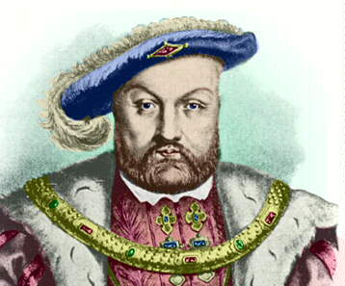
I spy an attractive lady – in-waiting called Anne Boleyn. If only I could marry her instead. Will the Pope give me a divorce?
I need a son. I have been married for 20 years and my wife, Catherine of Aragon is too old to have any more children. Who will inherit my throne when I die?
The Church is very rich. I need money for my luxurious court. If only I could get my hands on it.
The new Protestant ideas are spreading in Germany. Princes there are reforming their churches and throwing out the Catholic Church.
The Church takes money out my country in taxes to help build St Peter’s in Rome. What do I get in return?
Some people in England like the new Protestant ideas. They believe that the Bible should be in English not Latin.

Slide 47
Today
Get notes in order for notebook check
Renaissance/Reformation thematic review
**TEST WEDNESDAY** (Arts & Humanities on Tuesday)

Slide 48
Thematic Approach to History
Political – relating to governments and/or
interactions between nations or regions
Military – relating to militaristic interactions
between nations or regions
Economic – relating to the financial structures
of nations or regions
Social – relating to characteristics of classes
of people in nations or regions
Cultural – relating to the intellectual, artistic,
or religious characteristics of people in
nations or regions

