Slide 1
The Middle Ages – Day 1
Introduction and Feudalism
p. 129 – 133 Complete the outline for the Middle Ages.
We will go over this information after you have read through it.

Slide 2
Middle Ages Stations
You will be rotating between 3 stations to respond to questions relating to the following topics:
1 – Feudalism
2- The Crusades
3 – The Black Death
4 – Society
When you are finished, answer the following question somewhere on your sheet:
Discuss how you think the Crusades and the Black Plague contributed to a change in the class structure and economies of society in this part of the world and ushered in a new era.

Slide 3
Middle Ages Stations
You will be rotating between 3 stations to respond to questions relating to the following topics:
1 – Feudalism
2- The Crusades
3 – The Black Death
When you are finished, answer the following question somewhere on your sheet:
Discuss how the Crusades and the Black Plague might have changed the structure of society (Feudalism) and also the economies of
European regions.

Slide 4
The Middle Ages
Middle Ages Notes & Videos
Thematic review
Outcome: Students will be able to identify the economic, political, social, and cultural characteristics of the Middle Ages.

Slide 5
Thematic Approach to History
Political – relating to governments and/or
interactions between nations or regions
Military – relating to militaristic interactions
between nations or regions
Economic – relating to the financial structures
of nations or regions
Social – relating to characteristics of classes
of people in nations or regions
Cultural – relating to the intellectual, artistic,
or religious characteristics of people in
nations or regions

Slide 6
THE MIDDLE AGES

Slide 7

Section 4-7
The New Germanic Kingdoms
After the collapse of the Western Roman Empire, a new civilization emerged in western Europe.
This civilization was formed by the convergence of three elements: the Germanic peoples, the Roman legacy, and the Christian church.
European civilization developed during the Middle Ages, or medieval period (500–1500).
Historians used the term Middle Ages to refer to the middle period between the ancient world and the modern world.

Slide 8
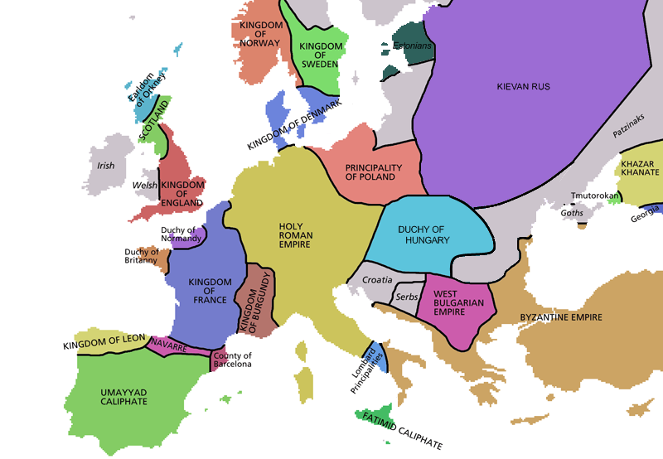

Slide 9
Section 4-14
Charlemagne and the Carolingians
In 768 Charles the Great, or Charlemagne, became ruler of the Frankish kingdom.
He was a strong statesman and pious Christian. Although illiterate, he supported learning.
Charlemagne ruled from 768 to 814.
During this time, he expanded the kingdom into what became known as the Carolingian Empire.
This empire covered much of western and central Europe and was unsurpassed until the time of Napoleon.

Slide 10
Charlemagne and the Carolingians
Charlemagne’s power and prestige grew.
In 800 he was crowned emperor of the Romans by the pope.
This coronation symbolized the coming together of the Roman, Christian, and Germanic elements that forged a new European civilization.
The spiritual leader of western Christendom had crowned a German king Roman emperor.

Slide 11
Section 4-17
Feudalism
The Carolingian Empire fell apart soon after Charlemagne’s death.
People began to turn to local landed aristocrats or nobles to protect them.
Nobles exchanged protection for service. This exchange led to a new political and social system called feudalism.

Slide 13
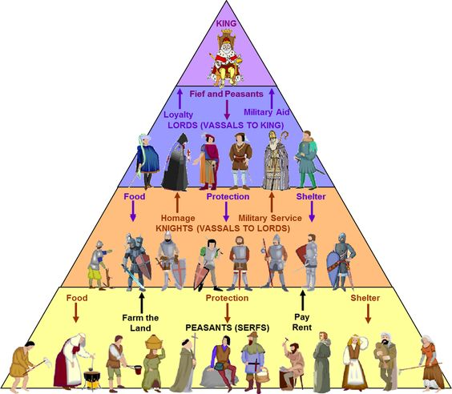

Slide 14
A New Social Order: Feudalism
Social Classes Are Well Defined
  Medieval feudal system classifies people into three social groups
    those who fight: nobles and knights
    those who pray: monks, nuns, leaders of the Church
    those who work: peasants
  Social class is usually inherited; majority of people are peasants
  Most peasants are serfs—people lawfully bound to place of birth
  Serfs aren’t slaves, but what they produce belongs to their lord

Slide 15
Manors: The Economic Side of Feudalism
The Lord’s Estate
  The lord’s estate, a manor, has an economic system (manorial system)
  Serfs and free peasants maintain the lord’s estate, give grain
  The lord provides housing, farmland, protection from bandits

Slide 16
Manors: The Economic Side of Feudalism
The Harshness of Manor Life
  Peasants pay taxes to use mill and bakery; pay a tithe to priest
  Tithe—a church tax—is equal to one-tenth of a peasant’s income
  Serfs live in crowded cottages with dirt floors, straw for beds
  Daily grind of raising crops, livestock; feeding and clothing family
  Poor diet, illness, malnutrition make life expectancy 35 years
  Serfs generally accept their lives as part of God’s plan
https://www.youtube.com/watch?v=eihD12kEYZE

Slide 17
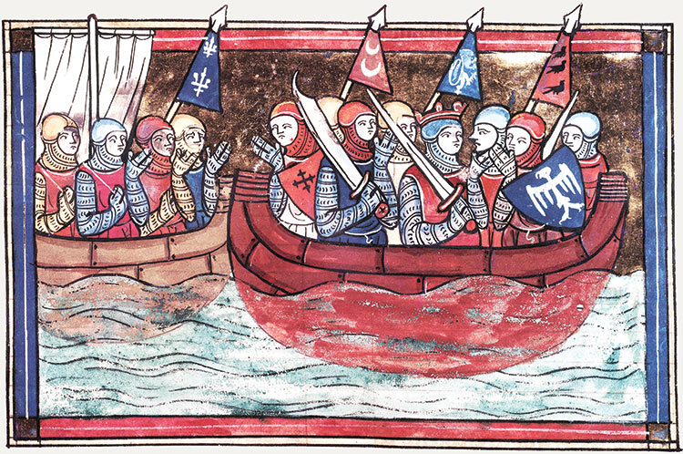
THE CRUSADES

Slide 18
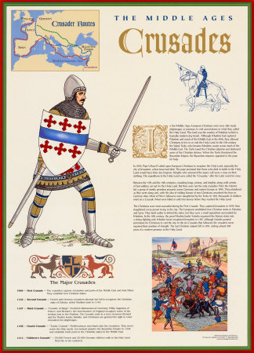
Crusades
A long series or Wars between Christians and Muslims
They fought over control of Jerusalem which was called the Holy Land because it was the region where Judaism, Christianity, and Islam all began.

Slide 19
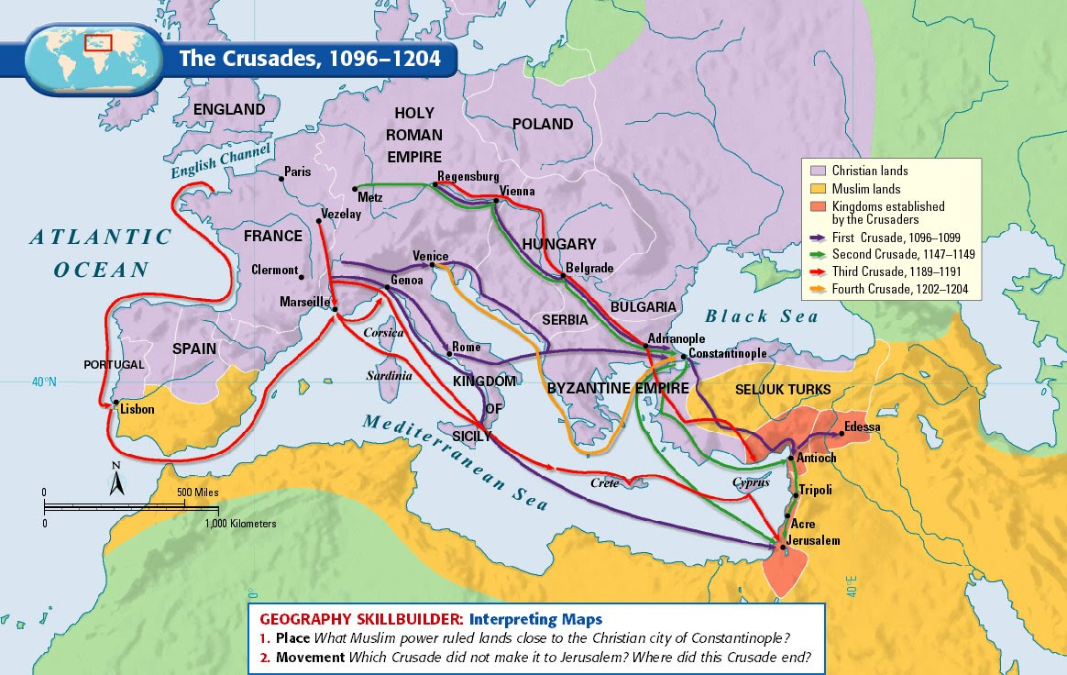

Slide 20
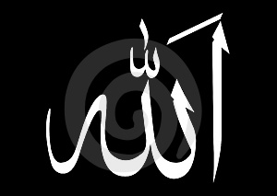

Causes of the Crusades

Slide 21
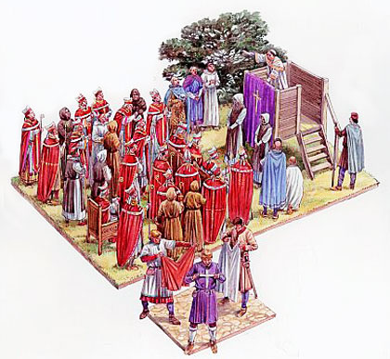
The Call to Arms
Pope Urban II called for the defeat of the Turks, returning the Holy Land to the Christians

Slide 22
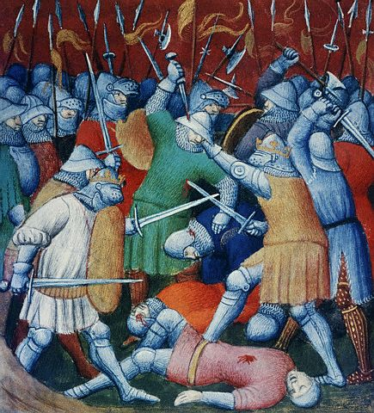
The First Crusade (1096-1099)
Peasant army
  Untrained
  Lacked military equipment
  Many killed by Muslim Turks
Knights
  Succeeded in capturing Jerusalem

Slide 23
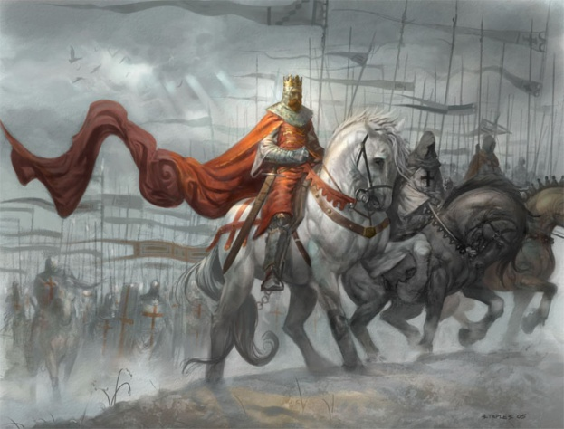
Second Crusade (1147-1149)
After victory many Christians went back home.
The Turks eventually took back much of the territory.
King of France and Holy Roman Emperor sent troops to stop the Turks.

Slide 24
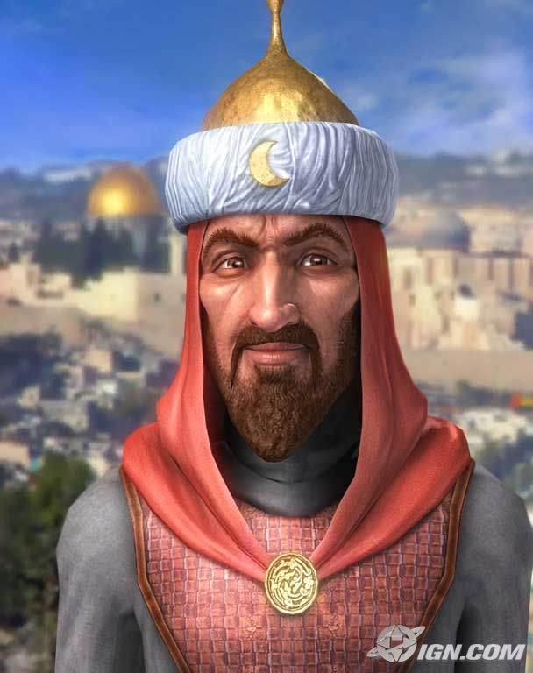
Second Crusade (1147-1149)
Saladin leads the Muslim Turks to victory, defeating the Christians
* He was considered a very wise ruler. He was known for his sometimes kind treatment of fallen enemies. Many Christians saw him as a model of knightly chivalry.

Slide 25
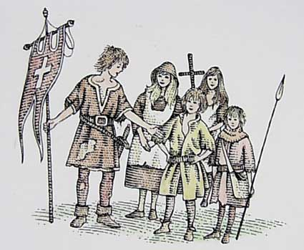
Crusades Continue Through 1200’s
Several more crusades attempted with no victories for the Christians
Children’s crusade, - 30,000 soldiers - many of them under 12 years old – Never made it to the Holy Land
Constantinople (Capitol of the Byzantine Empire) is finally sacked by the Turks in 1453

Slide 27
Results of the Crusades
Turks traveled they would trade
Improvements – Ships, Maps, Explorers (P)
Feudalism declines because Feudal lords die or spend too much money on military. (S)
Turks still rule the Holy Land
Travel – Europeans want to travel more
Trade – Europeans want product from the East such as sugar, cotton, silk, spices, etc. (E)
https://www.youtube.com/watch?v=CcGzQ3ga5R8

Slide 28
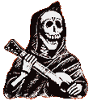
The Black Death
1347 - 1351

Slide 29
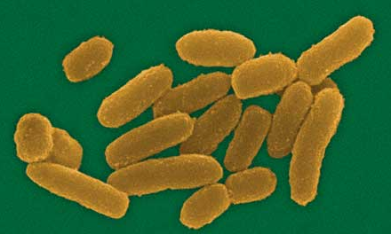
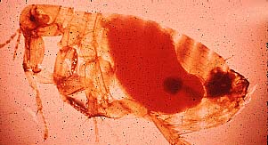
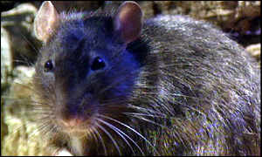
The Culprits
Bacteria
Flea
Rat

Slide 30
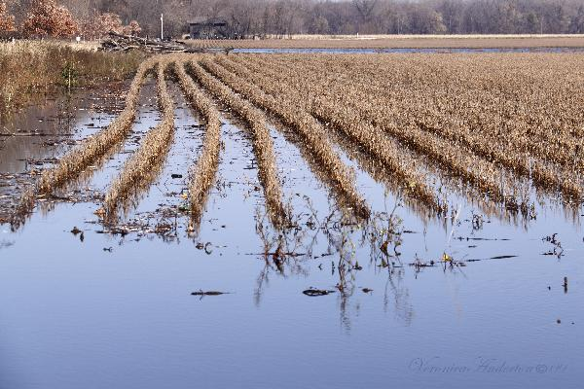
The Famine of 1315-1317
By the year 1300 Europeans were using almost all the possible land for farming
A population problem happened
  Too many people, not enough land
Weather changes in
Europe made three
bad years for crops
between 1315-17
because of too much
rain.

Slide 31
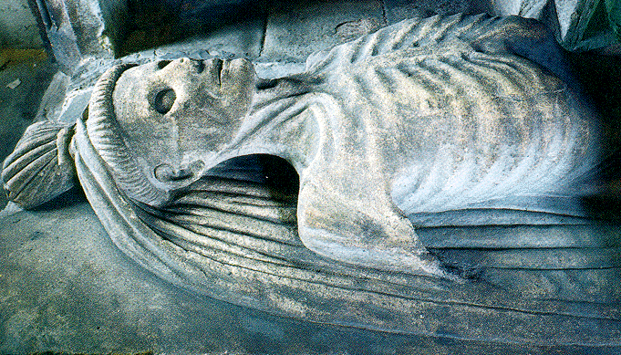
The Famine of 1315-1317
15% of the people in some English towns died because of no food (starvation)
Because the people were weak from starvation it was easy for them to get sick

Slide 32
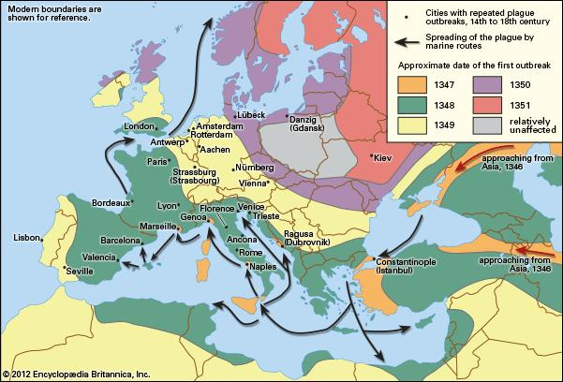

Slide 33
The Disease Cycle
Flea drinks rat blood
that carries the
bacteria.
Bacteria
multiply in
flea’s stomach.
Human is infected!
Flea bites human and
vomits blood from rat
into human cut
Flea’s stomach blocked
with bacteria.

Slide 34
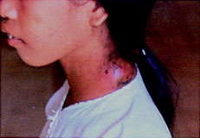
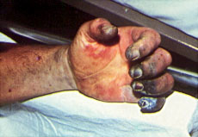
The Symptoms
Bulbous
Septicemic Form:
almost 100% of people die

Slide 35
The Mortality Rate
35% - 70%
25,000,000 dead !!!

Slide 36
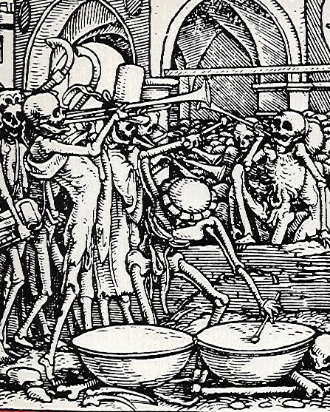
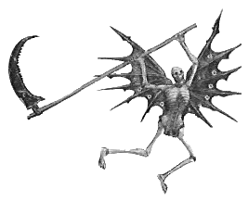

Medieval Art & the Plague
People are obsessed
with death.

Slide 37
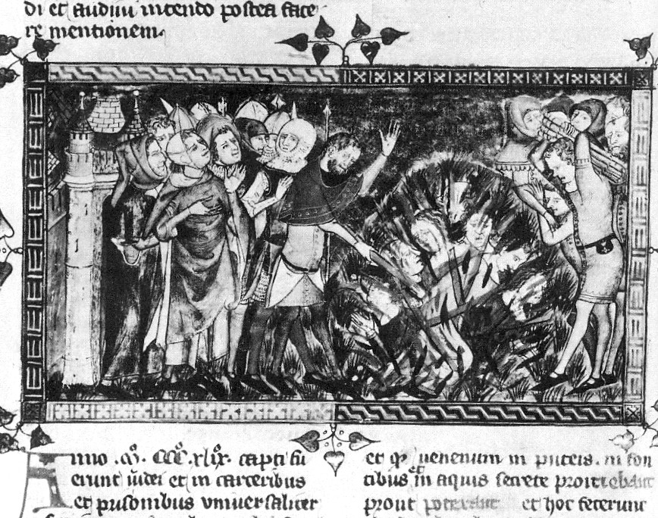

Slide 38
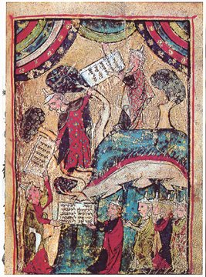
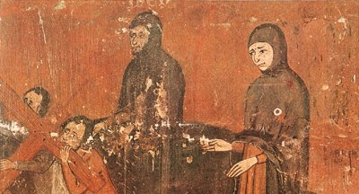
Attempts to Stop the Plague
Pograms against the Jews
“Golden Circle” Jews must wear all the time

Slide 39
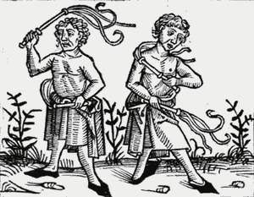

Slide 40
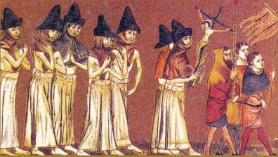
Attempts to Stop the Plague
Flagellants
People cut their bodies to punish for sins!

Slide 42
What were the
economic
and social effects
of the Black Death??

Slide 43
Economic Effects
Extreme inflation
Trade was dangerous because of spread of disease, so the prices of both goods produced locally and those imported from afar skyrocketed.
Because of illness and death workers became scarce, so even peasants felt the effects of the new rise in wages
In general, wages outpaced prices and the standard of living was subsequently raised.

Slide 44
Social Effects
The fashions of the nobility became more extravagant in order to emphasize the social standing of the person wearing the clothing.
The peasants became slightly more empowered, and revolted when the aristocracy attempted to resist the changes brought about by the plague.
Faith in religion decreased after the plague, both because of the death of so many of the clergy and because of the failure of prayer to prevent sickness and death.

Slide 45
http://www.youtube.com/watch?v=BsCkgX2epFw

Slide 46
Thematic Approach to History
Political – relating to governments and/or
interactions between nations or regions
Military – relating to militaristic interactions
between nations or regions
Economic – relating to the financial structures
of nations or regions
Social – relating to characteristics of classes
of people in nations or regions
Cultural – relating to the intellectual, artistic,
or religious characteristics of people in
nations or regions

