Slide 1
Chapter 29 - The Holocaust / “Final Solution”
HW: finish outlines for Chapter 29 for Monday

Slide 2
The Final Solution
The Nazis’ plan to annihilate the Jewish people.
As you have seen so far in this activity, the persecution and segregation of the Jews was implemented in stages.
From 1933-39, Nazi policies were aimed at isolating Jews from society.
After the invasion of Poland, were aimed at the imprisonment and murder of Jews.

Slide 3
First established ghettos (enclosed areas designed to isolate and control the Jews) in the General government (a territory in central and eastern Poland) and the Warthegau (an area of western Poland annexed to Germany).
Polish and western European Jews were deported to these ghettos where they lived in overcrowded and unsanitary conditions with inadequate food.

Slide 4
By June 1941, German mobile killing units began massive killing operations aimed at entire Jewish communities.
Gypsies (roma), Slavs (Russians and Poles), homosexuals, and Jehovah Witnesses were also executed by the SS.

Slide 5
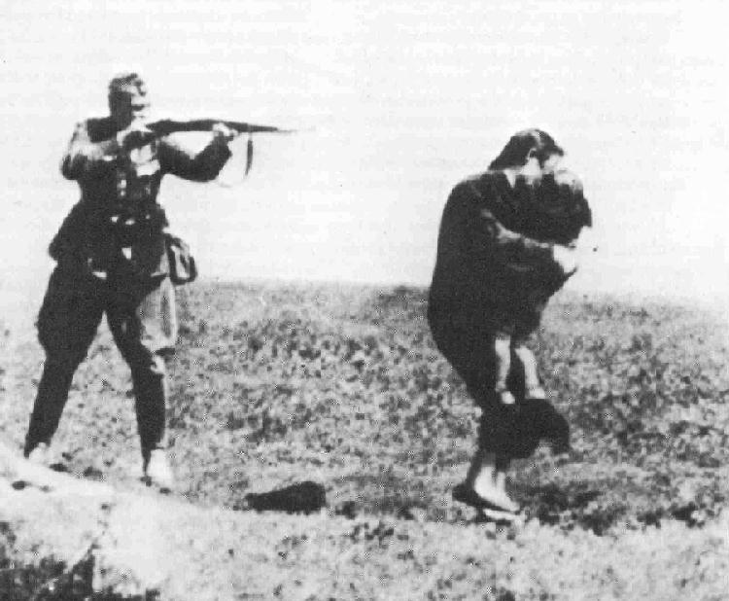
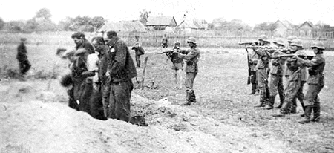
The Final Solution: Mobile Killing Units
Mother and child being executed
Polish Civilians being executed

Slide 6
Autumn of 1941, SS chief Heinrich Himmler begins the implementation of a plan to systematically murder the Jews of central and eastern Poland.
the SS and police introduced mobile gas vans.
These were used to complement ongoing shooting operations.
Three extermination camps were established in Poland -- Belzec, Sobibor, and Treblinka.

Slide 7
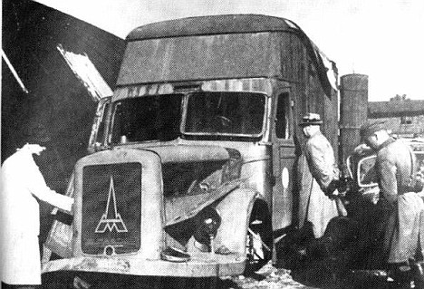
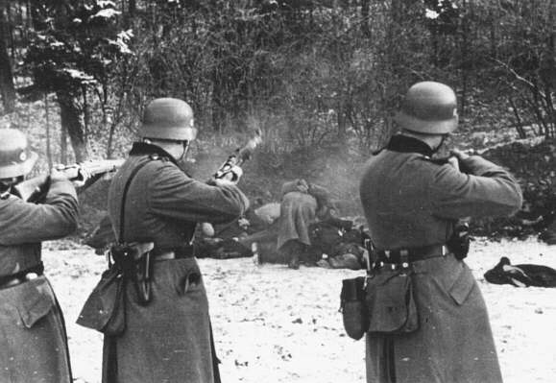
The Final Solution
Mobile Gas Van
Ongoing shooting operations

Slide 8
Concentration Camp and Extermination Camp
Concentration camps, on the other hand, had a number of purposes, among these to work as reformatory facilities, “punishment camps”, POW camps, transit camps, etc.
Extermination camps were only constructed with one purpose: to mass murder Jews and other “unwanted”.
Combined camps were used to serve both purposes.
Example: Auschwitz-Birkenau

Slide 9
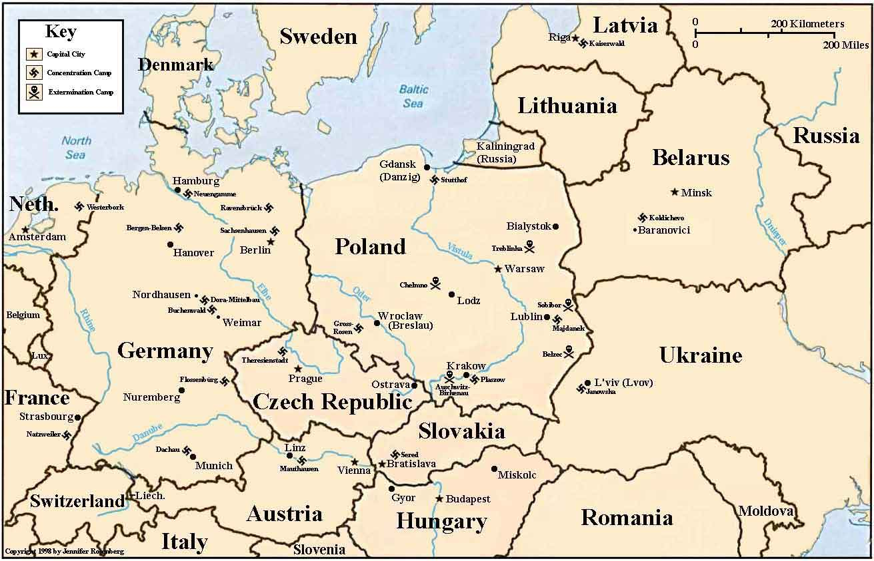
Map of Concentration and Extermination Camps

Slide 10
Auschwitz-Birkenau
Originally a concentration camp however, it was included in the organized mass murder of the Jews, following the construction of gas chambers in the Spring of 1942.

Slide 11
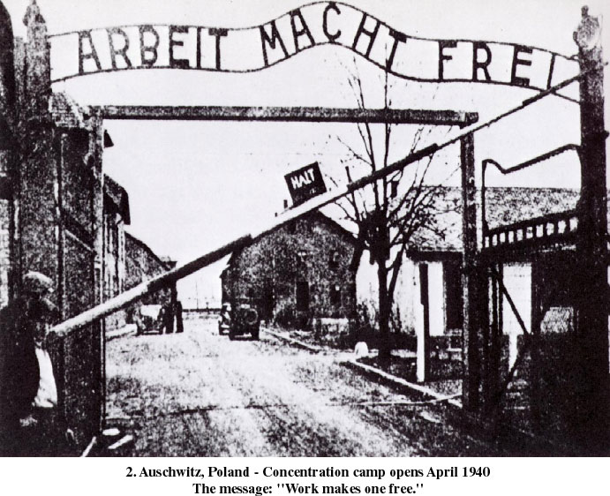
Auschwitz-Birkenau

Slide 12
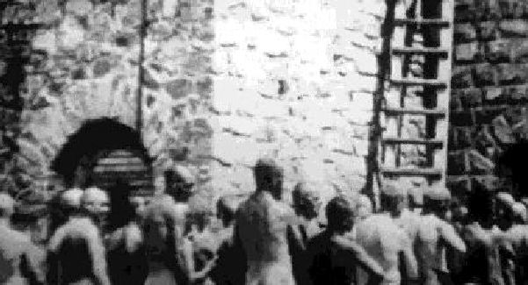
Auschwitz-Birkenau
Jews lining up for the Gas Chambers

Slide 13
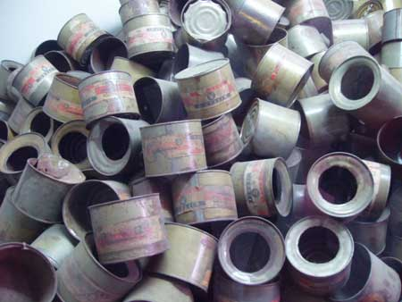
Auschwitz-Birkenau
Zyklon B- Gas used in Chambers

Slide 14
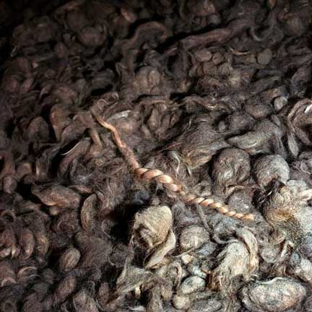
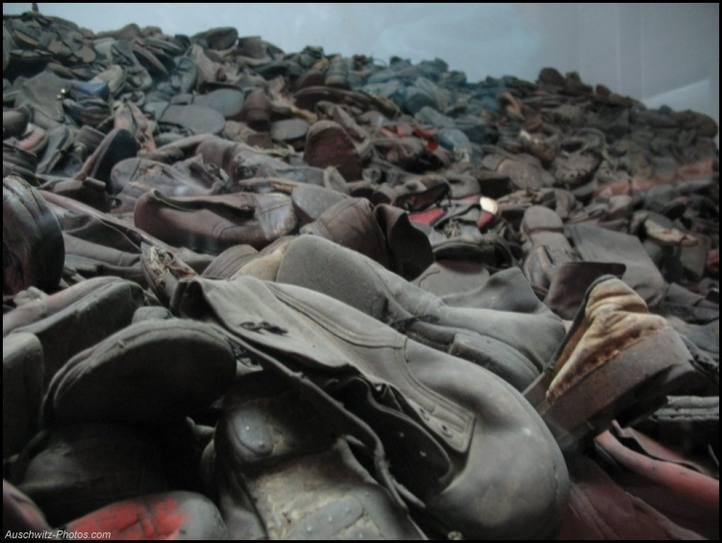
Auschwitz-Birkenau
Shoes of the victims
Hair of the victims

Slide 15
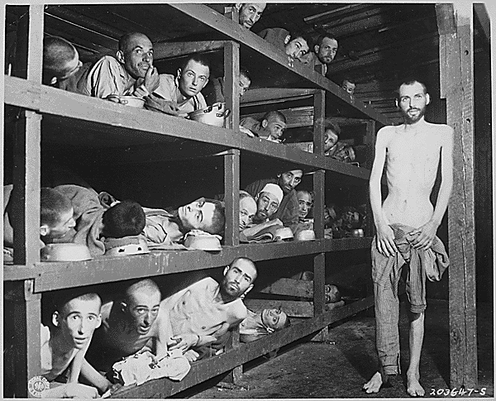
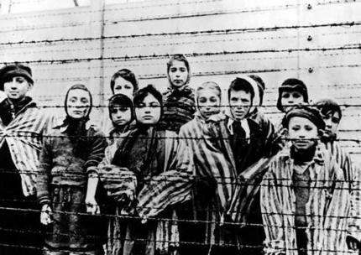
Auschwitz-Birkenau
Children of Auschwitz
Sleeping Quarters
One million Jews died at Auschwitz-Birkenau.

Slide 16
Final Solution Review 1941-1945
The Nazis murdered nearly 2,700,000 Jews in the extermination camps.
The “Final Solution" called for the murder of all European Jews by gassing, shooting, and other means.
Approximately six million Jewish men, women, and children were killed during the Holocaust
Two-thirds of the Jews living in Europe before WWII, died in the Holocaust.

Slide 17
Videos
https://www.youtube.com/watch?v=aS98MAN3Xtg (*student made - general history)
https://www.youtube.com/watch?v=Ho5zuuhDoMg (Auschwitz images with music)
https://www.youtube.com/watch?v=PH98iTYLrv4 (*Dachau footage)
https://www.youtube.com/watch?v=sHcJtU9dr6I (Band of Brothers clip)

