Slide 1
Chapter 30 – The Division of Europe
Reading Quiz
Discuss post-WWII
HW: “Toward European Unity” (p.997) – “Soviet Eastern Europe, 1945 – 1968” (stop at p. 1007)

Slide 2
Cold War
Superpowers= USA and USSR
Cold War- Post WWII tension/hostility between the superpowers
No actual fighting

Slide 3
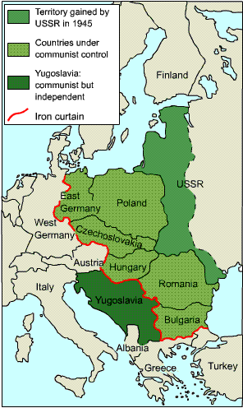
USSR
Puppet govts. established by force to protect Western frontiers (Buffer Zone)
“Satellites”- Poland, Czech., Hungary, Romania, Bulgaria (Bloc countries)
Albania and Yugoslavia- Communist
Part of Soviet Bloc

Slide 4
United Nations
April 1945 50 countries met
Charter and purpose developed
Save future from war
Promote national self-determination
Promote respect for human rights
Help nations solve problems
Headquarters- New York City

Slide 5
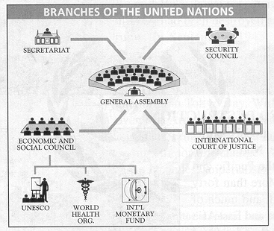

Slide 6
Rivalry in Europe - Potsdam
The U.S. wanted self-determination (free choice of type of government) for liberated Nazi territories in Europe
Stalin opposed this believing that free elections would oppose communism
Stalin felt he needed these nations to protect Russia’s western border and continued to occupy the territories with troops

Slide 7
First cold War Conflict
A civil war in Greece pitted communists against anti-communist forces (who were supported by Britain)
Great Britain could no longer support the anti-communists and the U.S. felt they should takeover the cause

Slide 8
Policy of Containment
With the Truman doctrine the U.S. began using a POLICY OF CONTAINMENT (to keep communism within its existing borders throughout the world)

Slide 9
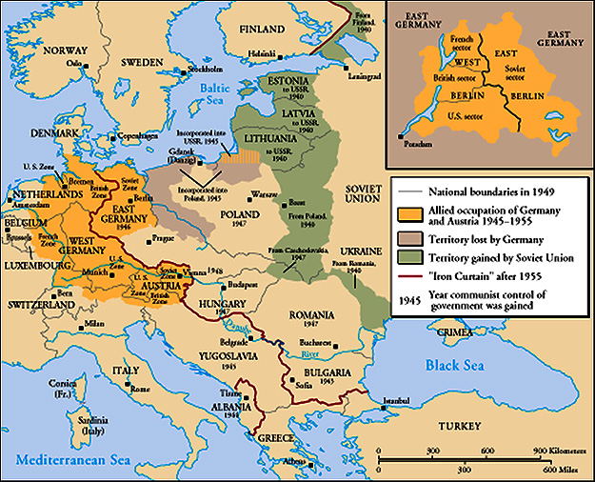
The “Iron Curtain”
From Stettin in the Balkans, to Trieste in the Adriatic, an iron curtain has descended across the Continent. Behind that line lies the ancient capitals of Central and Eastern Europe. -- Sir Winston Churchill, 1946

Slide 10
Truman Doctrine [1947]
Civil War in Greece.
Turkey under pressure from the USSR for concessions in the Dardanelles.
The U. S. should support free peoples throughout the world who were resisting takeovers by armed minorities or outside pressures…We must assist free peoples to work out their own destinies in their own way.
The U.S. gave Greece & Turkey $400 million in aid.

Slide 11
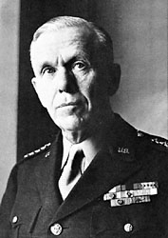
Marshall Plan [1948]
“European Recovery Program.”
Secretary of State, George Marshall
The U. S. should provide aid to all European nations that need it. This move is not against any country or doctrine, but against hunger, poverty, desperation, and chaos.
$12.5 billion of US aid to Western Europe extended to Eastern Europe & USSR, [but this was rejected].

Slide 12
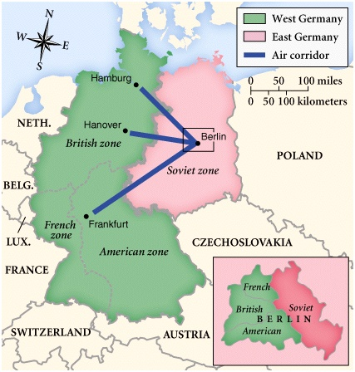
Post-War Germany

Slide 13
Division of Germany

Slide 14
Soviets Counter Marshall Plan
The Soviets saw the Marshall Plan as a U.S. attempt to buy the support of countries
In response they formed the Council for Mutual Economic Assistance (COMECON), but it failed due to lack of Soviet funding

Slide 15
Division of Germany
The allies (U.S., G.B., France) were making plans to return West Germany to it’s people
The Soviets opposed the creation of a separate West German State and blockaded (cut off access to) East Germany and East Berlin
Since the city of Berlin had been situated entirely within the Soviet zone of occupation, West Berlin became an island of democracy within Communist East Germany.

Slide 16
The Berlin Airlift - 1948
The Soviet blockade cut off food and supplies for the 2.5 million residence of West Berlin
The U.S. did not want WW III, but how could the people of West Berlin be kept alive with the whole city being in East German (soviet controlled) zone?

Slide 17
Berlin Airlift
The allied powers began a massive airlift campaign dropping food and supplies into West Berlin to keep the people alive
200,000 flights (more than 600 a day), 2.3 million tons of supplies, over 10 months

Slide 18
Berlin Airlift
http://www.youtube.com/watch?v=2d7eOF8-4gw

Slide 19
New Alliances
North Atlantic Treaty Organization (NATO) was formed between US and other European nations. (mutual help if attacked)
Warsaw Pact- formed in 1955 between Soviet Union, Albania, Bulgaria, Czechoslovakia, East Germany, Hungary, Poland, and Romania.
World is in an alliance system just like before WWI

Slide 20
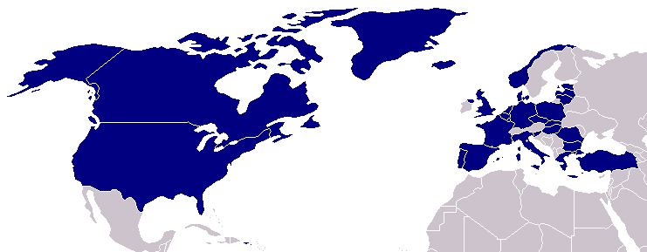
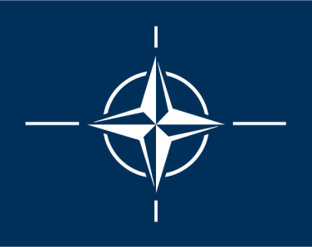
North Atlantic Treaty Organization (1949)
United States
Belgium
Britain
Canada
Denmark
France
Iceland
Italy
Luxemburg
Netherlands
Norway
Portugal
1952: Greece & Turkey
1955: West Germany
1983: Spain

Slide 21
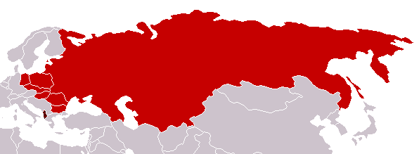
Warsaw Pact (1955)
U. S. S. R.
Albania
Bulgaria
Czechoslovakia
East Germany
Hungary
Poland
Rumania

Slide 22
Korean War
Began in 1950 as an attempt by the Communist gov’t of North Korea to take over South Korea.
2 big results
Confirmed American fears about spread of Communism
Made USA very determined to contain Soviet power

Slide 23
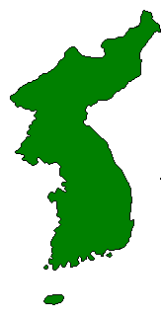
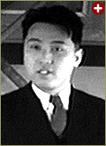
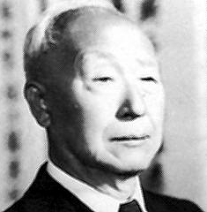
The Korean War: A “Police Action” (1950-1953)
Kim Il-Sung
Syngman Rhee
“Domino Theory”

Slide 24
Korean War

Slide 25
New Governments and European Economic Integration

Slide 26
France - 4th French Republic: 1945-1958
Democratic, but politically unstable [27 parties!]
Universal suffrage.
Weak President; powerful legislature
Many political parties [coalition governments]
Failure to gracefully leave Indochina.
Failed to settle the Algerian Crisis.

Slide 27
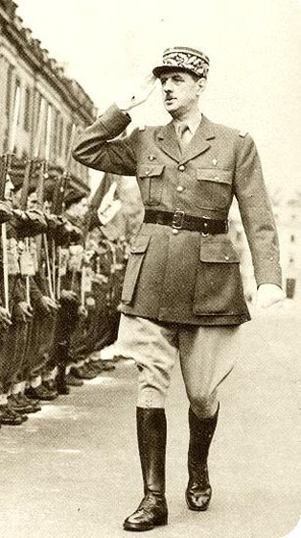
5th French Republic (1958-Present)
Powerful President. * first: Charles DeGaulle
Weak Cabinet.
Weakened legislature.
Separation of powers.

Slide 28
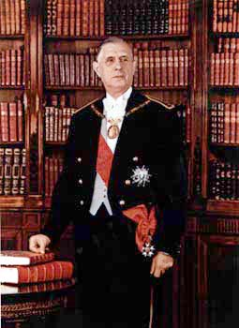
DeGaulle’s Achievements
Settled the Algerian Crisis.
Made France a nuclear power.
Sustained general prosperity.
Maintained a stable, democratic government.
Made France more politically independent.
BUT, late ’60s student unrest and social changes challenged him. In 1968 he resigned & died of a heart attack in 1970.

Slide 29
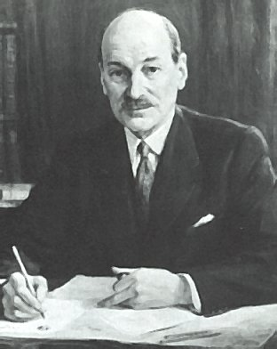
Great Britain: Clement Attlee & the Labor Party: 1945-1951
Limited socialist program [modern welfare state].
Natl. Insurance Act
Natl. Health Service Act
Nationalized coal mines, public utilities, steel industry, the Bank of England, RRs, motor transportation, and aviation.
Social insurance legislation: “Cradle-to-Grave” security.
Socialized medicine → free national health care.

Slide 30
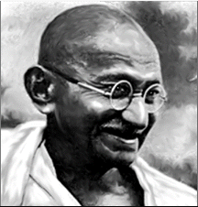
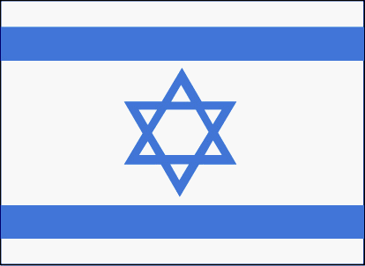
Clement Attlee & the Labor Party: 1945-1951
Britain is in a big debt!
The beginning of the end of the British Empire.
India – 1947
Palestine – 1948
Kenya → Mau Mau uprising - 1955

Slide 31
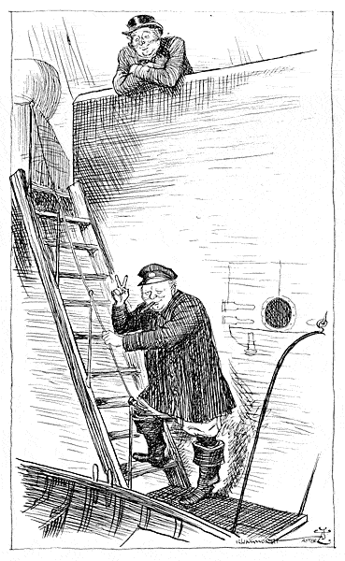
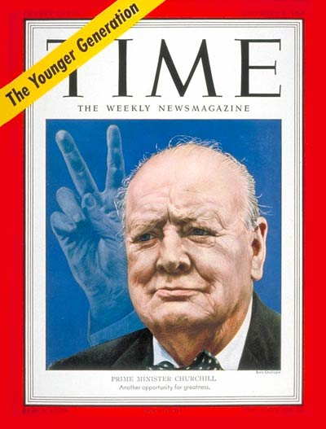
Churchill Returns: 1951-1955
He never really tried to destroy the “welfare state” established by Attlee’s government.

Slide 32
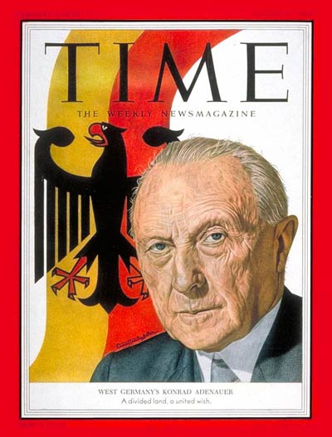
The Federated Republic of Germany
Created in 1949 with the capital at Bonn.
Its army limited to 12 divisions [275,000].
Konrad Adenauer, a Christian Democrat, was its 1st President.
Coalition of moderates and conservatives.
Pro-Western foreign policy.
German “economic miracle.”
“Father of Modern Germany.”

