Slide 1
Age of ‘isms
Agenda:
Review of Romanticism
Realism & Impressionism
HW: summary of three paintings (each ‘ism)

Slide 2
The Age of Realism

Slide 3
What contributed to the development of Realism?
Materialism: Science, technology, and industry can help to understand all truth, solve all problems, and create happiness for humans.
Utilitarianism: Virtue is based on utility and conduct should be directed toward promoting the greatest happiness for the greatest number of people.
Survival of the fittest (Darwinian theory)
development of socialism / Karl Marx’s Communist Manifesto
Rising standard of living (vaccinations, telegraph, public sanitation, electricity)

Slide 4
Realism in Visual Art
Greatest aim was to depict a truthful objective view of the world
Artists wanted to show society as it really was (not “Romanticized”)
→ Scenes of industrial cities, physical labor, real people
Artist was thought of as a scientific observer of detail

Slide 5
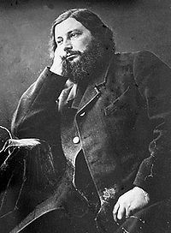
Gustave Courbet
1819 – 1877
Father, innovator of the Realist movement
And addressed social and controversial
issues through his art.
His style encompassed the spontaneity, irregularity, and harshness of real life.
Some works to be considered borderline pornographic

Slide 6
Gustave Courbet
After Dinner at Ornans, 1849

Slide 7
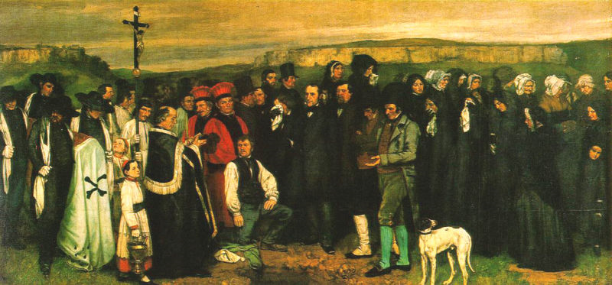
Burial at Ornans, 1850 Gustave Courbet

Slide 8
Gustave Courbet
The Stonebreakers 1849

Slide 9
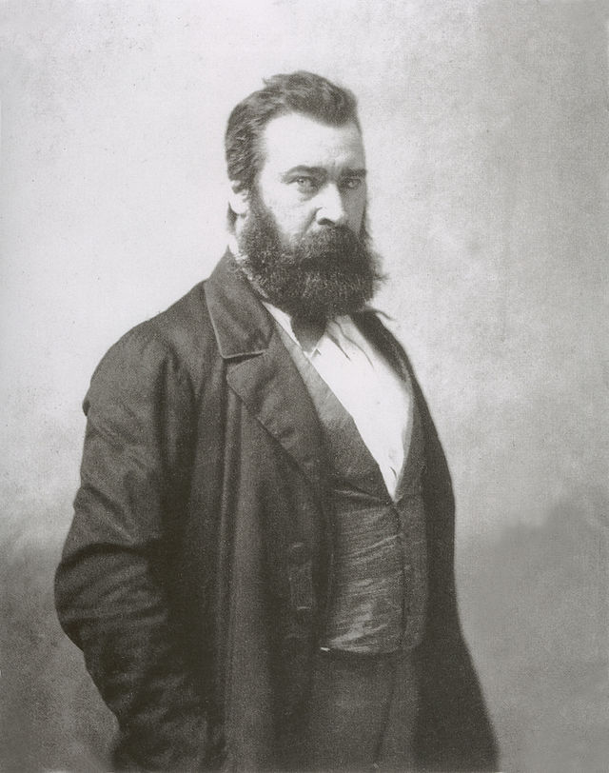
Jean-Francois Millet
1814 - 1875
Founder of the Barbizon school
of Realist painters in France
Style was very influential for Van Gogh,
Monet, and Seurat
The Gleaners is monumental composition
devoted to the rigors of the working class.

Slide 10
Jean-Francois Millet
The Gleaners 1857

Slide 11
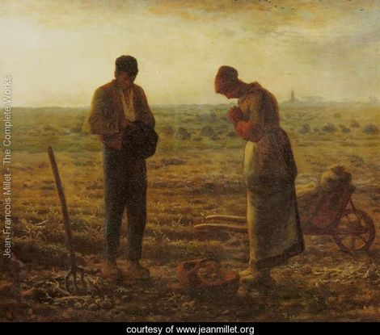
Angelus, 1857 Jean-Francois Millet

Slide 12
Jean-Francois Millet
The Walk to Work

Slide 13
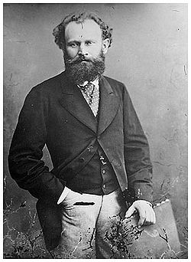
Édouard Manet
1832 – 1883
Born in Paris, France (frequently
visited and studied at the Louvre when
he was young and was extremely
Influenced by Ren. masters).
Painted “modern-life” subjects
He began as a Realist but made the transition to Impressionism
His two most famous paintings are thought to
have marked the beginning of Modern art.
The Luncheon on the Grass
Olympia

Slide 14
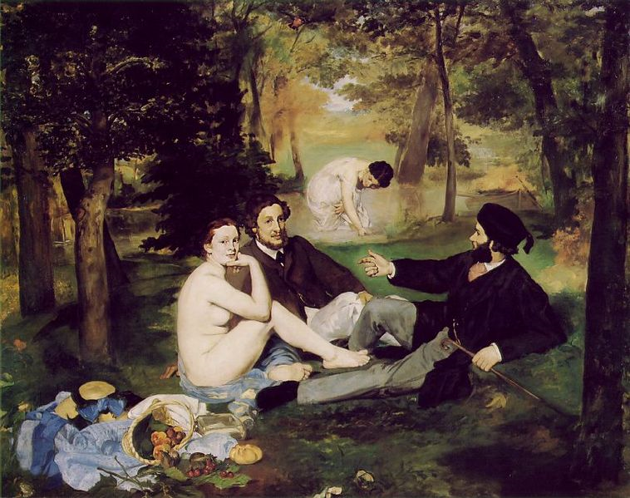
The Luncheon on the Grass
Édouard Manet
1863

Slide 15
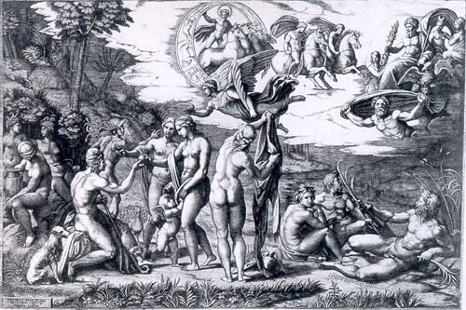
1510 HIGH ITALIAN RENAISSANCE

Slide 17
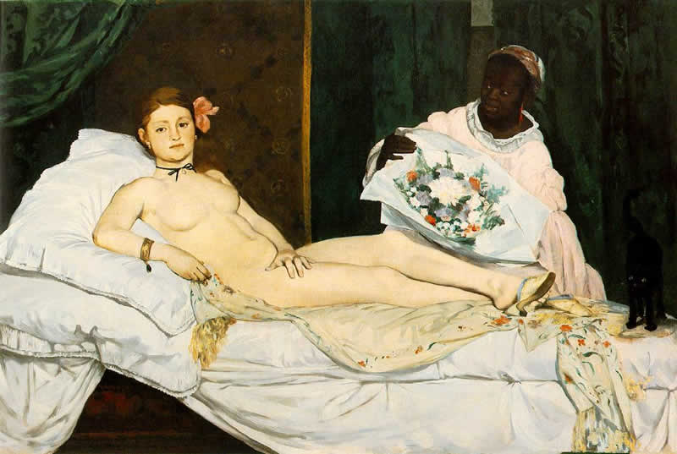
Olympia, 1863 Edouard Manet

Slide 18
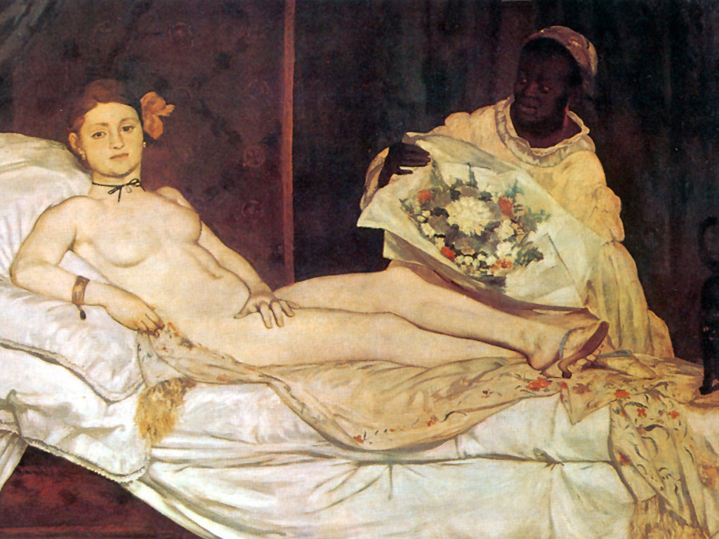
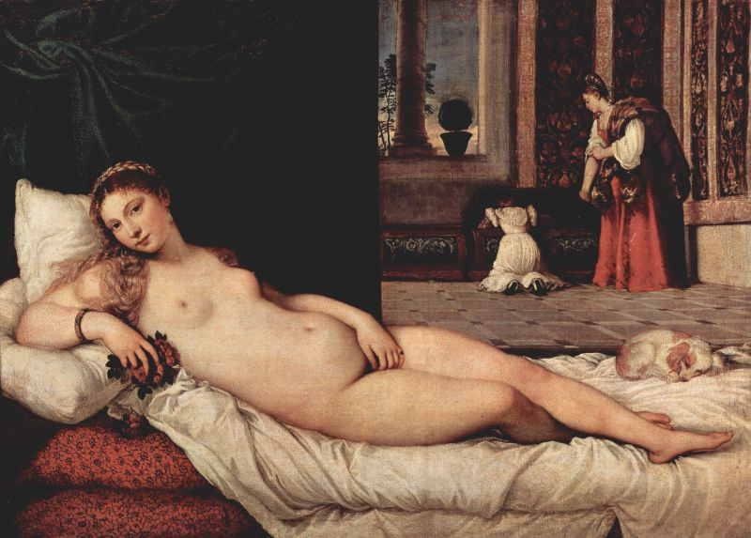
Edouard Manet,
Olympia, 1863.
Titian
Venus of Urbino, 1510

Slide 19
Realism in Literature
Focused on hardships of life (Charles Dickens Hard Times exposed the under side of industrial factory work)
Became a tool of reform to better individuals lives
Industrial hardships actually led to many reforms in labor laws and the factory system
Railroad workers hardships
Slavery in U.S.

Slide 20
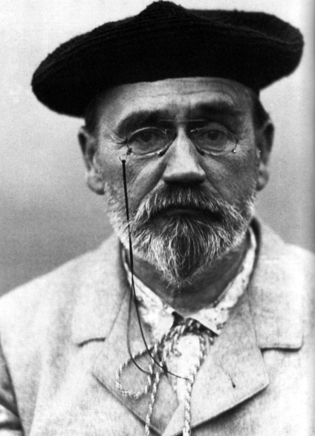
Emile Zola
Wrote what he saw – use of (scientific) observation
wrote about class struggle and taboo subjects
“objective” view of the world

Slide 21
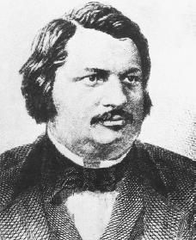
Honore Balzac
Satirist and comedic writer
Wrote The Human Comedy which consisted of nearly 100 stories and thousands of characters from every walk of life (all sectors of French society)
characterized social Darwinist theory

