Slide 1
Social Crisis, War, and Revolution
Chapter 7, Section 2
Section 2 notes
Multiple choice review
Tomorrow: A podcast!

Slide 2
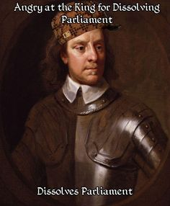
Social Crisis, War, and Revolution
Chapter 7, Section 2
Podcast !

Slide 3
Social Crisis, War, and Revolution
Chapter 7, Section 2
Section 2 packet – due tomorrow

Slide 4
Social Crisis, War, and Revolution
Chapter 7, Section 2
Section 2 notes
Multiple choice review
Students will be able to describe the causes of the English Civil War.

Slide 5
The 30 Years War

Slide 6
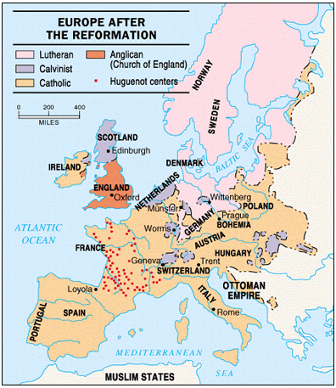
Historical Background
Europe was plagued by economic problems between 1560 – 1650
The biggest problem was inflation (increased populations drove up prices for land and food)
By 1600, Protestants outnumbered Catholics in the German Provinces but the Protestants were fragmented into denominations or sects.

Slide 7
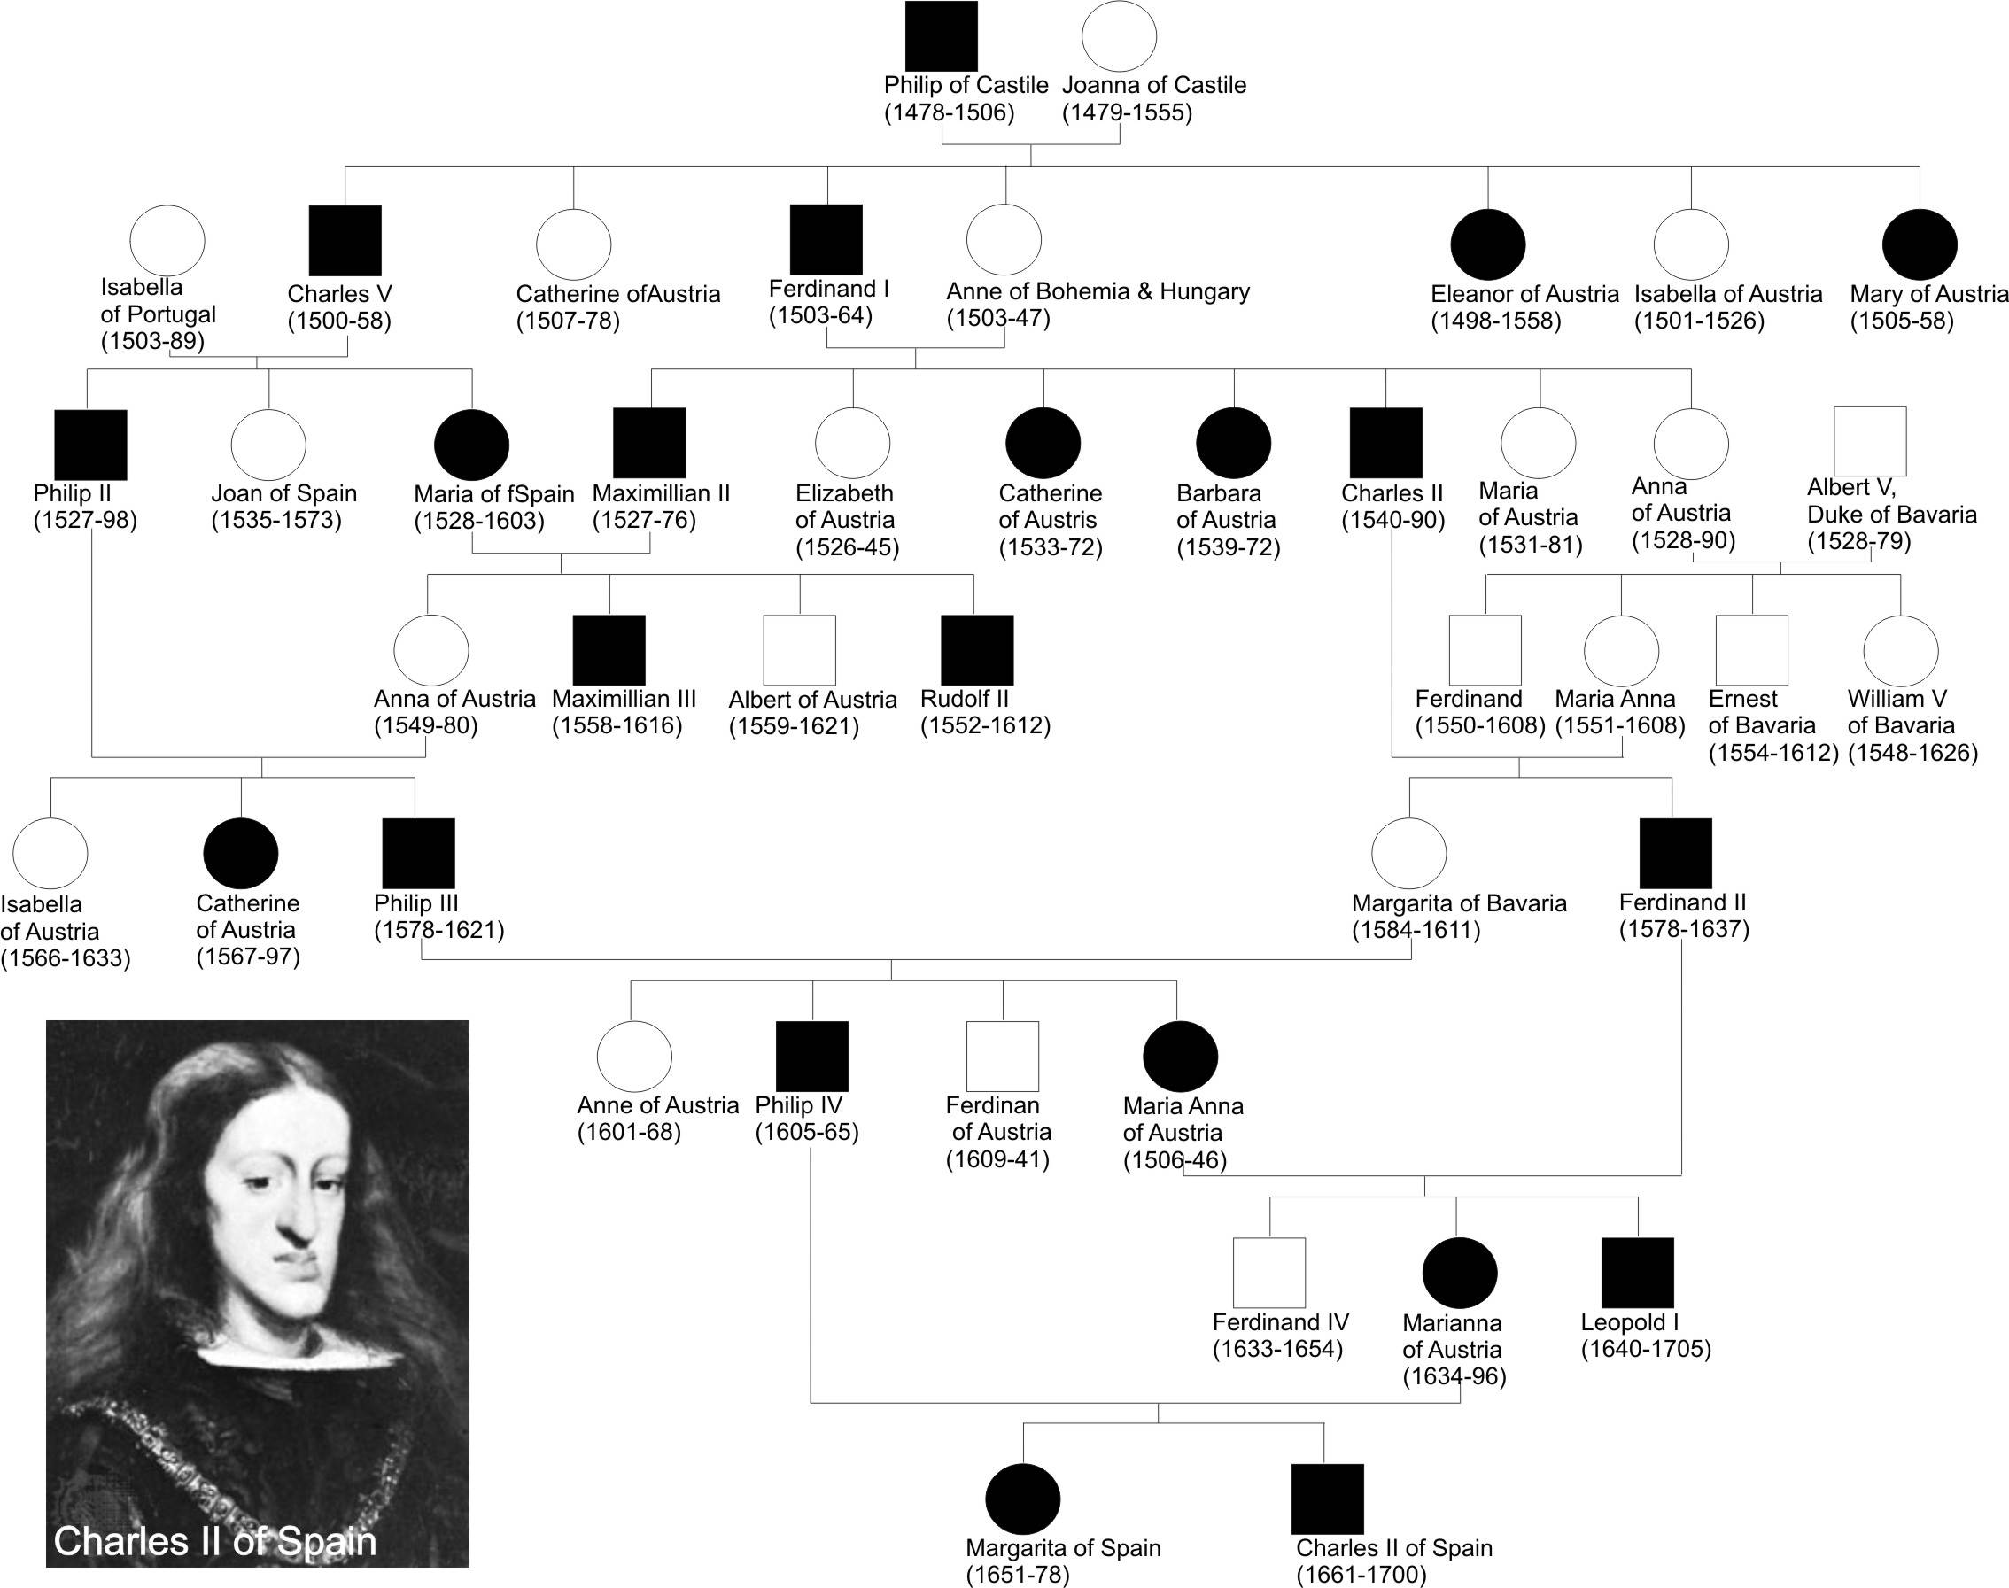

Slide 8
The Defenestration of Prague
Protestants set up a meeting with Catholic officials in Prague on May 23, 1618.
Meeting went badly, the Protestants seized two Catholic officials and tossed them out the window
This event is known as The Defenestration of Prague. The word defenestrate comes from Latin word for “window” and means “out the window”
The officials survived the fall because they landed in a dungheap or ditch; Catholics claimed angels saved them
This was the spark that ignited the 30 Years’ War

Slide 9
Defenestration of Prague

Slide 10
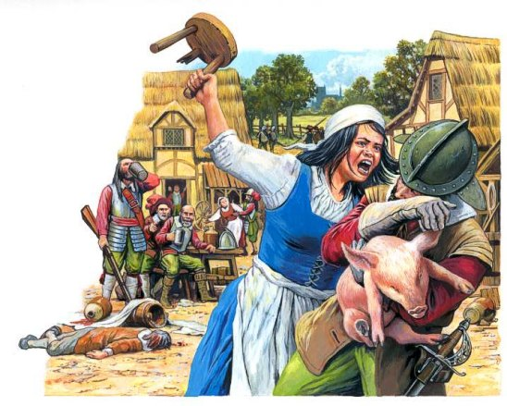
The 30 Years’ War
Four Phases of the 30 Years’ War:
The Bohemian Phase
The Danish Phase
The Swedish Phase
The French Phase

Slide 11
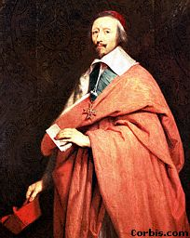
Who was fighting?
Power of the Hapsburgs (Holy Roman Empire)=Catholic
Versus
Protestants from German provinces, Sweden, Denmark; French Catholics (?!)
France wants Hapsburgs to lose and therefore support Protestants
Cardinal Richelieu - advisor to
King Louis XIII of France

Slide 12
The Peace of Westphalia (1648)
No participant in the 30 Years War possessed a large enough army to knock out its opponents
The 30 Years’ War officially ended in 1648 with the Peace of Westphalia
The treaties recognized the sovereignty of the 300+ German princes
The treaties upheld the Peace of Augsburg, added Calvinism to the list of religions allowed in German provinces.
France benefited from the fragmentation of the Holy Roman Empire and the weakening of the Habsburg family influence.
the political power of the Holy Roman Empire faded into oblivion;
the Habsburg family remained wealthy and strong, though, and would go on to rule the Austro-Hungarian Empire later

Slide 13
Important things ☺
The 30 Years War began as a war of religion and developed into an international war of politics
While the war started as a religious war, the war healed no religious wounds
Because the vast majority of the fighting took place in Germany, the German provinces suffered more than any other participants (physical damage to crops, villages; economic damage; population decrease)

Slide 14
English Civil War

Slide 15
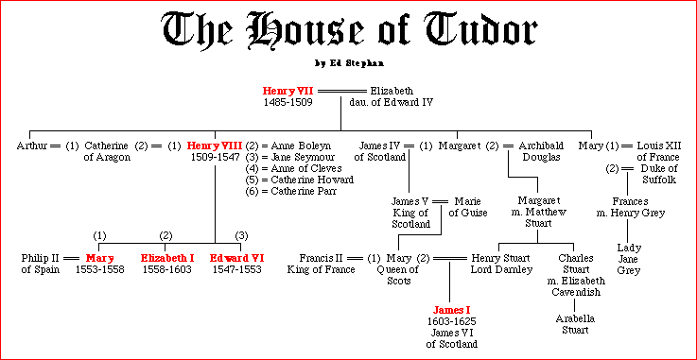
England – Mary Queen of Scots

Slide 16
Mary Queen of Scots
As Henry VII of England's great-granddaughter, Mary was next in line to the English throne, after Henry VIII's children
the Scottish nobility decided that they must make peace with England, and they agreed that she should marry Henry VIII's son, the future Edward VI.
The Catholics opposed this and rearranged her marriage to
the prince of France (Francis II).
She was subsequently married two more times, and after the Protestants in Scotland became angry with her, she fled for England. Queen Elizabeth held her in captivity for almost 20 years and finally had her executed in 1587. Her son survived and became king after Elizabeth died.

Slide 17
Write this in the “info” column on your chart.
Ruler | Info
James 1 (1603-1625) | Argued with Parliament over money Would not change the Church of England to Puritan worship Authorized a new Bible version (known today at the “KJV” or “King James Version”

Slide 18
Write this in the “info” column on your chart.
Ruler | Info
Charles I (1625-1649) | Dissolved Parliament when they would not give him money Forced to sign the Petition of Right when he called Parliament back in need of money. Ignored the Petition of Right when he wanted Sparked the English Civil War with Parliament Tried for treason against Parliament and executed

Slide 19
English Civil War
The English civil War was a dispute between the King and Parliament
The King believed in divine right and therefore did not need parliaments permission in decision making
Parliament wanted to share power

Slide 20
English Civil War
The main issues were the right to tax, the direction of the church, limits on the kings powers
At this point thousands of puritans left for America

Slide 21
The Opponents
Supporters of the king were known as Royalists or Cavaliers

Slide 22
The Opponents
Supporters of the parliament were called Roundheads

Slide 23
Victory for the Roundheads
The leader of the roundheads Oliver Cromwell had military training and used his skills to create a strong army that wins the war
Then Cromwell creates the Rump parliament (where each member is hand picked)

Slide 24
Write this in the “info” column on your chart.
Ruler | Relations with Parliament
Oliver Cromwell (1649-1658) | Puritan Cromwell abolished the monarchy and the House of Lords Later he sent the remaining members of Parliament home and ruled as a dictator. martial law (New Model Army); outlawed sports, dancing, ANYTHING FUN When he dies, his son takes control but is soon booted out by Parliament and a monarchy is restored.

Slide 25
Rulers’ Relations With Parliament
Ruler | Relations with Parliament
Charles II (1660-1685) | He is not able to settle the continuing religious disputes and continues problems with Parliament over money. Turns to Catholic King Louis XIV of France for money (Secret agreement: Charles would slowly re-Catholicize England) The king had no legitimate children, and he was well aware that the Scots viewed with alarm the prospect of his Roman Catholic brother James succeeding him. Charles died after a stroke in 1685 with the problem still unresolved.

Slide 26
Rulers’ Relations With Parliament
Ruler | Relations with Parliament
James II (1685-1688) | Fought over appointment of Catholics to high office in violation of English law. Even though he had a son, Parliament decided to make his eldest daughter, Mary, the new queen. (She was a Protestant) James did not want to be killed, so he fled the country for France and Mary and her husband became queen and king.

Slide 27
The Glorious Revolution
The English nobility secretly invite William of Orange to invade England
The “invasion” would be called the “Glorious Revolution” (because very little blood was shed)

Slide 28
Rulers’ Relations With Parliament
Ruler | Relations with Parliament
William and Mary (1689-1702) | Governed as partners, with power of monarchy limited by Bill of Rights This new reign was called the Glorious Revolution. Under William and Mary, England became a constitutional monarchy.

Slide 29
Life under William and Mary
Under the rule of William and Mary a bill of rights was passed dealing with: taxes, armies, right to bear arms, trial by jury, limited monarchy, public worship, and the destruction of the idea of divine right

Slide 30
Review Questions

