Slide 1
Social Change during the Renaissance

Slide 2
Social Change
Laura Cereta – true Renaissance feminist?
Women’s role – previous discussion; Book of the Courtier (“gentilwoman”); different from woman of the Middle Ages
Clocks – how did this invention contribute to labor in society?
Culture & Sexuality – attitude what you’d expect toward Women; attitude toward homosexuality yet hypocritical toward young boys?
Slavery – ethnic connotation of “slav,” increase in number of African slaves throughout sixteenth century; deals with African kings in exchange for people; African slaves became novelty/ sign of wealth

Slide 3
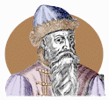
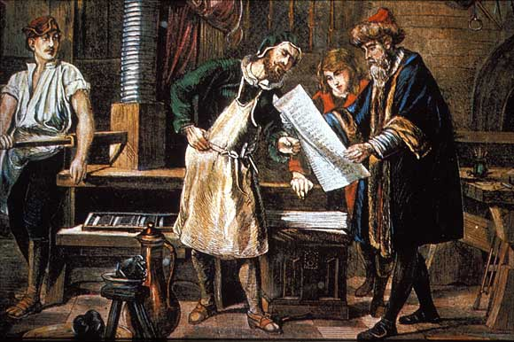
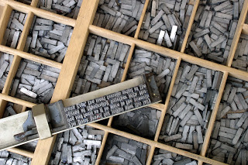
Johannes Gutenburg

Slide 4
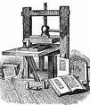
Printing Press
Gutenburg’s Bible was the first European book printed using moveable type- the printing press
Printing encouraged scholarly research and increase desire of public to gain knowledge (access to works of the past)
Ideas of the Renaissance and Reformation could not have spread like they did without the printing press
Allowed Europe to compete with China who had invented printing much earlier
Notes:
Do family and marriage differentiated instruction outline from book on pg 162 of teacher addition

Slide 5
Revival of Monarchy
After 1450, divided feudal monarchies ➔ unified national monarchies
Rise of towns, alliance of growing business classes with kings—broke bonds of feudal society
Created more efficient bureaucracies; Enabled the “New Monarchs” to begin centralizing control of their realms
Opposition to monarchial power
1. Nobles resented the decline of political influence
2. Clergy members saw the pope as their leader, not the monarch
3. Independent towns resisted more centralized
monarchial control Increased the public (national) debt by taking out loans from merchant-bankers.
Reduced the political power of the clergy: The medieval notion of the Church being supreme to the state was replaced in belief and practice

Slide 6
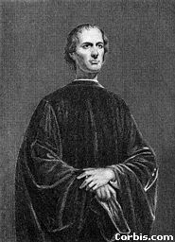
Niccolo Machiavelli

Slide 7
Niccolo Machiavelli
Diplomat of Florence (1469 – 1527)
Wrote The Prince (1513)
guidelines for rulers of time (lion & fox)
People selfish, fickle, corrupt
Ruler should do anything necessary to keep power (politically effective)
Rulers lied, broke treaties, killed as people can’t be trusted
Rule should be judged by results of actions
It is better to be _____________than _____________.

Slide 8
Revival of Monarchy (cont.)
France: two cornerstones of 15th-c. nation-building:
Collapse of English Empire in France after Hundred Years’ War, 1453
Pragmatic Sanction of Bourges gives authority over appointment of bishops; Concordat of Bologna reinforces deal with Pope by giving first year of income to him, still keeping power to appoint.
Charles VII (r. 1422–1461), Louis XI (r. 1461–1483)—doubled territory
England
Turmoil of Wars of the Roses, 1455–1485 (Lancaster vs. York)
Henry VII brings nobles to heal with special royal court, the Star Chamber, establishes harsh punishments and methods which reinforce the authority of the monarchy against the nobles

Slide 9
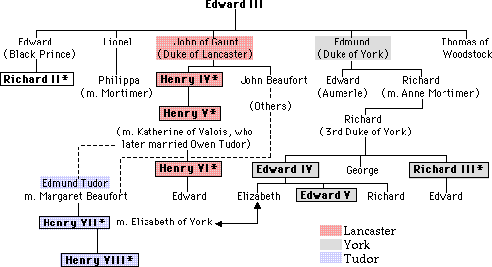

Slide 10
Revival of Monarchy (cont.)
Spain: 1469 marriage of Isabella of Castile & Ferdinand of Aragon, unified Spain
Together secured borders, ventured abroad militarily, Christianized Spain
Brought Spanish church under state control, ended toleration of Jews & Muslims
- hermandades: alliances of cities to oppose nobles, Helped bring cities in line with royal authority; Spanish Inquisition: (conceived by Isabella) Monarchy enforced the authority of the national (Catholic) church
- Sponsored Christopher Columbus, leading to Spanish Empire in Mexico & Peru, helping make Spain the dominant European power in 16th c.

Slide 11
Anti-semitism
- The Inquisition targeted conversos: Jews who
had converted to Christianity but were now suspected of backsliding into Judaism
-Thus began a wave of anti-Semitism in certain
parts of Europe
- In Portugal, 4,000 Jews who refused to leave
were massacred in 1506.
·

