Slide 1
Chapter 6, Section 3: SOUTHEAST ASIA IN THE ERA OF THE SPICE TRADE
Section 6.3 outline & Questions –
p. 201-204
6.3 Outline – finish today
6.3 questions – due Thursday
TOMORROW PSAT

Slide 2
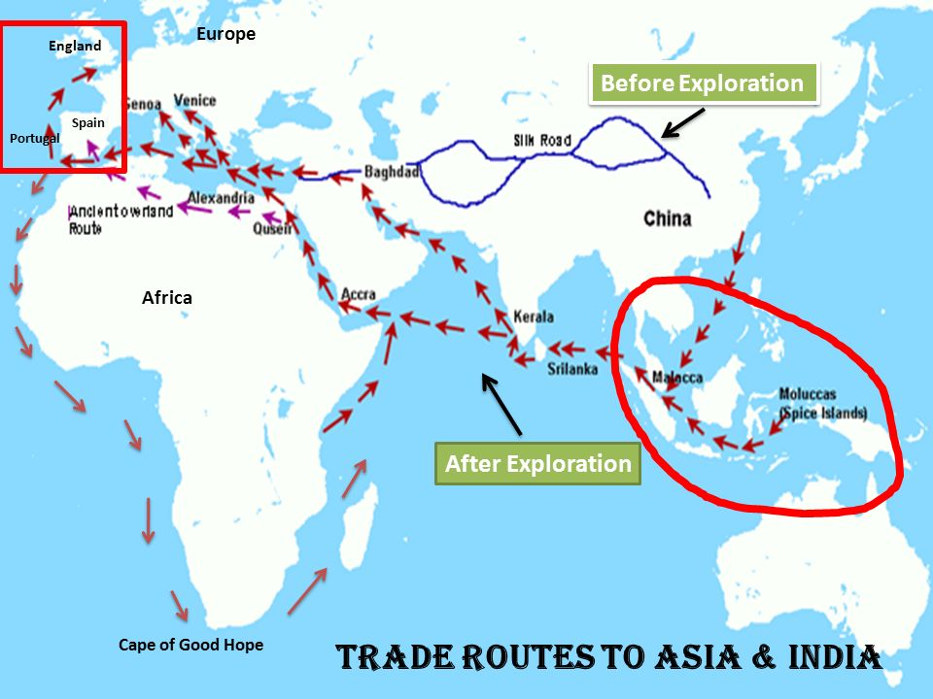

Slide 3
Chapter 6, Section 3: SOUTHEAST ASIA IN THE ERA OF THE SPICE TRADE
Go over Section 6.3 outline & Questions
Trade routes map
Students will create a map of spice and slave trade routes.

Slide 4
Section 6.3 – Spice trade in southeast asia

Slide 5
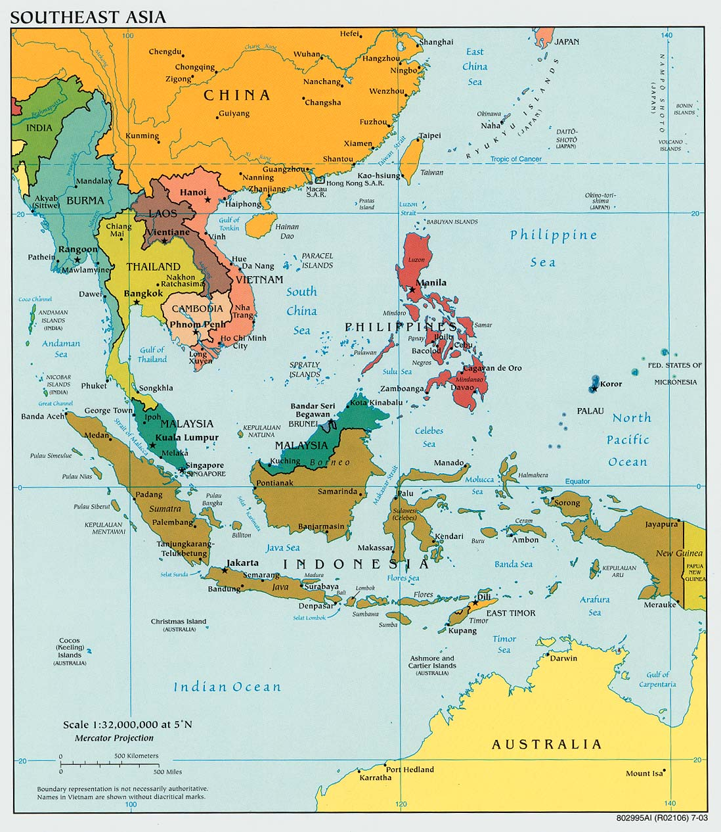

Slide 6
Emerging Mainland States
A. In 1500, mainland Southeast Asia was relatively stable. From Burma to Vietnam, kingdoms with their own ethnic, linguistic, and cultural characteristics were being formed.
B. Conflicts did erupt between the emerging states. Burma and Thailand clashed. The Vietnamese began their “March to the South.” By the end of the fifteenth century, they subdued the rival state of Champa. They then took control of the Mekong delta from the Khmer, a monarchy that virtually disappeared by 1800.

Slide 7
Emerging Mainland States
C. Muslim merchants penetrated the Malay Peninsula and the Indonesian archipelago. The major impact of Islam came in the fifteenth century with the rise of the new sultan at Melaka. Melaka was powerful because of its strategic location and the spice trade’s rapid growth. Melaka shortly became the leading power in the region.

Slide 8
Emerging Mainland States
D. The European success in creating trading empires in the East and conquering the Americas owed much to the use of gunpowder/guns and cannons. For example, the heavy cannon of the Portuguese ships made defeating the lighter Muslim fleets easy. The Ottoman and Safavid Empires also used gunpowder effectively, causing historians to label them and others “gunpowder empires.”

Slide 9
The Arrival of Europeans
A. In 1511, the Portuguese seized Melaka and soon occupied the Moluccas, or Spice Islands. They were the chief source of the spices that attracted the Portuguese to the Indian Ocean.

Slide 10
The Arrival of Europeans
B. The Portuguese were able to establish only trading posts and way stations en route to the Spice Islands. That situation changed with the arrival of the English and Dutch traders, who were better financed than the Portuguese. In the early 1600s, the Dutch gradually pushed the Portuguese out of the spice trade. The Dutch also drove the English out of the spice trade. The English were reduced to one port on the coast of Sumatra, and the Dutch occupied most of the formerly Portuguese forts along the trade routes, including Ceylon (present-day Sri Lanka).

Slide 11
The Arrival of Europeans
C. The Dutch began to consolidate their political and military control over the entire area. They brought the island of Java under their control and established a fort there to protect their possessions in the East. They used tactics such as trying to dominate the clove trade by limiting cultivation to one island and forcing others to stop growing and trading the spice.

Slide 13
The Arrival of Europeans
D. Europeans had less impact on the Southeast Asian mainland than on the Malay Peninsula and Indonesia. The Portuguese established limited trade relations with several mainland states (part of the continent, as opposed to peninsulas and offshore islands), including Thailand, Burma, Vietnam, and what remained of the old Angkor kingdom in Cambodia. European states also tried to gain missionary privileges. The mainland states generally were able to unite and drive the Europeans out.

Slide 14
The Arrival of Europeans
E. Civil war in Vietnam temporarily divided the country into two separate states. By the mid-seventeenth century, Europeans began to take sides in local politics. Soon, however, it became clear that the economic opportunities were limited and many Europeans pulled out. French missionaries tried to stay, but they were blocked in their efforts by authorities who saw Catholicism as a threat to the prestige of the Vietnamese emperor.

Slide 15
The Arrival of Europeans
F. The mainland states of Burma, Thailand, and Vietnam were able to resist the Europeans partly because they had strong monarchies that resisted foreign intrusion. Non-mainland states had less political unity. They were also victims of the fact that they were so rich in the spices that the Europeans coveted.

Slide 16
Religious and Political Systems
A. Between 1500 and 1800 religious beliefs changed in Southeast Asia. Islam and Christianity made converts in the non-mainland states and the Philippines. Buddhism was advancing in the mainland and became dominant from Burma to Vietnam. B. Politically, Southeast Asia evolved into four styles of monarchy: Buddhist, Javanese, Islamic, and Vietnamese.

Slide 17
Religious and Political Systems
C. The Buddhist style of kingship became the chief form of government in Burma, Thailand, Laos, and Cambodia. The king was considered superior to other human beings, serving as the link between human society and the universe.
D. Javanese kingship was rooted in Indian political traditions. Like Buddhist kings, Javanese rulers were believed to have a sacred quality, maintaining the balance between the material and spiritual worlds. The palace was designed to represent the center of the universe

Slide 18
Religious and Political Systems
E. Islamic sultans on the Malay Peninsula and some islands of the Indonesian archipelago were viewed as mortal, though with special qualities. They were defenders of the faith and staffed the bureaucracy—a body of nonelective government officials—with aristocrats.
F. Vietnamese kingship followed the Chinese model. The Vietnamese emperor ruled by Confucian principles. He was seen as a mortal appointed by Heaven to rule because of his talent and virtue. He also was an intermediary between Heaven and Earth.

Slide 19
Trade Routes Map
Include the following country’s trading routes on your map:
Spain – red or pink
England – blue or purple
Portugal - green
The Netherlands – orange or yellow
Read through your notes and record each instance of trade that is mentioned in the chapter. use pgs. 194 (read about Spain), 198 & 203
Include both the Spice Trade and Slave Trade (solid lines for slaves, dashed lines for spices), dotted lines for gold/Silver)
Label the countries/regions / continents that were involved with the trade:
-European countries
-African regions
-Ottoman Empire
-Southeast Asia
-the Americas

Slide 20
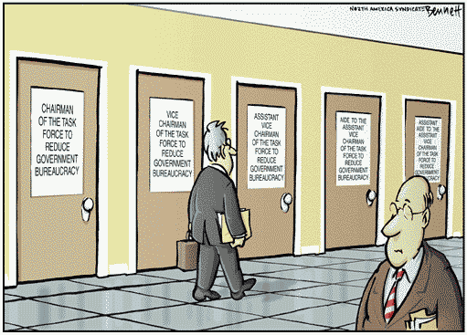
Bureaucracy

Slide 21
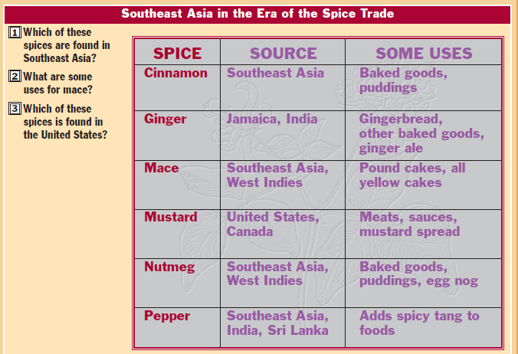
Introduction

