Slide 1
Arts & Humanities – lesson 7
Discuss 2nd semester
Romanticism & Realism lecture

Slide 2
Romanticism

Slide 3
The Romantic Movement
Began in the 1790s and peaked in the 1820s.
Mostly in Northern Europe, especially in Britain and Germany. Also idealized in the American West.
A reaction against classicism.

Slide 4
Characteristics of Romanticism
1. The Individual/ The Dreamer:
Individuals have unique, endless potential.
Self-realization comes through art
Artists are the true philosophers.

Slide 5
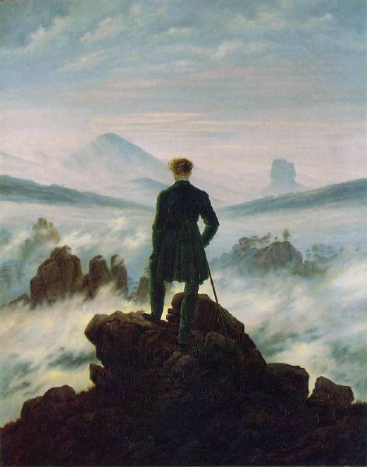
Wandering Above the Sea of Fog Caspar David Friedrich, 1818

Slide 6
Characteristics of Romanticism
2. Glorification of Nature:
Peaceful, restorative qualities [an escape from industrialization]
Awesome, powerful, horrifying aspects of nature.
Indifferent to the fate of humans.
Overwhelming power of nature.

Slide 7
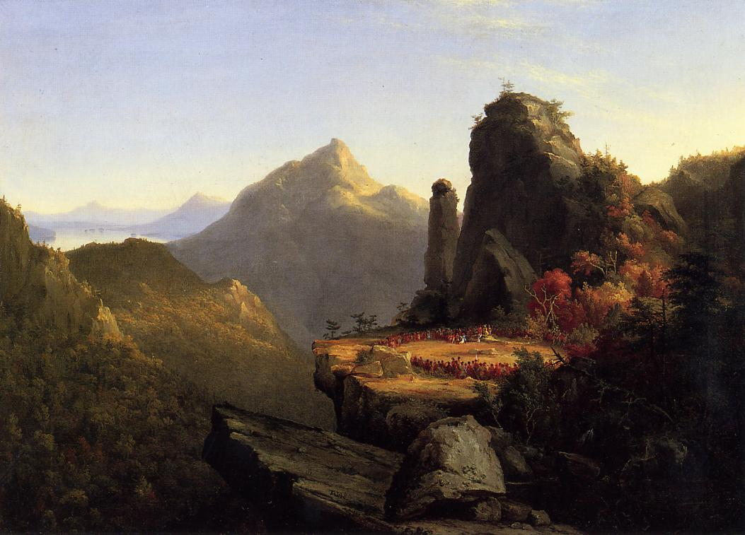
Last of the Mohicans, Thomas Cole, 1827

Slide 8
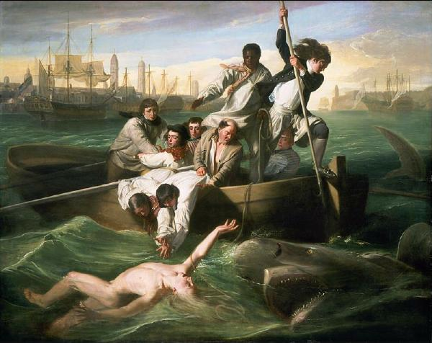
Watson and the Shark John Singleton Copley 1778

Slide 9
Characteristics of Romanticism
3. Revival of Past Styles:
Gothic & Romanesque revival.
Medieval themes were a favorite for art and poetry.

Slide 10
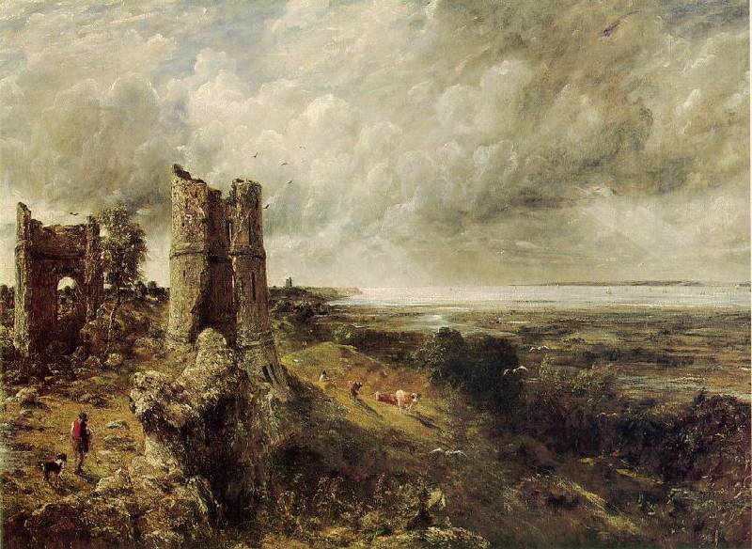
Hadleigh Castle - John Constable, 1829

Slide 11
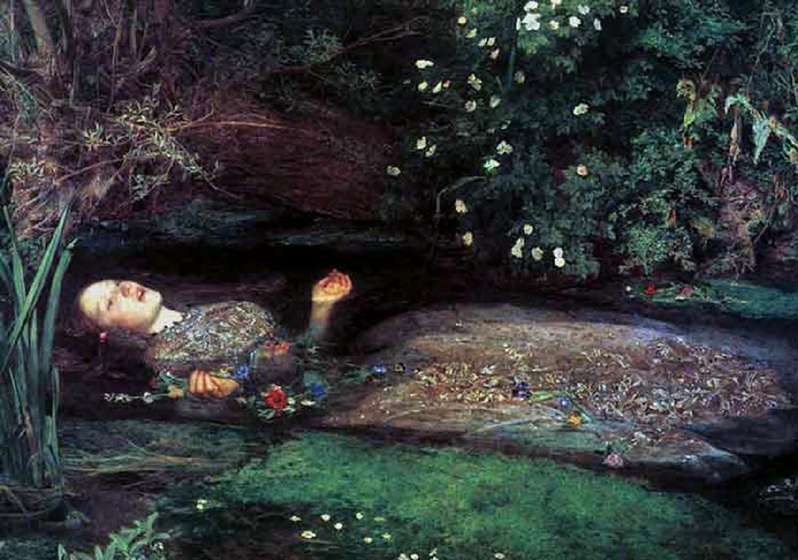
Ophelia, John Everett Millais, 1851

Slide 12
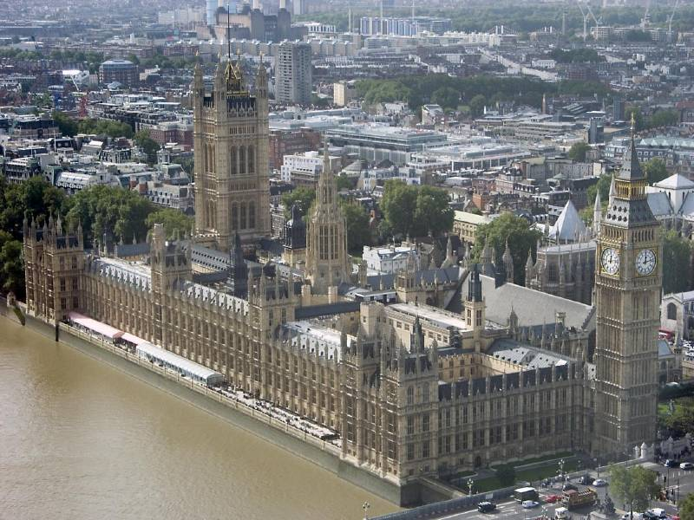
British Houses of Parliament 1840-1865 (Gothic Revival)

Slide 13
Characteristics of Romanticism
4. The Supernatural:
Ghosts, fairies, witches, demons.
The shadows of the mind—dreams & madness.

Slide 14
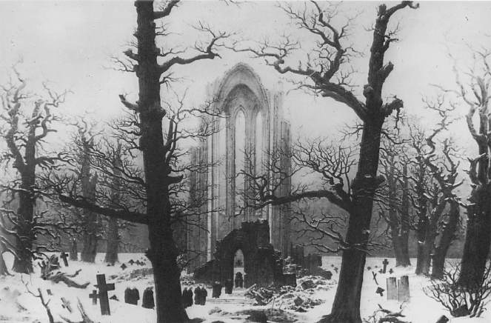
Cloister Cemetery in the Snow Caspar David Friedrich, 1817-1819

Slide 15
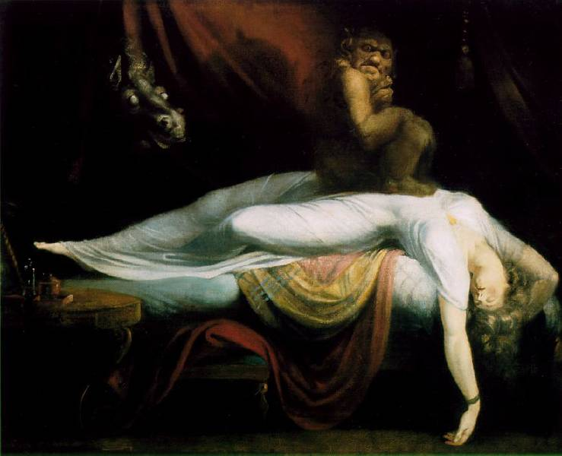
Nightmare (The Incubus) Henry Fuseli, 1781

Slide 16
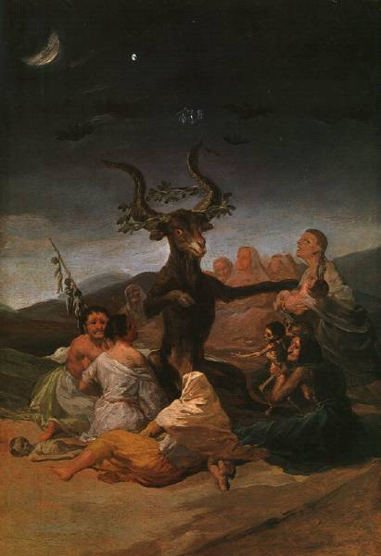
Witches Sabbath Francisco Goya, 1798

Slide 17
Characteristics of Romanticism
5. Exoticism:
Interest in foreign places, things
A sense of escape from reality.
Moral justification of imperialism?

Slide 18
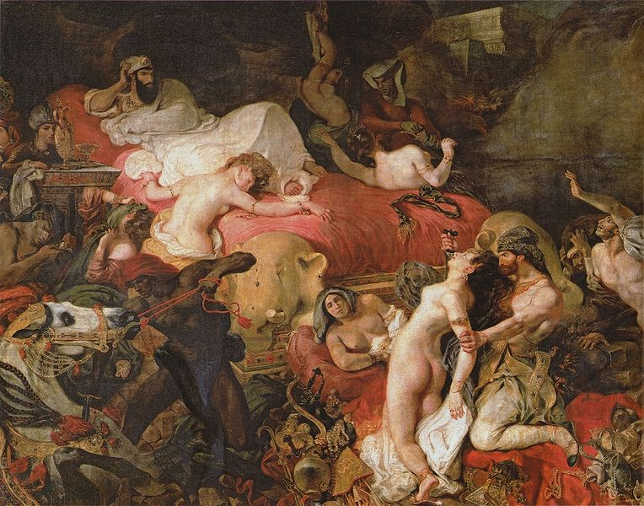
Death of Sardanapalus, Eugene Delacroix, 1821

Slide 19
Characteristics of Romanticism
6. Drama / Tragedy:
Heroism
Scenes of battle, sacrifice
Glorification of historic events

Slide 20
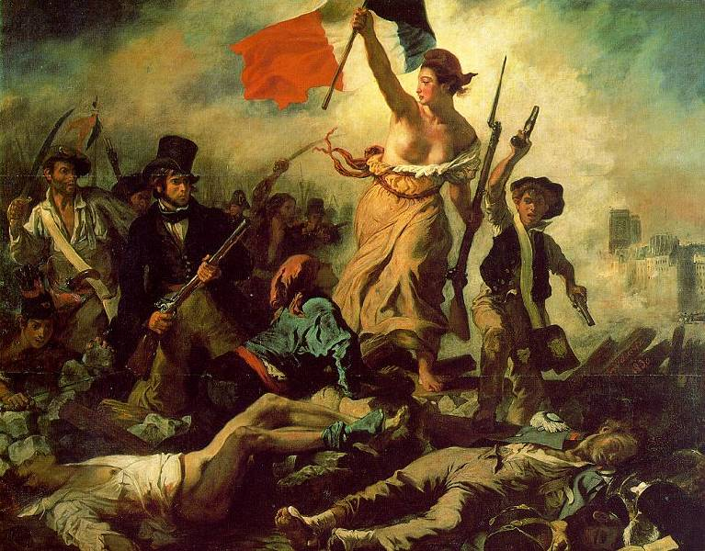
Liberty Leading the People, 1830
Nationalism of France

Slide 21
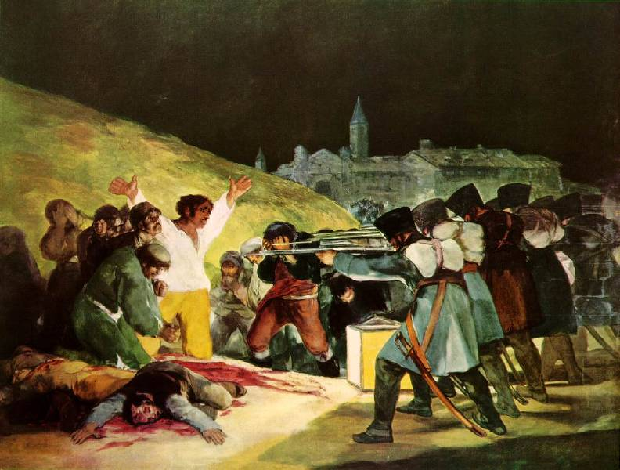
Third of May, 1808 Francisco Goya, 1815

Slide 22
The Great Age of the Novel
Gothic Novel: Jane Eyre - Charlotte Bronte (1847) Frankenstein- Mary Shelley (1818)
Historical Novel: Les Miserables - Victor Hugo (1862) The Three Musketeers – Alexander Dumas (1844)

Slide 23
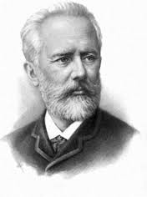
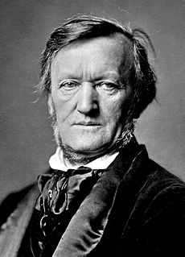
Romantic Music
Pyotr Tchaikovsky – Russian composer famous for writing the music for
the Nutcracker, Sleeping Beauty, Swan Lake, and the 1812 Overture.
His music often evokes strong emotional responses of love, nationalism, and
drama.
1812 - https://www.youtube.com/watch?v=VbxgYlcNxE8 (13:45)
Swan Lake - https://www.youtube.com/watch?v=SDhq70yrtiI
Sleeping Beauty Waltz - https://www.youtube.com/watch?v=2Sb8WCPjPDs (:40)
Richard Wagner – German composer famous for his dramatic operas
and developing the concept of Gesamtkunstwerk (“total art work”),
the total integration of music and drama. He was very interested in the
cultures of ancient Greece and the Vikings. His most famous opera is
the seventeen-hour cycle, Der Ring des Nibelungen.
Ride of the Valkyries - https://www.youtube.com/watch?v=GGU1P6lBW6Q

