Slide 1
Ch. 23,25 – Revolutions & Unifications
Group propaganda assignment:
France – p. 777-780
Austria-Hungry – p. 780
Prussia – p. 781-782
Italy – p. 826-829
Germany (under Bismarck) – p. 829 – 833
Russia – p. 837 - 838

Slide 2
Revolutions & Unifications of the late 19th, early 20th centuries
Finish Propaganda and revolutions and unifications assignment; present tomorrow
Otto Von Bismarck video
HW: Outline – “Nation Building in the US” and “Modernization of Russia” (p.833-838)

Slide 3
Revolutions & Unifications of the late 19th, early 20th centuries
Present Propaganda and revolutions and unifications assignment; lecture & videos
HW: Outline – “The Responsive National State, 1871 - 1914” (p.838 - 846)

Slide 4
Tom Richey – Revolutions of 1848
https://www.youtube.com/watch?v=fiUvF060u_4

Slide 5
Why Revolutions in Europe?
Causes:
Resentment over Conservative policies of Congress of Vienna
Hunger
Nationalism
Influence of Socialist economic policies

Slide 6
Why Failure?
Groups can’t agree how to run
Middle class & workers
Conservative monarchs remove workers from revolution (destroy coalitions)
Labor laws & social reform
Middle class no support

Slide 7
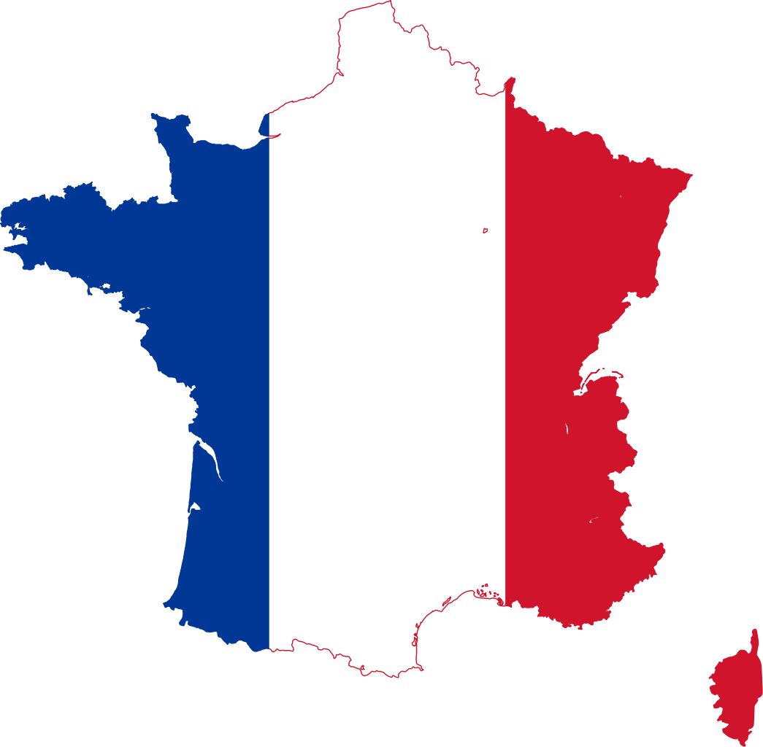
France

Slide 8
Bourbons Lose Power
1830- Short, nearly bloodless revolution
Last Bourbon- Charles X
Caused own demise- ignored middle class liberals & Parisian radicals
Tried to rule as absolute monarch

Slide 9
Revolutions Starts
Charles X eliminates few powers held by Chamber of Deputies
Liberals & radicals riot
Charles flees to GB

Slide 10
The New King
Crown offered to Charles’ cousin, Louis Philippe
Sympathetic to liberal reform
Louis Philippe ruled as “citizen king” and shared power w/ Chamber of Deputies
Ruled until 1848 revolutions

Slide 11
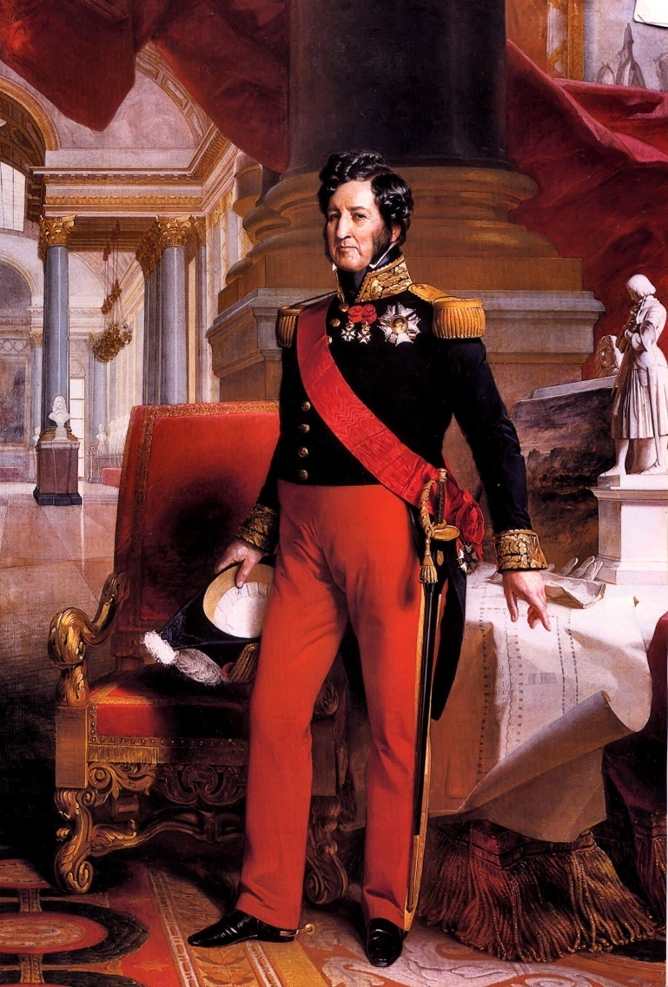
Louis Philippe → The “Citizen King”
The Duke of Orleans
Lead a thoroughly bourgeois life.
His Program:
Property qualifications reduced enough to double eligible voters.
Press censorship abolished.
The King ruled by the will of the people, not by the will of God.
The Revolution’s tricolor replaced the Bourbon flag.
The government was now under the control of the wealthy middle class.
(r. 1830-1848)

Slide 12
Why Revolt?
Only country where:
demand for democratic govt. = main point for revolution
Radicals force in revolution
Late 1840’s- Louis Philippe refuses demands of Chamber of Deputies to be more democratic
People rise up, govt. falls

Slide 13
Replacement Govt.
Temporary govt. led by Alphonse de Lamartine
Romantic poet
France declared Republic
Republic divided= falls apart

Slide 14
Divided Republic
Lamartine-only political reform
Louis Blanc- political and economic reform
Govt. create jobs for unemployed
“workshops”- shut down by Lamartine
Result: bloody street battles in Paris

Slide 15
More Problems
Workers opposed
Liberals afraid social reform will lead to loss of economic power
Conservatives fear loss of land
Both do NOT want to lose economic power
Change from French Revolution

Slide 16
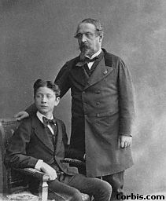
Napoleon III

Slide 17
Result of Violence
Radicals’ violence= France becomes more moderate liberal govt.
1848 Constitution- Parliament and Strong president elected by people
1848 election- Louis Napoleon Bonaparte (nephew)- won election

Slide 18
Support for Louis
Peasants- resented Paris’ dominance in politics
Wanted peace and order

Slide 19
Louis Breaks Oath
Napoleon’s constitution adopted
Louis becomes Emperor Napoleon III (rulers 20 yrs)
Why did people accept this? PEACE
How did a conservative, absolutist come to power in a democratic election?

Slide 20
Third Republic
Formed after Franco-Prussian War (by National Assembly)
March 1871 Paris Commune (radical govt.) took control of Paris
War w/ National Assembly- Parisian workers v. assembly's army
May 1871- Commune defeated

Slide 21
Third Republic
1875 Nat’l Assembly decided on new govt.
Third Republic- lasted 60 yrs.
France still divided- many political parties want power
1871-1914- France averaged change of govt. every 10 years

Slide 22
France – Tom Richey
https://www.youtube.com/watch?v=VlQQU_Vs3_c

Slide 23
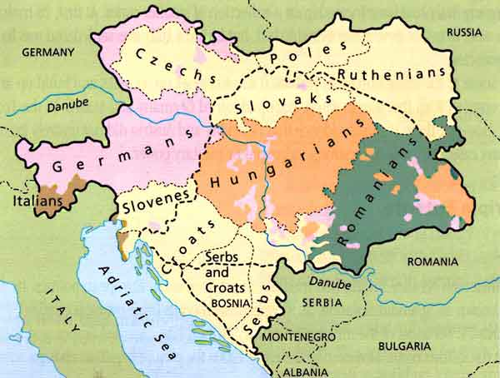
Austria-Hungary

Slide 24
Background
Working class radicals and middle class realize Metternich system not working
Push for nation-states (various cultures living within one “country)
First half of 1848- 50 revolts in Europe
Russia and GB only major countries not affected

Slide 25
Austria- Hungary Hapsburgs
Empire too ethnically diverse
Nationalism-problem made worse
Vienna uprising- led by students for political power
Metternich driven out
Austrians abolish serfdom
Revolutionary spirit diminished
Documents burned (Great Fear)

Slide 26
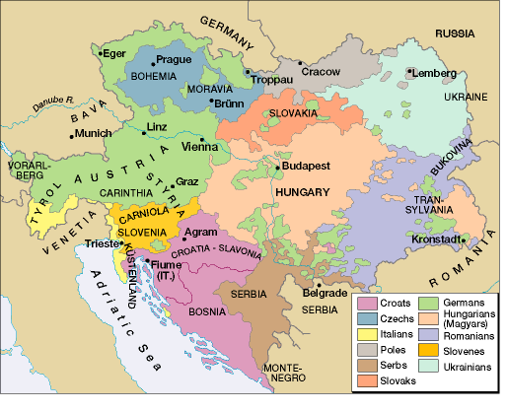
Differing Nationalities in the Austrian Empire

Slide 27
Austria- Hungary
Magyars- more culturally diverse than Vienna
Desire to eliminate Austrian rule
Est. Hungarian nation-state
Want to rule: Romanians, Serbians, Croatians

Slide 28
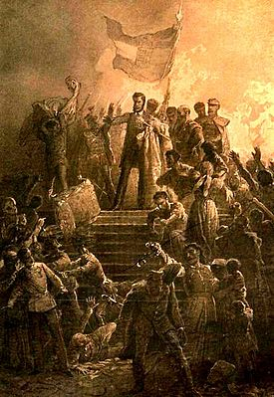
Austria- Hungary
Czechs wanted own country
Slovaks resisted
Groups wanting independence
Czechs, Slovakians, Germans
Germans look to Prussians
Slavs look to Russians
No unity= revolt unsuccessful

Slide 29
Reactions to 1848 Revolts
Rulers initially caught off guard
Concessions granted to rebels
Prussia’s King Frederick William IV- election of democratic parliament and all-German parliament
Hungary-temporary freedom from Austria
Austria seemed to be falling apart

Slide 30
Reactions to 1848 Revolts
Summer- Rebels in disagreement What to do now?
Rulers had time to regain power
Pose counter-revolution with armies
1849 things back to 1848 status
Forces of changed only contained, independence movements will emerge again

Slide 31
Austria’s Fate
Wanted to rebuild after Austro-Prussian War but nationalities they ruled were unhappy
1867- Dual monarchy est.
Austria and Hungary 2 independent and equal states
Common ruler, with own Parliament
United army

Slide 32
https://www.youtube.com/watch?v=1leV_OY3BeA
Tom Richey – Prussia (German States)

Slide 33
Italian
Unification

Slide 34
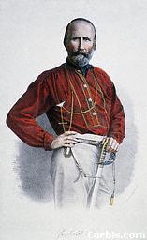
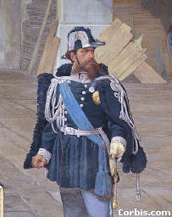
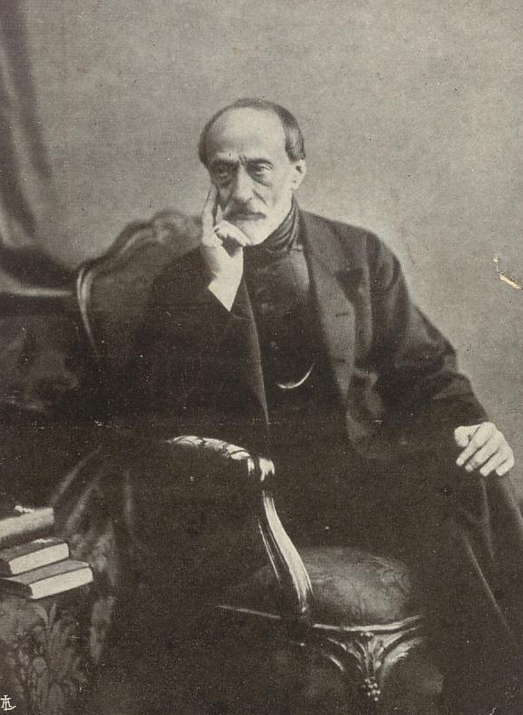
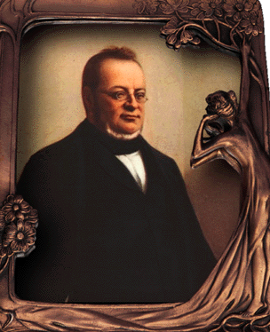
Italian Nationalist Leaders
Giuseppi Garibaldi [The “Sword”]
King Victor Emmanuel II
[“The Crown”]
Count Cavour [The “Head”]
Giuseppi Mazzini [The “Heart”]

Slide 35
Italy
1805 Napoleon combined separate states into Kingdom of Italy
Ruled by France
1848 revolts affected 8 Italian states
Mazzini headed Republican govt. in Rome
Mazzini sparks Italian nationalism
Young Italy- mid class, under 40
Italy divided
Nationalists want unity
Austria, Spain, Pope want independent states

Slide 36
Italy
Nationalism had little mass support
Cultural differences (N. v. S. Italy)
Educated & mid class
Austria was obstacle
Metternich saw nationalism as threat (arrested Mazzini)
Nationalism was encouraged liberal ideas

Slide 37
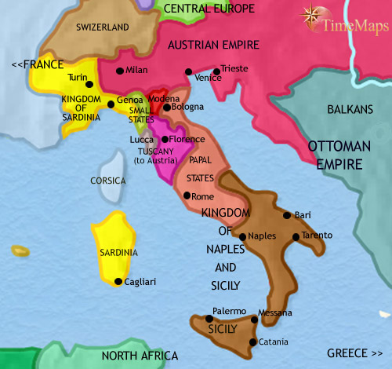

Slide 38
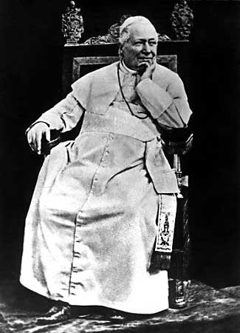
Pope Pius IX: The “Spoiler”?
Syllabus of Errors – denounces the
separation of church and state

Slide 39
Cavour, Napoleon III, and Austria
Camillo di Cavour wants to unite Northern Italy and Sardinia
Victor Emmanuel would be king but needed to drive Austria out of Lombardy and Venetia.
He turns to Napoleon III to help fight against Austria
France and Sardinia defeat Austria in 1859 but Napoleon III decides that he cannot made enemies with the papal states to the South, so he makes a compromise with Austria: Northern Italy will only receive Lombardy (not Venetia). Cavour resigns.

Slide 40
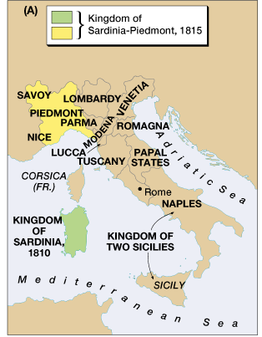
Sardinia-Piedmont: The “Magnet”
Italian unification movement: Risorgimento [“Resurgence”]

Slide 41
Return of Cavour and Nationalist Support
Nationalists in Central Italy drive out the princes and call for unity with Sardinia.
Cavour returns in 1860 after nationalists in central Italy fuel the desire for unity
Cavour gains Napoleon’s favor again by ceding Savoy and Nice to France.
Italian nationalist and patriot Giuseppe Garibaldi leads Guerilla army of Red Shirts to liberate the kingdom of the Two Sicilies which were under the control of the papacy. Cavour sends armies to papal states to occupy and help Red Shirts.

Slide 42
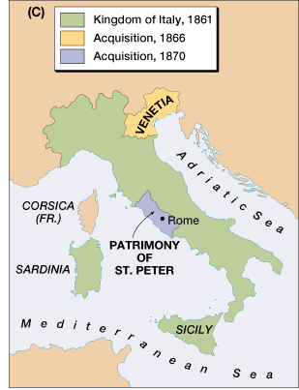
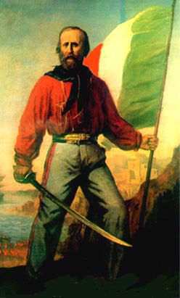
Garibaldi & His “Red Shirts” Unite with Cavour

Slide 43
Unification
To keep peace with France, Cavour instead orders a vote for the people of the south to join Sardinia. Thus Italy was unified into one nation by 1870 and became a parliamentary monarchy under King Victor Emmanuel.

Slide 44
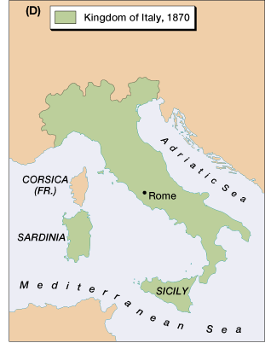
French Troops Leave Rome, 1870
Italy is united!

Slide 45
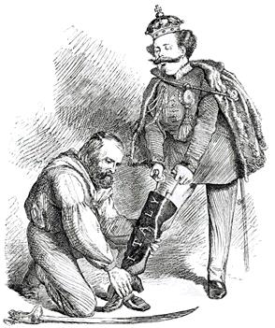
A Unified Peninsula!
A contemporary British cartoon, entitled "Right Leg in the Boot at Last," shows Garibaldi helping Victor Emmanuel put on the Italian boot.

Slide 46
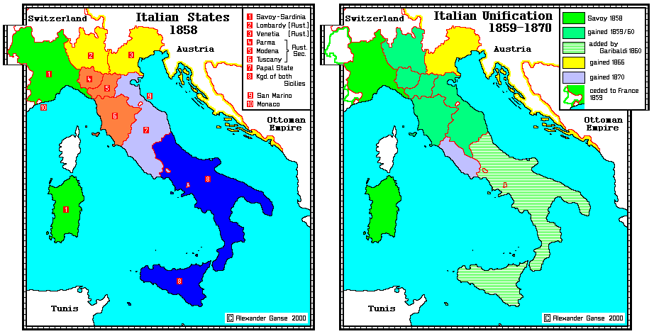

Slide 47
https://www.youtube.com/watch?v=9SjTNUJgrqY&feature=iv&src_vid=1leV_OY3BeA&annotation_id=annotation_3351424463
Tom Richey – Italy (1848)
https://www.youtube.com/watch?v=wl4Us_lUJeA
Paul Sargent – Italian Unification

Slide 48
German
Unification

Slide 49
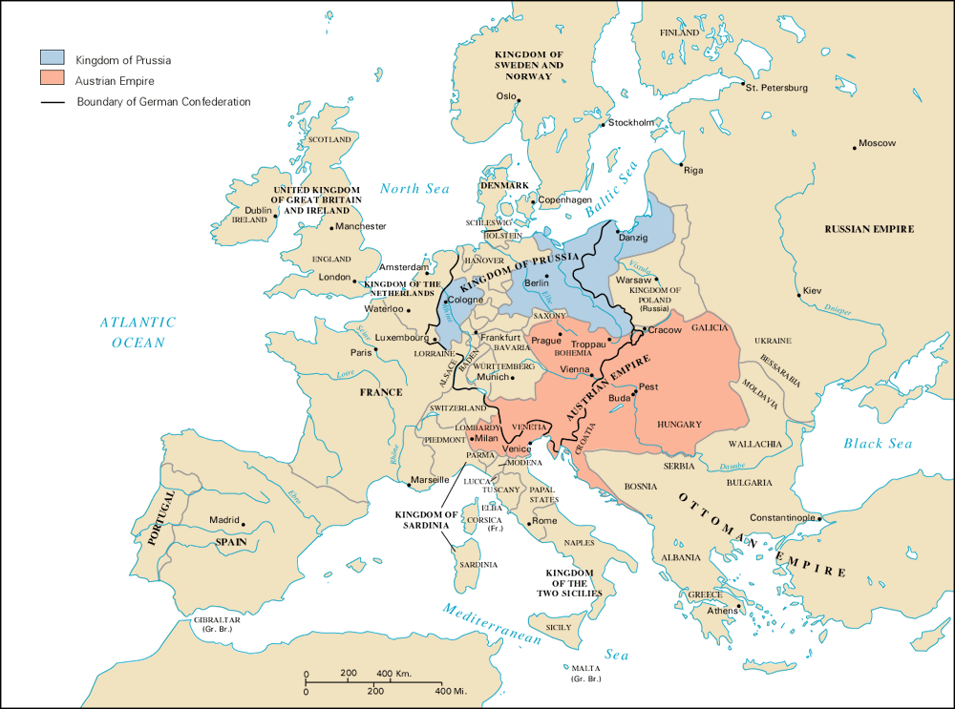
Prussia/Austria Rivalry

Slide 50
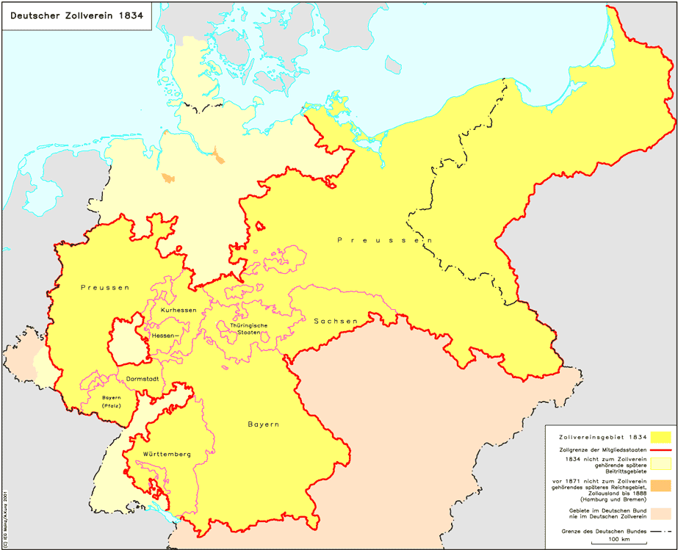
Zollverein, 1834

Slide 51
Germany
39 different “countries”
Loose confederation made at Congress at Vienna
1st step toward unification
Diet- all German parliament
Powerless- no army to enforce decisions
Could NOT make laws w/out total approval (Prussia & Austria)

Slide 52
Germany
Liberals and nationalists wanted unity
1815 Austria was most powerful state
Germans most dominant national group
Political, military leaders

Slide 53
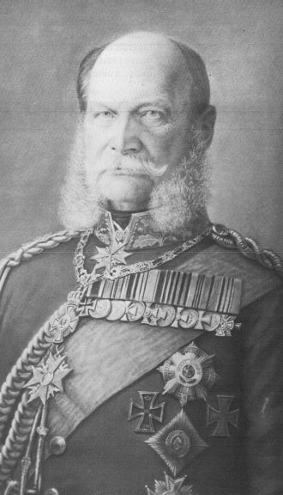
Kaiser Wilhelm I

Slide 54
Prussia
Conservative
Most adult men voted
Parliament had little power
King Wilhelm I (Hohenzollern)- almost unlimited power, ministers wealthy landlords
Middle class little political power
1862 Wilhelm I names Bismarck PM

Slide 55
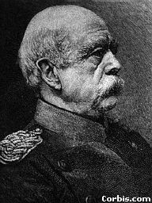
Bismarck
Goal: make Prussia head of United Germany
Austria main rival
Unite Germany by “blood and iron”
Unification through war

Slide 56
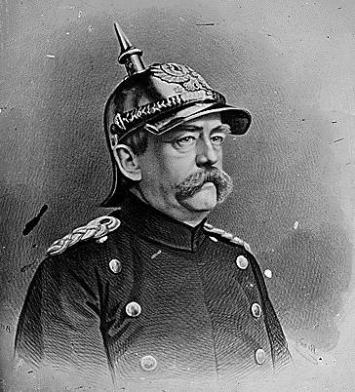
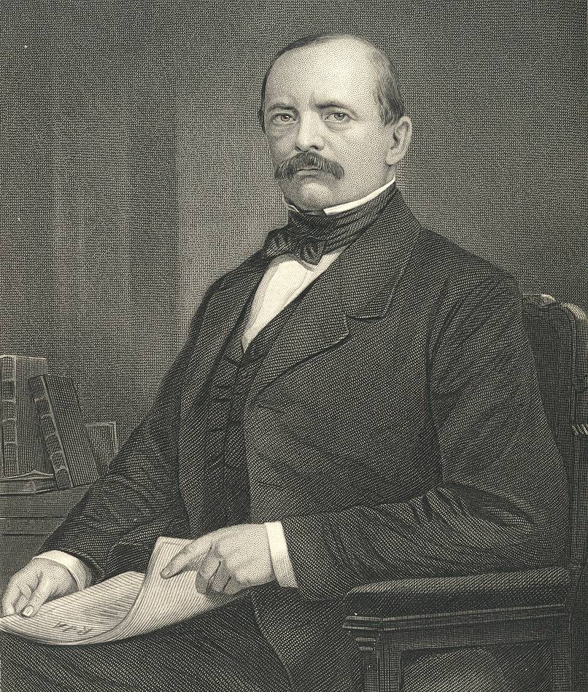
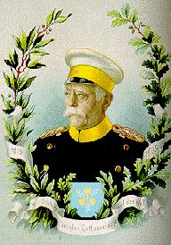
Chancellor Otto von Bismarck
The “Iron Chancellor”
Realpolitik
“Blood & Iron”

Slide 57
The First Step
Increase Prussia’s power
1864 war with Denmark
Gain Schleswig & Holstein- Germans lived there
builds Prussian pride, respect from other Germans

Slide 58
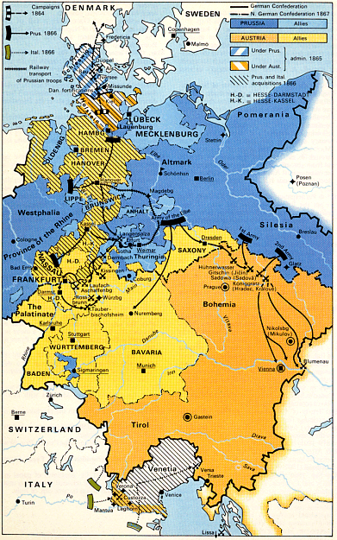
Step #1: The Danish War [1864]
The Peace of Vienna

Slide 59
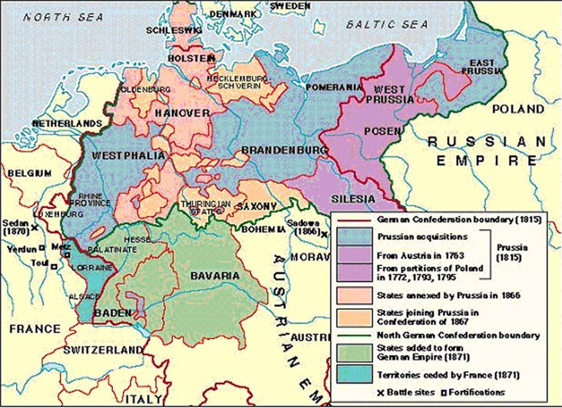

Slide 60
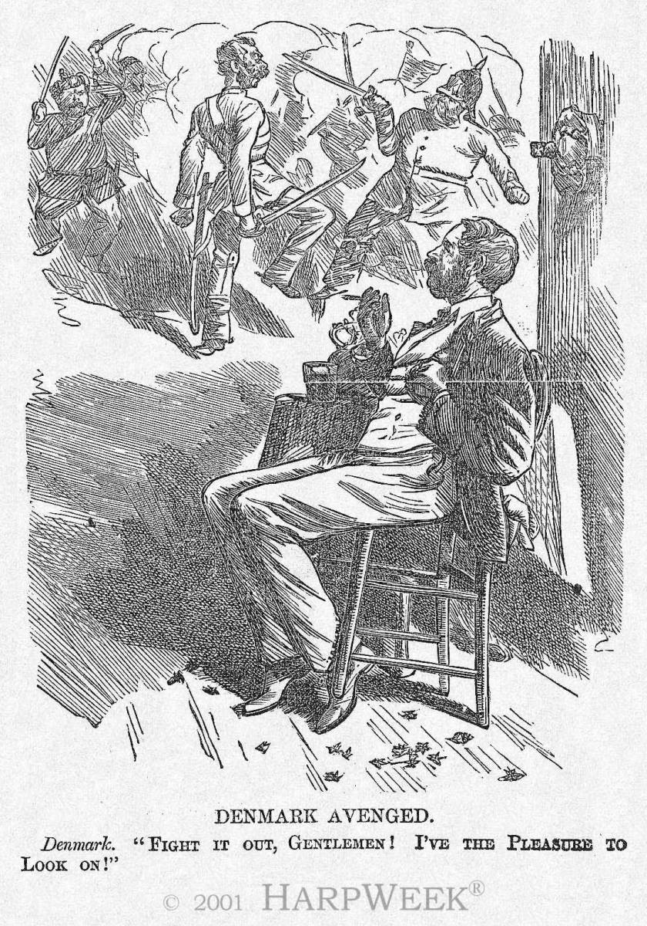
Step #2: Austro-Prussian War [Seven Weeks’ War], 1866
Prussia
Austria

Slide 61
Alliances
Russia- supported suppression of Polish Revolt
France- neutral in Austro-Prussian conflict
Italy- would give Venetia to them in exchange for attacking Austria

Slide 62
7 Weeks War
1866 Bismarck provokes war with Austria
RRs – Prussian military moves faster than Austrian
Prussia uses superior training and equipment
Austria loses
Austria lost land to Prussia, Venetia to Italy
Austria forced out of German Confederation
Prussia controlled N. Germany
1st time- East and West Prussian Kingdoms joined

Slide 63
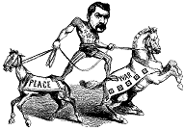
Step #3: Creation of the Northern German Confederation, 1867
Shortly following the victory of Prussia, Bismarck eliminated the Austrian led German Confederation.
He then established a new North German Confederation which Prussia could control → Peace of Prague

Slide 65
Problems Remain
1867 Remaining N. German states join Ger. Confederation
Prussia dominates
North and South still not divided
N.- Protestant
S.- Catholic (fear of domination)

Slide 66
Franco-Prussian War

Slide 67
Bismarck’s Plan
Outside threat bring S. Germany in
France was outside threat because of Catholic unity and because Bismarck wants to flex new German muscles

Slide 68
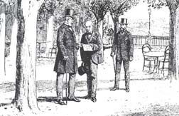
Step #4: Ems Dispatch [1870]: Catalyst for War
1868 revolt in Spain and Queen
is overthrown.
Spanish leaders wanted Prince Leopold von Hohenzollern. [a cousin to the Kaiser & a Catholic], as their new king.
France protested [afraid to be surrounded by Hohenzollern family]
The French Ambassador asked the Kaiser at Ems to apologize to Nap. III for supporting Leopold.
Bismarck “doctored” the telegram from Wilhelm to the French Ambassador to make it seem as though the Kaiser had insulted Napoleon III.

Slide 69
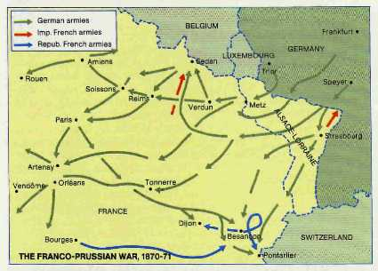
Step #5: Franco-Prussian War [1870-1871]
German soldiers “abusing” the French.

Slide 70
War Starts
June 19, 1870- France declares war on Prussia
Prussian armies pour into France before France can mobilize
Sept. 1870- main French fort surrounded
4 months later French give in to hunger

Slide 71
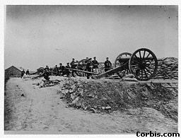
Franco-Prussian War

Slide 72
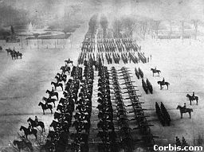
Germans in Paris

Slide 73
War Ends
France paid Prussia 5 billion francs
France gives up Alsace-Lorraine (coal and iron)
Final step in Unification
Nationalism
Jan. 18, 1871- Wilhelm I of Prussia crowned Kaiser (2nd Reich)

Slide 74
Treaty of Frankfurt [1871]
The Second French Empire collapsed and was replaced by the Third French Empire.
France paid a huge indemnity and was occupied by German troops until it was paid.
France ceded Alsace-Lorraine to Germany [a region rich in iron deposits with a flourishing textile industry].

Slide 75
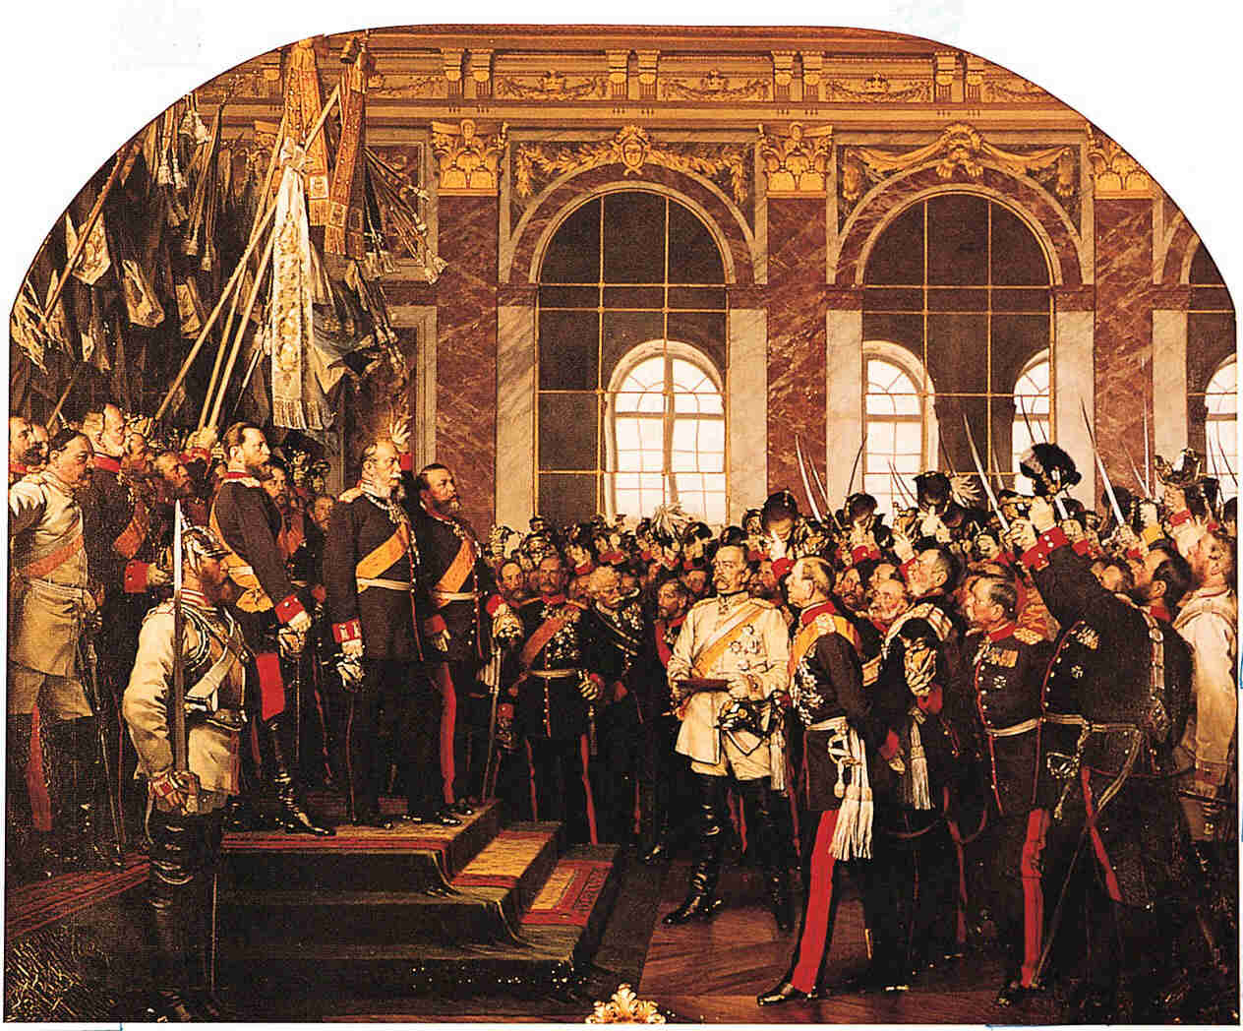
Coronation of Kaiser Wilhelm I [r. 1871–1888]

Slide 76
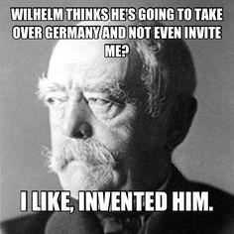

Slide 78
Russia

Slide 79
Russia
Weaknesses:
little industry
inefficient agriculture
serfs (80%) tied to land- uneducated, poor, no incentive to work
stern rule of czar
political tension between nationalities
1800’s attempt to expand Pan-Slavism
gain access to Mediterranean

Slide 80
Decembrist Revolt
Alexander I dies- army officers revolt
Officers had contact with West (Napoleonic Wars)
Goal: written constitution (Western-style rights)

Slide 81
Repression and Nicholas I
1825 Decembrist Revolt crushed
Russification- force Russian language, culture and subject nations
Destroy nationalism and revolts
Serfdom not abolished- needed support of the wealthy
500 peasant revolts crushed
Westernization hampered

Slide 82
The Crimean War [1854-1856]
Russia [claimed protectorship over the Orthodox Christians in the Ottoman Empire]
Ottoman Empire
Great Britain
France
Piedmont-Sardinia
Summary
https://www.youtube.com/watch?v=F_SMMpUFZT0

Slide 83
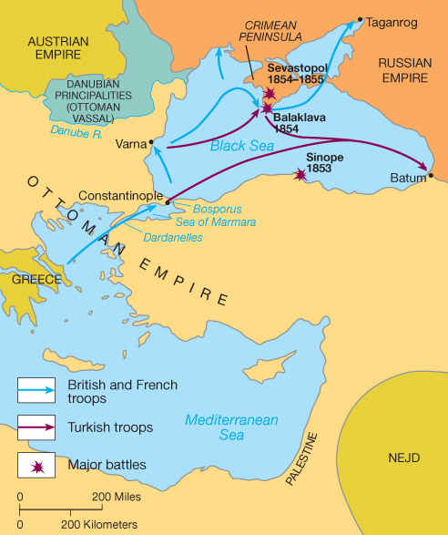
The Crimean War [1854-1856]

Slide 84
Treaty of Paris [1856]
No Russian or Ottoman naval forces on the Black Sea.
All the major powers agreed to respect the political integrity of the Ottoman Empire.
Made Russia realize that they were significantly behind in industrialization and modernization.

Slide 85
Repression and Nicholas I
“Fight revolutionary spirit”
Limited education
Books and newspapers censored
Secret police
Crimean Wars lost- Russia behind

Slide 86
Reforms and Alexander II
Reform needed for Westernization
1861 Serfdom abolished
1/2 land remained for nobles
1/2 mirs (village commumities)- SOLD money for govt.
Peasants still tied to land (not allowed to leave, others would have to pay more)

Slide 87
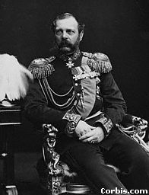
Alexander II

Slide 88
More Reforms
Zemstvos- people gain some control over affairs
local councils- nobles, townspeople, peasants
More schools
Court system modernized
Army reformed
Economic development encouraged with building of railroads and factories

Slide 89
1863 Polish Revolt
Reform ended
Russification pushed in Poland
led to more Polish nationalism

Slide 90
1870 Will of the People
Russian nationalists
officials murdered
bomb kills Czar Alexander in 1881

Slide 91
Repression and Alexander III
Russia becomes a police state to end revolutionary activity
power of zemstvos reduced
persecution of Jews- pogroms
Russification- Autocracy, Orthodoxy, Nationalism
Nationalism still grows
Industrialization continues
Russia still behind rest of world

Slide 92
Political Upheaval
War between China/Russia and Japan over Manchuria caused political upheaval at home in Russia After defeats by Japan
Workers wanted reform and presented a petition to the czar but troops opened fire on the crowd - Bloody Sunday, Jan. 1905
This caused more uprising by working class
Duma (elected parliament) was put into place after issue of October Manifesto but was dismissed in 1907; workers and liberal middle class still not happy…

