Slide 1
Eastern European Revolutions
Complete the chart and discussion questions for Eastern European nations using C. 31

Slide 2
Soviet Union & Eastern Europe – 1980s & 1990s
Discuss Soviet Union 1980s; finish chapt. 30 questions (if not complete)
HW: “Revolutions of 1989” (p.1034 – 1040); fill out Eastern European Revolutions chart (minus Yugoslavia)

Slide 3
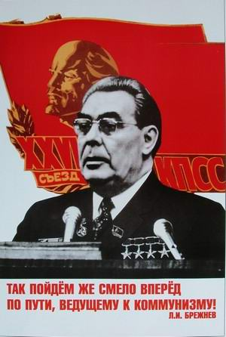
THE BREZHNEV ERA – the ‘70s – “re-Stalinization”
Re-imposed Stalinist system, but without terror
Political dictatorship
Party control over all aspects of Soviet life
Command economy
Propaganda & manipulation of media
Suspicious & confrontational attitude towards outside world

Slide 4
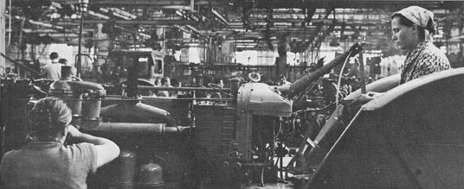
THE BREZHNEV ERA
Low productivity
Overemployment
Declining food supply
Inadequate infrastructure

Slide 5
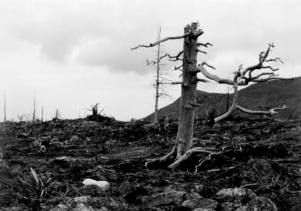
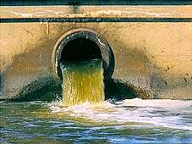
THE BREZHNEV ERA
Economic Stagnation
and Decline
Depletion of natural & human resources
Environmental damage
Inherent flaws of “command-administrative” system

Slide 6
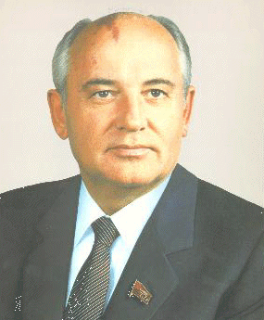
Gorbachev

Slide 7
Future of Reform – what happens in the ‘80s
Within three years of the death of Soviet leader Leonid Brezhnev in 1982, following the brief "interregna," Gorbachev was elected General Secretary by the Politburo in 1985.
Soviet army pulled from Afghanistan
Nuclear weapons reduced
Satellite nations were surrendered
Germany is permitted to reunify

Slide 8
Perestroika
1986 “Economic Restructuring”
Economic hardship (trying to shift system without tools or training)
Problems= central planning
Local managers= more authority
Laws allow for private business
Severe need for new technology
https://www.youtube.com/watch?v=UBOZOPS3G4w :56

Slide 9
Glasnost
1986 “Openness”
Lenin through Brezhnev (minus a little Khrushchev)= totalitarian state
Religion accepted, not liked
Christians open churches, Jews leave
Dissidents released
Controls relaxed (censorship)
Criticize govt, examine social problems

Slide 10
Two Dissidents
Alexander Solzhenitsyn
Criticized Stalin
Sent to gulag, wrote book
1974- forced out of USSR, to US
Andrei Sakharov
Helped develop hydrogen bomb
Returned to Moscow under glasnost

Slide 11
Demokratizatsiya
1989 Economic success- Party must loosen control
Multi-candidate elections
Secret ballot
New legislature Congress of Peoples’ Deputies (still only 1 party)
Gorbachev elected President – hardline communists DO NOT LIKE THIS

Slide 12
Economic Reform
Market economy replaces central planning
Individual enterprise, private property
Foreign Investments
Socialism emphasized (not quite Capitalism)
Reform brings higher standard of living and problems

Slide 13
Economic Problems
Chernobyl Accident- Explosion at a nuclear power plant in Ukraine
Economy and standard of living fall
Lack of cohesion emerged
Communism had led to artificial unity
Freedom and democracy provoke dissatisfaction
Ethnic/national groups want independence
Yeltsin (leader of Russian Federation’s Parliament) and Russian Republic declare independence

Slide 14
Revolutions in Eastern Europe
People in Eastern Europe were not always happy with Soviet style Communist Governments
Gorbachev made it clear that the Soviet Union would not intervene anymore militarily in their countries (No more Brezhnev Doctrine)
Led to revolutions breaking out throughout Eastern Europe

Slide 15
POLAND
Workers protest led to change
1980- Worker named Lech Walesa organized national trade union know as Solidarity, quickly gained support of works and the Roman Catholic Church – Gdansk Agreement
Walesa gets arrested but protest continues
In 1988, the Polish government agreed to free parliamentary elections—the first free elections in Eastern Europe in 40 years.
A new government was elected, ending 45 years of Communist rule in Poland.
December 1990, Walesa was chosen as president.
Shock Therapy - Free-market reforms led to severe unemployment and discontent.
1995, Aleksander Kwasniewski, a former Communist, defeated Walesa and became the new president.
Continued Poland’s move toward a prosperous free market economy.

Slide 16
Revolutions of 1989 and Disbanding of the Soviet Union
Today: Discuss revolutions of ’89, disbanding of Soviet Union, German reunification
Tomorrow: Yeltsin, Putin, Yugoslavia
Wednesday: EU, Globalization, Immigration
HW: outline - “Building a new Empire in the 1990s” (p. 1040 – 1051)

Slide 17
Hungary
Under Janos Kadar- communist dictatorship, but with some liberal reforms
Reform- free enterprise, stock market,
New constitution- free parliamentary elections (multi-party) 1989
Oct. 1989 Radicals depose Communists
Communists vote itself out
New govt.= conservative govt.

Slide 18
Czechoslovakia
Velvet Revolution - Mass demonstrations took place in 1988 and 1989.
In December 1989, the Communist government collapsed and elected Vaclav Havel as president.
The new government in Czechoslovakia faced old ethnic conflicts.
The two national groups, Czechs and Slovaks, agreed to a peaceful division of the country.
January 1, 1993, Czechoslovakia split into the Czech Republic and Slovakia.

Slide 19
ROMANIA
1965-Communist leader Nicolae Ceausescu had set up a dictatorship
He used secret police to crush all dissent.
His economic policies led to a sharp drop in living standards, including food shortages and the rationing of bread, flour, and sugar.
His plan for rapid urbanization made the Romanian people angry.
Entire villages were bulldozed as part of the plan.
December 1989, the secret police murdered thousands of people who were peacefully demonstrating.
The army refused to support any more repression. Ceausescu and his wife were captured and executed.
A new government was quickly formed.

Slide 20
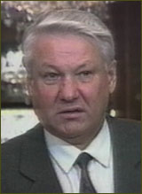
Yeltsin

Slide 21
Why the Coup?
Top Party officials, KGB, defense ministry- upset over Gorbachev about E. Europe
Fear of losing power

Slide 22
The Coup
Aug. 2, 1991 Communists stage Coup
Gorbachev taken into custody while on vacation
State of Emergency declared
People protest- fear of dictatorship
Yeltsin speaks against coup (gains fame)

Slide 23
The Coup Fails
Gorbachev returns to Moscow
Resigns as Secretary General
Communist Party officially disbanded
Soviet strength had collapsed
Baltic States demand and gain independence
10 republics declare independence (not complete break)

Slide 24
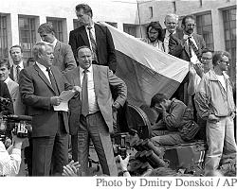
Yeltsin on Tank

Slide 25
End of the USSR
Post-coup leaders of republics form State Council
Gorbachev president, Yeltsin most powerful
Council creates loose confederation and prevents economic collapse
Council breaks down
Commonwealth of Independent States- Ukraine, Russia, Byelorussia, others follow
Gorbachev resigns Dec. 25, 1991
https://www.youtube.com/watch?v=VAPk7z5Yzrw

Slide 26
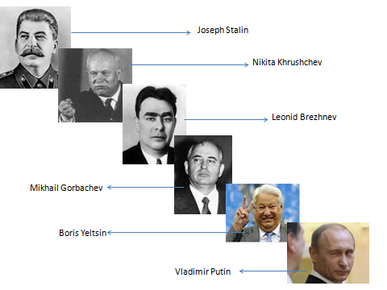

Slide 27
New Germany

Slide 28
East Germany
1971-Erich Honecker became head of the Communist Party
Used the Stasi, the secret police, to rule for the next 18 years.
1989,many East Germans began to flee their country after Hungary opens its borders.
Mass demonstrations broke out in the fall of 1989.
November 9, the Communist government gave in and opened its border with the West.
Thousands of East Germans rushed across the border.
Families who had not seen each other in years were reunited.
People on both sides of the Berlin Wall began tearing the wall down.
The reunification of Germany took place on October 3, 1990.

Slide 29
West Germany
1982 Helmut Kohl-sets up 10 point plan and Alliance for Germany
1990 plans reunification of Germanys
Agreement with Gorbachev in 1990 for nuclear dismantling
Paris Accord – involved US and other nations

Slide 30
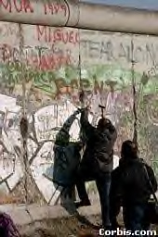

Slide 31
Fall of Soviet Union & Disintegration of Yugoslavia

Slide 32
Former Yugoslavia
Yugoslavia had a Communist government, but it had never been a Soviet satellite state.
Josep Tito died in 1980
A government composed of representatives from the six republics and two provinces of Yugoslavia kept the country under Communist rule.
By 1990, new parties had emerged, and the Communist Party lost its power.
In 1990, the Yugoslav republics of Slovenia, Croatia, Bosnia-Herzegovina, and Macedonia began to push for independence.

Slide 33
Former Yugoslavia
Dec. 29, 1989- Communist leaders suggest multi-party system
Broke apart in war
Ethnic groups- Serbs, Croats, Muslims, Slovenes, Macedonians, Montenegrins
6 republics

Slide 34
Ethnic Ties
Differences:
Serbs- Greek Orthodox, Cyrillic alphabet
Croats & Slovenes- Catholic, Roman alphabet
Similarities:
Both don’t like Muslims
Common tie = common country

Slide 35
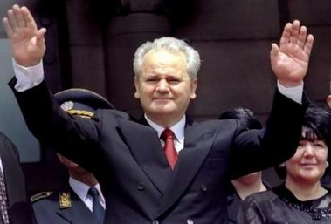
Slobodan Milosˇevic´
Became the leader of Serbia in 1987
He wanted to redraw borders to include the Serb minorities in a new Greater Serbian state.

Slide 36
Conflict in the Balkans
PHASE 1: June 1991- Slovenia and Croatia declared their independence.
September- Yugoslavian army began a full assault against Croatia.
Before a cease-fire was arranged, the Serbian forces captured one-third of Croatia’s territory.
PHASE 2: In 1992, the Serbs began an assault against Bosnia-Herzegovina.
By mid- 1993, Serbian forces had acquired 70 percent of Bosnian territory.

Slide 37
Bosnia
Feb. 1992 Bosnia-Herzegovina- independence
Serbs opposed- would be minority to Muslims
March 1992- war (Karadzic supported by Bosnian Serbs)
Serbs used brutality against Bosnian Muslims (ethnic cleansing)
1995 70% Bosnia held by Serbs

Slide 38
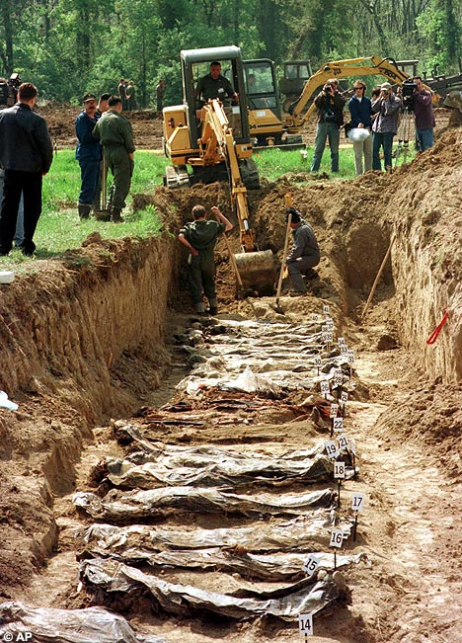
Ethnic Cleansing
Many Bosnians were Muslims. Toward them, the Serbs followed a policy they called ethnic cleansing (killing them or forcibly removing them from their lands).
1995, 250,000 Bosnians (mostly civilians) had been killed, and two million others were homeless.

Slide 39
NATO Involvement
1995, Bosnian and Croatian forces regained much of the territory that had been lost to Serbian forces.
NATO orders air strikes in retaliation for Serb attacks on civilians.
Attacks forced the Serbs to sign a peace treaty on December 14.
Agreement split Bosnia into a loose union of a Serb republic and a Muslim-Croat federation.
NATO sent a force of sixty thousand troops to monitor the area (peacekeeping).

Slide 40
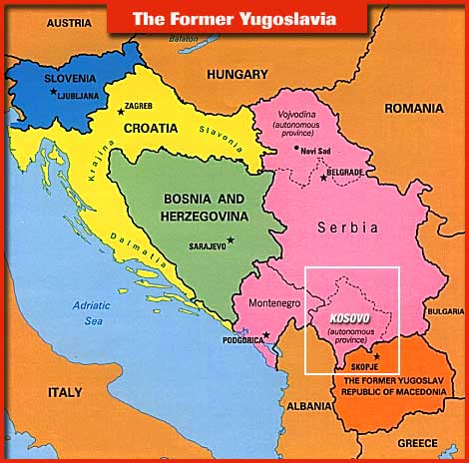
Kosovo
1974- Tito made Kosovo an autonomous (self-governing) province within Yugoslavia, inhabitants were mainly ethnic Albanians.
1989, Milosˇevic´ took Kosovo’s autonomous status away.
PHASE 3: Ethnic Albanians formed the Kosovo Liberation Army in the mid-1990s in response to Serbian rule.

Slide 41
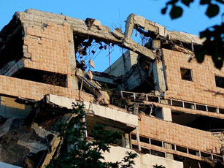
Kosovo
Serb forces began to massacre ethnic Albanians.
In 1999, Albanians in Kosovo gained autonomy within Serbia.
Milosˇevic´ objected and a NATO bombing campaign forced Yugoslav cooperation.

Slide 42
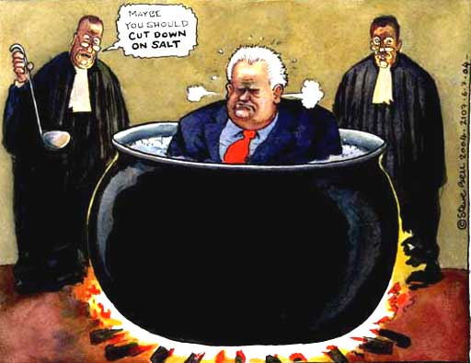
Serbia and Montenegro
Elections held in 2000 ended Milosˇevic´’s rule, and he was brought to trial for his role in the bloodshed in the Balkans.
In 2003, Serbia and Montenegro formed republics.

Slide 43
Crash course – Clinton years https://www.youtube.com/watch?v=-rboN6F2g-k

Slide 44
