Slide 1
Chapter 28 – The Search for Political Stability & the Great Depression

Slide 2
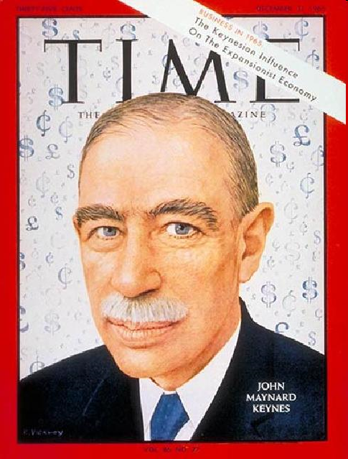
Political Uncertainty 1920-1930
John Maynard Keynes, and economist denounces the Treaty of Versailles and said the harshness will lead to economic hardship in all countries...Germany must have the opportunity to prosper in the future (….was he right?!)

Slide 3
Uneasy Peace, Uncertain Security
The Treaty of Versailles that ended WWI left many nations unhappy
Problems:
1. border disputes in Eastern Europe
2. League of nations not effective (no military force, and U.S. did not join)

Slide 4
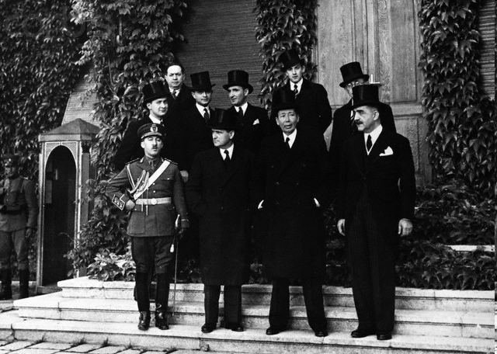
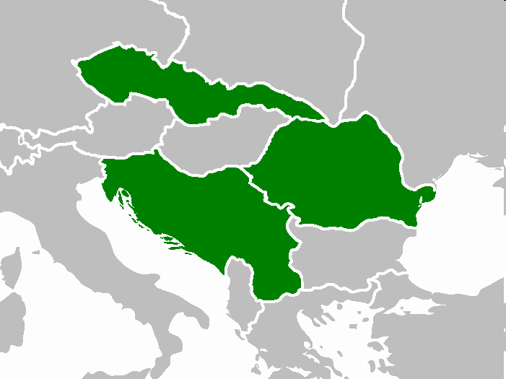
Political Uncertainty
France, turned to the “Little Entente”; Czechoslovakia, Romania, and Yugoslavia to prevent restoration of Hapsburg monarchy in Hungary and future German aggression (this collapses in 1937 when Germany annexes Sudetenland in Czechoslovakia).
France’s aggression towards Germany made Britain and U.S.A. distant from agreeing to any alliance.

Slide 5
Uneasy Peace, Uncertain Security
Effects of the Treaty on Germany
1. France demanded strict enforcement of the treaty
2. Determined Germany owes $33 Billion in war reparations
3. After one year Germany announced it could no longer pay

Slide 6
Uneasy Peace, Uncertain Security
4. In response French troops occupy the Ruhr Valley with the intention of operating the mines and factories there as payment
5. German workers refused to work for the French and go on strike

Slide 7
Uneasy Peace, Uncertain Security
6. To pay the workers the German government began printing money
7. By doing this they devalued their money and created inflation (rise in prices)
8. With their currency virtually worthless workers took their pay home in wheelbarrows

Slide 8
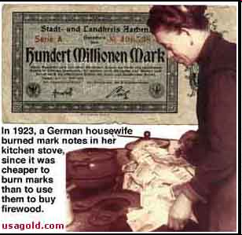
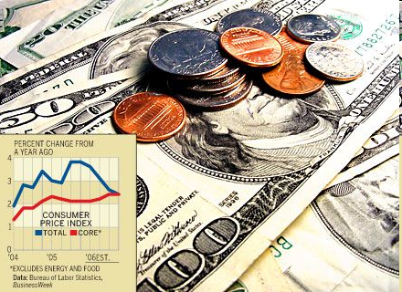
Political Uncertainty
Germany printed billions of marks to pay off the reparations. . Severe inflation followed. The German Mark was worthless.

Slide 9
Worthless German Money

Slide 10
Worthless German Money

Slide 11
Worthless German Money

Slide 12
U.S. Responds
The Allies (especially the U.S.) could see that the situation could not continue
In 1924 the U.S. proposed the Dawes Plan
1. Reduced Germany’s total debt
2. Reduce yearly German payment
3. $200 million loan to Germany
4. Encourage U.S. investment in Europe
There was a brief period of prosperity 1924-1929

Slide 13
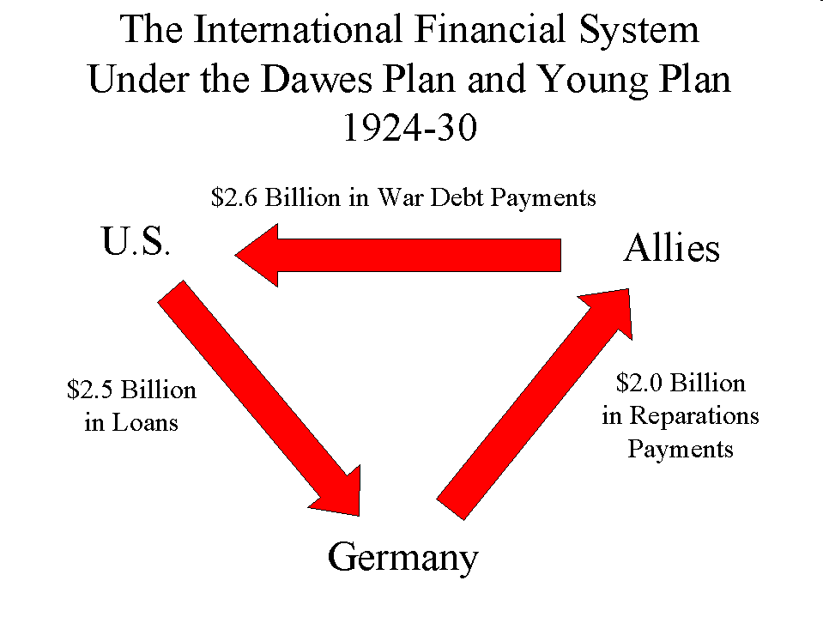
The Dawes Plan (1924)
The U.S. would loan Germany money so it could re-build and pay off the war debt.

Slide 14
Treaty of Locarno
Germany joined the League of Nations (1924)
(1925) - Guaranteed Germany’s border with France and Belgium, allied troops would leave Rhineland in 1930
“Spirit of Locarno” – THIS will be the lasting peace we need…
Still most nations were unwilling to reduce their military
LATER - 63 nations signed the Kellogg-Briand pact to denounce war as a policy (August 1928) ( First Signatories included France, the United States, the United Kingdom, Ireland, Canada, Australia, New Zealand, South Africa, India, Belgium, Poland, Czechoslovakia, Germany, Italy and Japan.)

Slide 15
The Great Depression
In the 1920s the U.S. stock market was booming, this caused U.S. investors who were investing in Europe and Germany to pull out their money and by stocks
In October 1929 the stock market crashed
U.S. investors began to withdraw even more money from European investments
European (especially German) banks were weakened, industry slowed, trade slowed, unemployment rose
1932 – 25% of British workers were unemployed, 40% of German workers

Slide 16
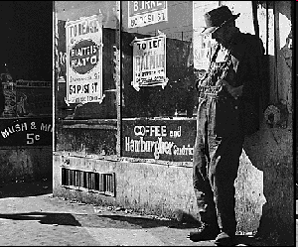
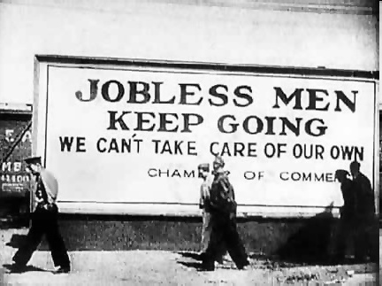
The Great Depression
Causes:
1. People were buying “stocks on margin”: People bought a fraction of the stock and borrowed the rest from banks, and investors.
2. People speculated that the stock market would make them money with borrowed money

Slide 17
Depression Spreads
US economic crash felt worldwide
Investors call back foreign loans
Hard impact on Europe (esp. Germany, Austria depended on for war debts)
1929-1932-
world manufacturing fell 65%
international trade fell 65%
unemployment skyrockets

Slide 18
Factory sells less products
Factory lays off employees
Creates unemployment
Factory produces less, which raises prices (supply low – prices high)
More unemployed people don’t have money to spend, and high prices keep them from spending

Slide 19
The Great Depression

Slide 20
The Great Depression
Governments did not know how to respond
The result :
1. More government involvement/regulation in the economy (businesses)
2. Communism became more popular (Marx had predicted a capitalist collapse and it seemed true)
3. Many people began to follow dictators that offered solutions (desperate people believe the biggest liar)

Slide 21
Democratic States After the War
Most European nations had democratic governments and women could vote in most
In Germany the democratic gov. was called the Weimar Republic

Slide 22
Problems with the Weimar Republic
1. No outstanding political leaders (Hindenburg was leader but could not work well with other government officials and political parties.
2. Serious economic problems
3. Inflation, loss of income, loss of savings drove the middle class to oppose the Weimar gov.
4. Fear pushed people to support extremist parties

Slide 23
France During the Great Depression
France did not suffer as badly as other nations due to a balanced economy and dependence on agriculture
A new political party the Popular Front fought for workers to collective bargaining
This produced 40 hr. wk., 2 wk. paid vacation, and minimum wage

Slide 24
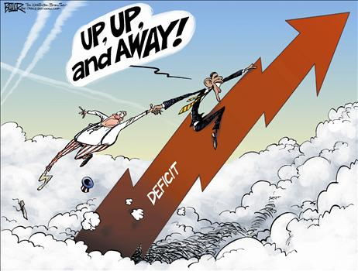
Britain
Severely hurt- relied on foreign trade
1931 Coalition cabinet elected (National Govt.)
High protective tariff
Regulate currency
Increase taxes
Lower interest (production)
Britain began putting people to work on public works projects (building highways and public buildings)

Slide 25
U.S. during the Great Depression
Franklin Delano Roosevelt (FDR) was the new U.S. president
He proposed the NEW DEAL:
1. public works
2. Welfare system
3. Social Security Act
4. Unemployment insurance

Slide 26
https://www.youtube.com/watch?v=h-7YCcZUXmw
Ruhr Valley, Hyperinflation, recovery (8 min)
https://www.youtube.com/watch?v=bPq33t6CT4U
How the US Stock Market crash affected Germany (6 min)

