Slide 1
Evolution of the Italian Renaissance

Slide 2
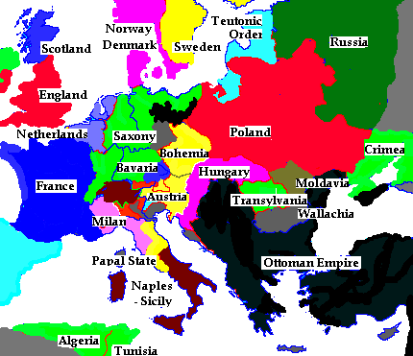
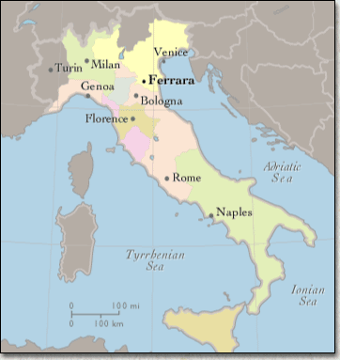
Evolution of the Italian Renaissance
1300-1600

Slide 3
Italian States
The civilization of the Italian Renaissance was urban, centered on towns that had become prosperous from manufacturing, trade, and banking.
Italians had acquired considerable wealth, and some of this wealth was used to support writers, scholars, and artists.

Slide 4
Communes
Communes – sworn associations of free men seeking
Complete economic and political independence from nobles
-Maintained the cities (trade, taxes, police)
-Created a new social class (“urban nobility”) from
strategic marriages
-Owning property = wealth and qualification to hold office
-Popolo – rebellious organized class who were heavily taxed
and did not fit the criteria to hold office

Slide 5
Attempts at Republics (representative gov)
Ultimately set up as a result of campaigns by the popolo but
still excluded them
-Because of the failure of these governments, eventually signori,
(dictators?) or oligarchies were established
-Oligarchies gave the illusion that they were governed by a
Constitution but ultimately it was just for show
-Decisions were made at the princely courts where the rulers
Used the space also to show off their wealth and power

Slide 6
“Balance of Power”
Italy became an area of city-states which hindered unification. Also disabled them from unifying against common enemies, such as France.
When one state became a threat (started to become too powerful) the others combined forces to keep it down (shifting alliances)
Venice v. Milan example
Modern diplomatic systems: embassies and ambassadors

Slide 7
Primary Italian States
Florence
Oligarchy
Medici family
Savonarola
Milan
- Oligarchy – Sforza family
Venice
Oligarchy
Monopoly on spice and luxury trade
Papal States
Popes & Borgia family
Naples/ Kingdom of the Two Sicilies
Poor land
- French & Spanish conflict …absorbed by Spanish empire

Slide 9
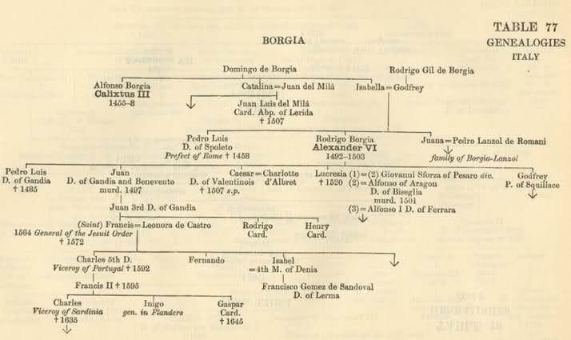
Borgias (Papal States)

Slide 10
Intellectual Hallmarks of the Renaissance

Slide 11
Renaissance Timeline
500 AD
Middle Ages
Renaissance
Rediscovery of knowledge
and culture
Greek and Roman
Loss of knowledge
and culture (due to wars,
famine, and disease
Increase in knowledge and culture
1350-1450

Slide 12
Recovery of Classics
Humanities- subjects concerned with culture and humankind
Interest in Greek and Roman Civ.
Secularism, science, rationality and individualism
People imitated language, customs, ways of Classical Civilization

Slide 13
Humanism
Study of Latin and Greek Classics and ancient Church fathers
for sake of learning
hopes for rebirth of ancient norms, values
Liberal Arts- grammar, rhetoric, history, politics, moral philosophy
celebrate humankind and life of virtue
Secularism- absence of religion, earthly subjects

Slide 14
Humanism
New view of human beings emerged as people started to emphasize individual ability.
“Men can do all things if they will”
– ~Leon Bottista Alberti ~ 15th Century Italian
Valued well rounded individuals who were capable of achievement in many areas of life

Slide 15
Interest in Earthly Life
Middle Ages
Ancient writers used to back Church teaching
Life was preparation for afterlife
Renaissance
Tried to understand ancient civilization
Live life as fully as possible

Slide 16
Role of Men
According to Castiglione (The Courtier)
Should be:
Educated in Greek, Roman
Charming, polite, witty
Dance, write poetry, play music
Strong but graceful
Rider, wrestler, swordsmen

Slide 17
Role of Women
More opportunities for equality and advancement existed for women in Middle Ages
Education and talent was to be used in the home, or as inspiration for men
Little opportunity in economic, social, and political life

Slide 18
Role of Women
According to Castiglione, should be:
Upper-class educated like men
Educated in the Classics
Paint, play music, dance
Not to seek fame as men can
Inspire poetry not write it

Slide 19
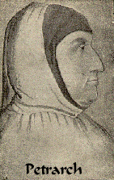
Petrarch
Pioneer of early humanism
Italian born poet
Led early development of Renaissance humanism
Encouraged study of Roman philosophy and literature

Slide 20
Writers
Petrarch- Classical and Christian values= uneasy coexistence
Letters to the Ancient Dead
Boccaccio- social commentary
Decameron
Dante- VERNACULAR
Divine Comedy
Castiglione – Book the Courtier – social roles of men and women

Slide 21
Historical Thinking Skills: Historical Argumentation
Historical thinking involves the ability to define and frame a question about the past and to address that question through the construction of an argument.

