Slide 1
Chapter 27 – The Peace Settlement
TODAY: Discuss Treaty of Versailles / Peace Settlement
TOMORROW: Only Sophs. Will be here – Young Indiana Jones?
WEDNESDAY – LEQ Workshop (if you still have the rubric from the beginning of the year, bring it. If not, I’ll have more copies.
THURSDAY – Writing the LEQ + review MC
FRIDAY – Chapters 26, 27 MC Exam

Slide 2
The Armistice
A halt to fighting
Nov. 11,1918- Germany signs along with Austria-Hungary, Ottoman Empire
German Kaiser forced to give up throne- Weimar govt. est. in Germany (Provisional/ Western type govt.)

Slide 3
The Peace Treaties
David Lloyd George- Britain
Georges Clemenceau- France
Woodrow Wilson- United States
Vittorio Orlando- Italy
Russia – dealing with their own issues

Slide 4
Wilson’s 14 Point Plan
Self-determination- Govts. Free from foreign control
A fair peace- “peace without victory” where enemies wouldn’t want revenge
Disarmament- lasting peace meant end to militarism

Slide 5
Wilson’s 14 Point Plan cont…
Fair treatment of colonial people- Imperialist power look out for welfare of people (part of govt.)
League of Nations- International peace keeping group, settle quarrels, no secret treaty

Slide 6
1. No more secret agreements ("Open covenants openly arrived at").
2. Free navigation of all seas.
3. An end to all economic barriers between countries.
4. Countries to reduce weapon numbers.
5. All decisions regarding the colonies should be impartial
6. The German Army is to be removed from Russia. Russia should be left to develop her own political set-up.
7. Belgium should be independent like before the war.
8. France should be fully liberated and allowed to recover Alsace-Lorraine
9. All Italians are to be allowed to live in Italy. Italy's borders are to be "along clearly recognisable lines of nationality."
10. Self-determination should be allowed for all those living in Austria-Hungary.
11. Self-determination and guarantees of independence should be allowed for the Balkan states.
12. The Turkish people should be governed by the Turkish government. Non-Turks in the old Turkish Empire should govern themselves.
13. An independent Poland should be created which should have access to the sea.
14. A League of Nations should be set up to guarantee the political and territorial independence of all states.

Slide 7
Problems with Plan
France strongly opposed
most battles in France
fear of future attack
Self-determination- no way to draw borders and please everyone
too many nationalities

Slide 8
Peace of Paris
5 treaties- one with each defeated country
Most important was Treaty of Versailles negotiated with Germany
June 1919

Slide 9
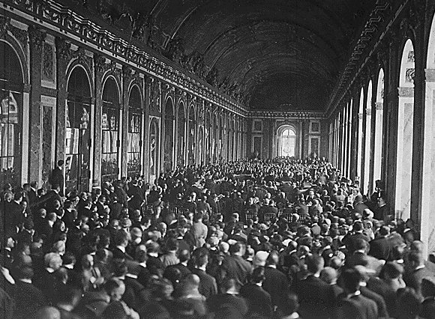
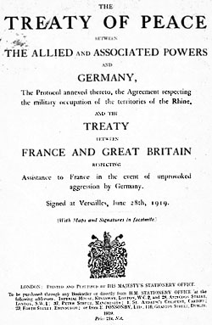
Hall of Mirrors

Slide 10
Treaty of Versailles
5 major issues
Territorial Changes
Mandates
Reparations
New States
League of Nations

Slide 11
Territorial Changes
France- regains Alsace-Lorraine, Saar region (coal mines)
Poland- Polish corridor (German land), Danzig established as free city

Slide 12
Territorial Changes cont…
Germany
Rhine river demilitarized
Army reduced to 100,000 with no heavy artillery
Draft abolished
Navy greatly reduced

Slide 13
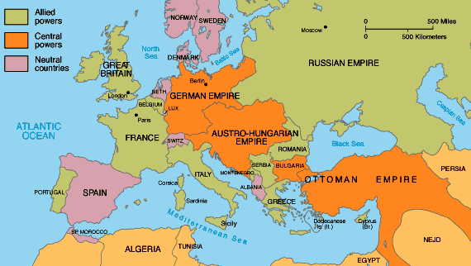
1914

Slide 14
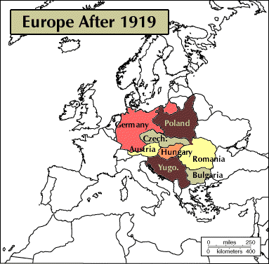

Slide 15
New States
Austria-Hungary= Czechoslovakia, Yugoslavia, Hungary
Austria forbidden from uniting with Germany again (remember this….)
Ottoman Empire= lost land outside Turkey (Turkish nationalists overthrew Ottomans

Slide 16
Mandates
Regions administered by another country until ready for independence

Slide 17
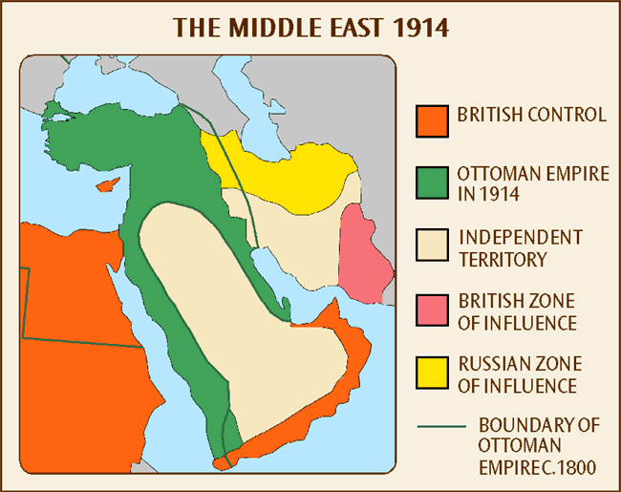
1914

Slide 18
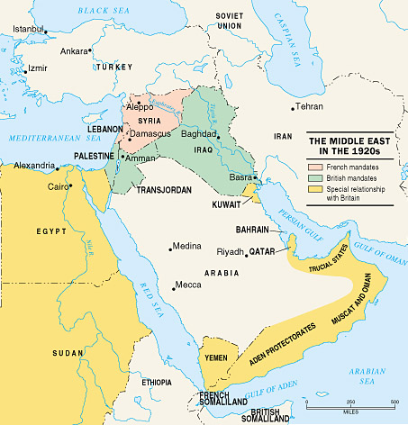

Slide 19
Reparations- war damages
War blamed on Germany -
Germany forced to pay to make up for loss of property, ships, farms
1921- amount to pay= $33 billion

Slide 20
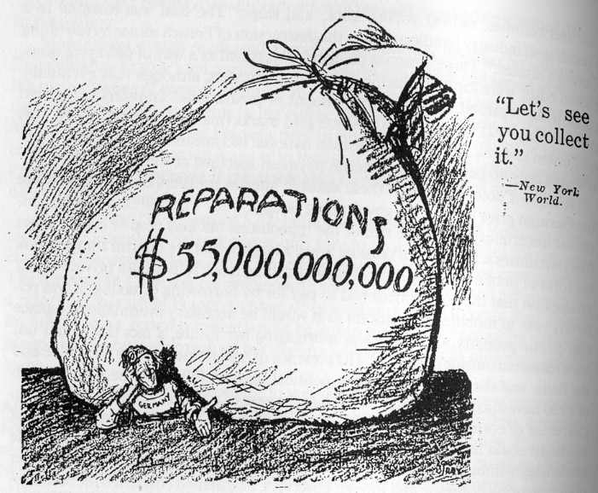
Article 231 – War Guilt Clause + Reparations
Germany had to accept responsibility for damages
In war.

Slide 21
League of Nations
160 countries
US did NOT join- isolationism (stay out of foreign entanglements and conflicted with Congressional ability to declare war)
Members respect each others borders and settle disputes within League

Slide 22
Problems with Treaty
Treaty too harsh on Germany
Hard for new govt. to survive following treaty conditions - revolutions
Germans resent Allies
Just stopped fighting did NOT surrender

Slide 23
The Aftermath
Total War- all human and material resources of countries used
8 million dead, 21 million wounded
Civilians killed, population sacrificed, propaganda, censorship

Slide 24
Unresolved Problems
Militarist ideas persisted- REVENGE
Imperialism- increased desire for independence
Nationalism- rivalries intensified
League of Nations- weak with no real power

Slide 25
Economic Costs
Technology grew drastically; production of cars, planes, radios etc. skyrocketed.
Europe's overall economy suffered loss in landscapes, physical property and finances
Europe’s economy was weakening, while The United states was growing into a global economic power.
Civil strife and revolution breaks out in Germany and a more democratic provisional gov’t is set up with resistance from extreme radicals (Karl Liebknecht, Rosa Luxemburg).

Slide 26
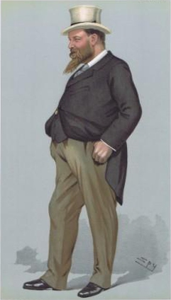
Zionist Movement
*Balfour Declaration – proclaims part of Palestine homeland for Jews
Lord Rothschild – received the letter
From the gov’t

Slide 27
Balfour Declaration: 1917
Foreign Office
November 2nd, 1917
Dear Lord Rothschild.
I have much pleasure to convey to you, on behalf of His Majesty’s Government, the following declaration of sympathy with Jewish Zionist aspirations {hopes} which has been submitted to, and approved by, the Cabinet.
“His Majesty’s Government view with favor the establishment in Palestine of a national home for the Jewish people, and will use their best endeavors to facilitate {assist} the achievement of this object, it being clearly understood that nothing shall be done which may prejudice the civil and religious rights of existing non-Jewish communities in Palestine, or the rights and political status enjoyed by Jews in any other country.”
I should be grateful if you would bring this declaration to the knowledge of the Zionist Federation.
Yours sincerely,
ARTHUR JAMES BALFOUR
British Foreign Secretary

Slide 28
https://www.youtube.com/watch?v=6YJfOZkriyk&list=PLh_EHnOyU3dNBDuJ2FS8PhqW6i6XLnCX1

