Slide 1
AP- Chapts. 23 & 25
Agenda:
Discuss Economic views & Socialism
Hand out contextualization chart
You will get review packets tomorrow
Chapters 23, 25 MC & SAQ Test = THURSDAY
HW: None! Maybe begin organizing binder/notes
For upcoming review and test

Slide 2
Economic Views

Slide 3
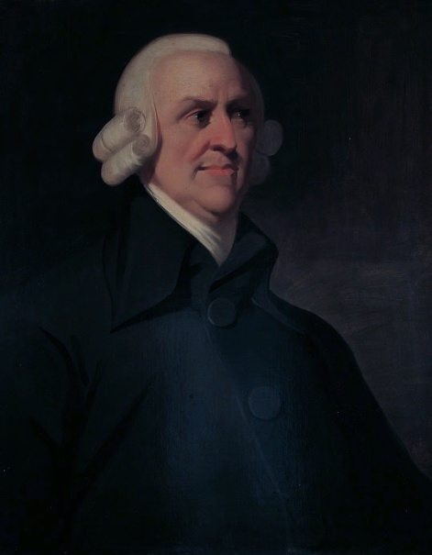
Adam Smith
Wealth of Nations (1776)
Critical of eighteenth century mercantilism because of the government regulations, state-Approved monopolies, and privileges of certain
Individuals and businesses
laissez-faire, “hands-off” approach,
free-competition, all citizens would
have equal opportunity to benefit
Led to capitalism which prevailed during the Industrial Revolution

Slide 4
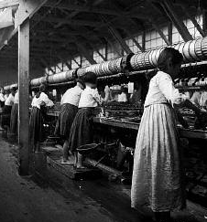
David Ricardo
“Iron Law of Wages,” 1817
When wages are high, workers have more children. More children create a large labor surplus that depresses wages.
Used by industrialists in reaction to calls for reform of working conditions in Britain

Slide 5
Robert Owen
Scottish Social reformer, argued
against child labor
Testified before Parliament in 1816 about
stunted mental and physical growth of
Children who worked in the mills.
He took it upon himself to reform and finally parliament passed the Factory Act of 1833 which limited work hours for children of certain ages.

Slide 6
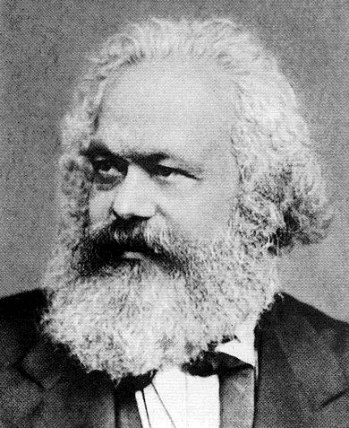
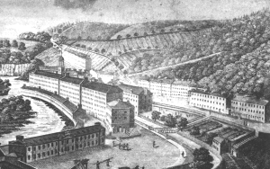
The Socialists: Utopians & Marxists
People as a society would operate and own the means of production, not individuals.
Their goal was a society that benefited everyone, not just a rich and well-connected few.
Tried to build perfect communities [utopias].

Slide 7
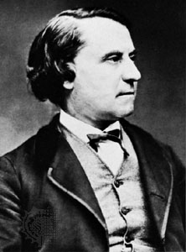
Louis Blanc
French Utopian Socialist
Published Organization of Work (1839) and urged workers to campaign for universal voting rights as well as right to work
Wanted to establish “social workshops” funded by the state but controlled and driven by the workers (early concept of “cooperatives”)
Served on many committees to enforce right to work and participated in a workers revolt in 1848 which forced him to flee to England

Slide 8
Karl Marx
Marx called for a new system – he said that all of human history was a class struggle.
A. One group of people, BOURGEOSIE, or middle class, (the oppressors) owned the means of production (land, raw materials, money, factories, etc.). He argued that this gave them the power to control government and society.
B. The other group, PROLETARIAT, or working class (the oppressed) depended on the owners of the means of production.

Slide 9
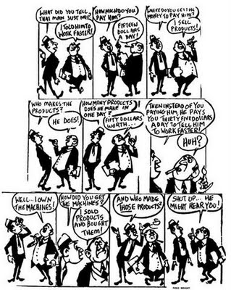
Surplus Value
Marx believed that the bourgeoisie basically bought the products of the laborers at a cheap price, and then sold those same products back to them at a high price, in effect stealing the surplus value as their profit.

Slide 10
Marxism
Marx predicted an open revolution between the two groups in which the proletariat would violently overthrow the bourgeoisie. Afterward the proletariat would set up a dictatorship (government led by one person or group with an absolute power) producing a classless society.
Pure Marxist wanted a violent revolution to overthrow capitalism.
Revisionist Marxists prefer change through worker organizations (unions) and political parties.

Slide 11
The Communist Manifesto
Seven Stages to the Establishment of Communism/ Socialism
Historical Materialism
Theory of Surplus
Stages in Economic Development
Class Struggle
Use of Force
Dictatorship of the Proletariat
Establishment of Communism/ Socialism

