Slide 1
Economic Development of the Dutch

Slide 2
Dutch lead Development of Capitalism
Capital invested in business ventures
Goal: pay costs and make profit to reinvest
Chance for profit- economy boomed 1660’s – herring industry
Money not spent on luxury (led strict lifestyle)

Slide 3
Dutch Trade
Bought surplus grain in Poland
Sold in S. Europe after poor harvest
Scandinavian lumber sold in Europe
10,000 Dutch trading ships by 1600
Shipped for other countries
Trade not war ships

Slide 4
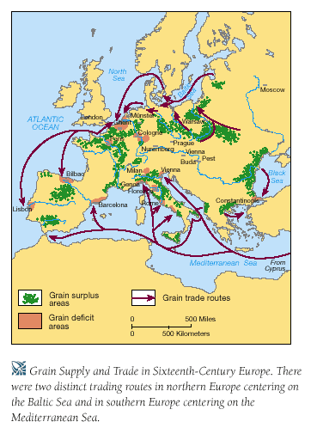

Slide 5
The Golden age of the dutch republic
Discuss Dutch Republic
Videos & questions
Start on ….if time
HW: Begin Chapt. 17 – outline – “Lords and Peasants of Eastern Europe” (p. 565 – 569); “The Rise of Austria” (p. 569 – 573)

Slide 6
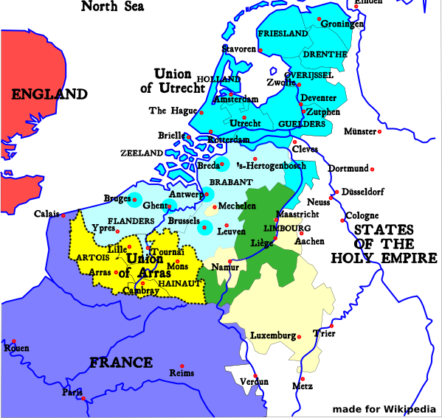
The Spanish Netherlands: Union of Utrecht, 1579
The United Provinces still recognized Spanish rule, but, in 1581, they declared their independence.

Slide 7
United Province of Netherlands
Republic / confederation (weak union of strong provinces)
Governors elected for each province whose power depended on merchants, landowners
States General- delegates from 7 provinces (Stadholder) responsible for defense and good order.
Stadholders wanted to avoid centralization but as a whole the country had the largest navy and was the wealthiest of any country in Europe at that time.
Religious tolerance

Slide 8
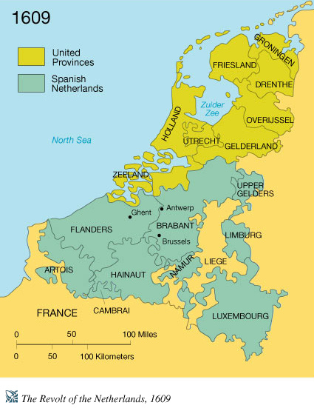

Slide 9
The Dutch Federation
REGENTS
- provincial level group of wealthy merchants
- held virtually all the power
- strong advocates of local independence
STADHOLDER
- States General representative from each province
- responsible for defense and order
STATES GENERAL
- federal assembly
- foreign affairs (war)
- all issues had to be referred to the local Estates

Slide 10
Local Economy
Fishing industry was cornerstone of local Dutch economy – Herring
The profits helped to building their shipping industry and their merchant marine
They began shipping (importing) lumber, grapes, grain and (exporting) diamonds, linen, Delftware but made more money by the actually transport

Slide 11
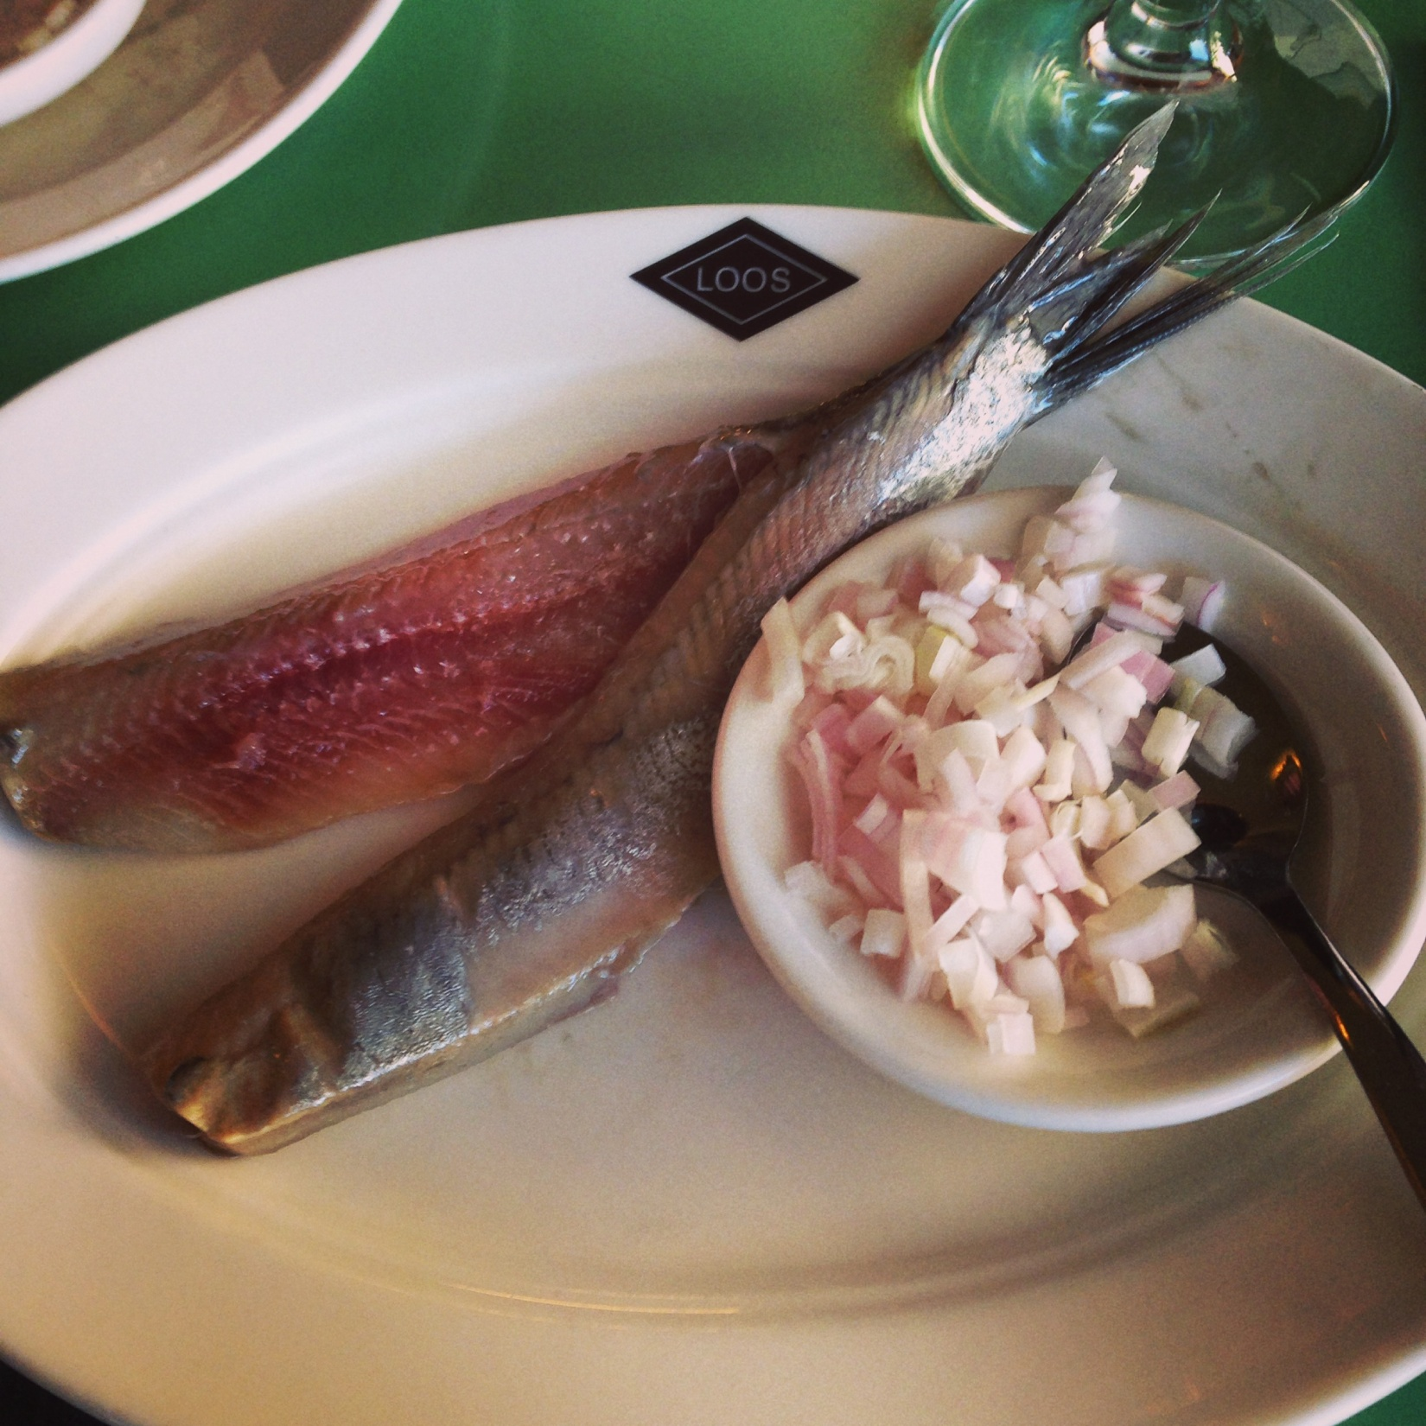

Slide 12
Dutch East Indies Co. 1602
Spices most prized items from Southeast Asia
Competitor = Portugal
Firm amassed fleet superior to Portugal
Profit reinvested in more trading ventures
Any Dutch citizen could by shares
Other nations soon followed (France, Britain)
Commercial Revolution-organized trade
Beginning of Capitalism

Slide 13
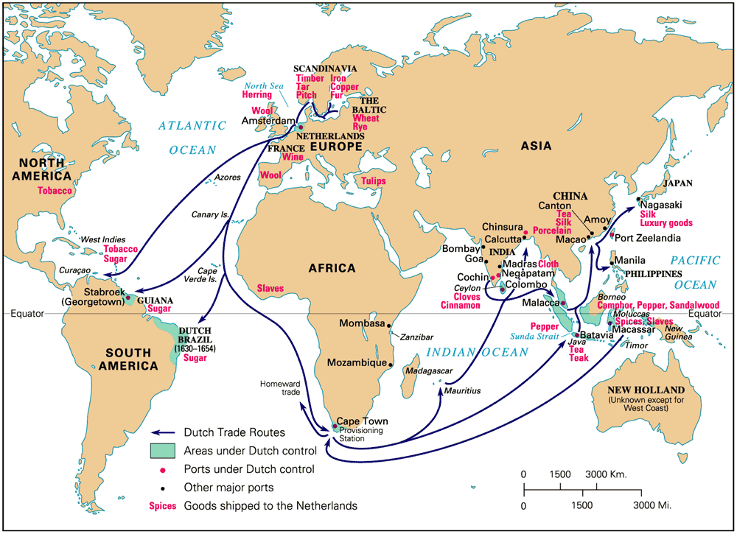

Slide 14
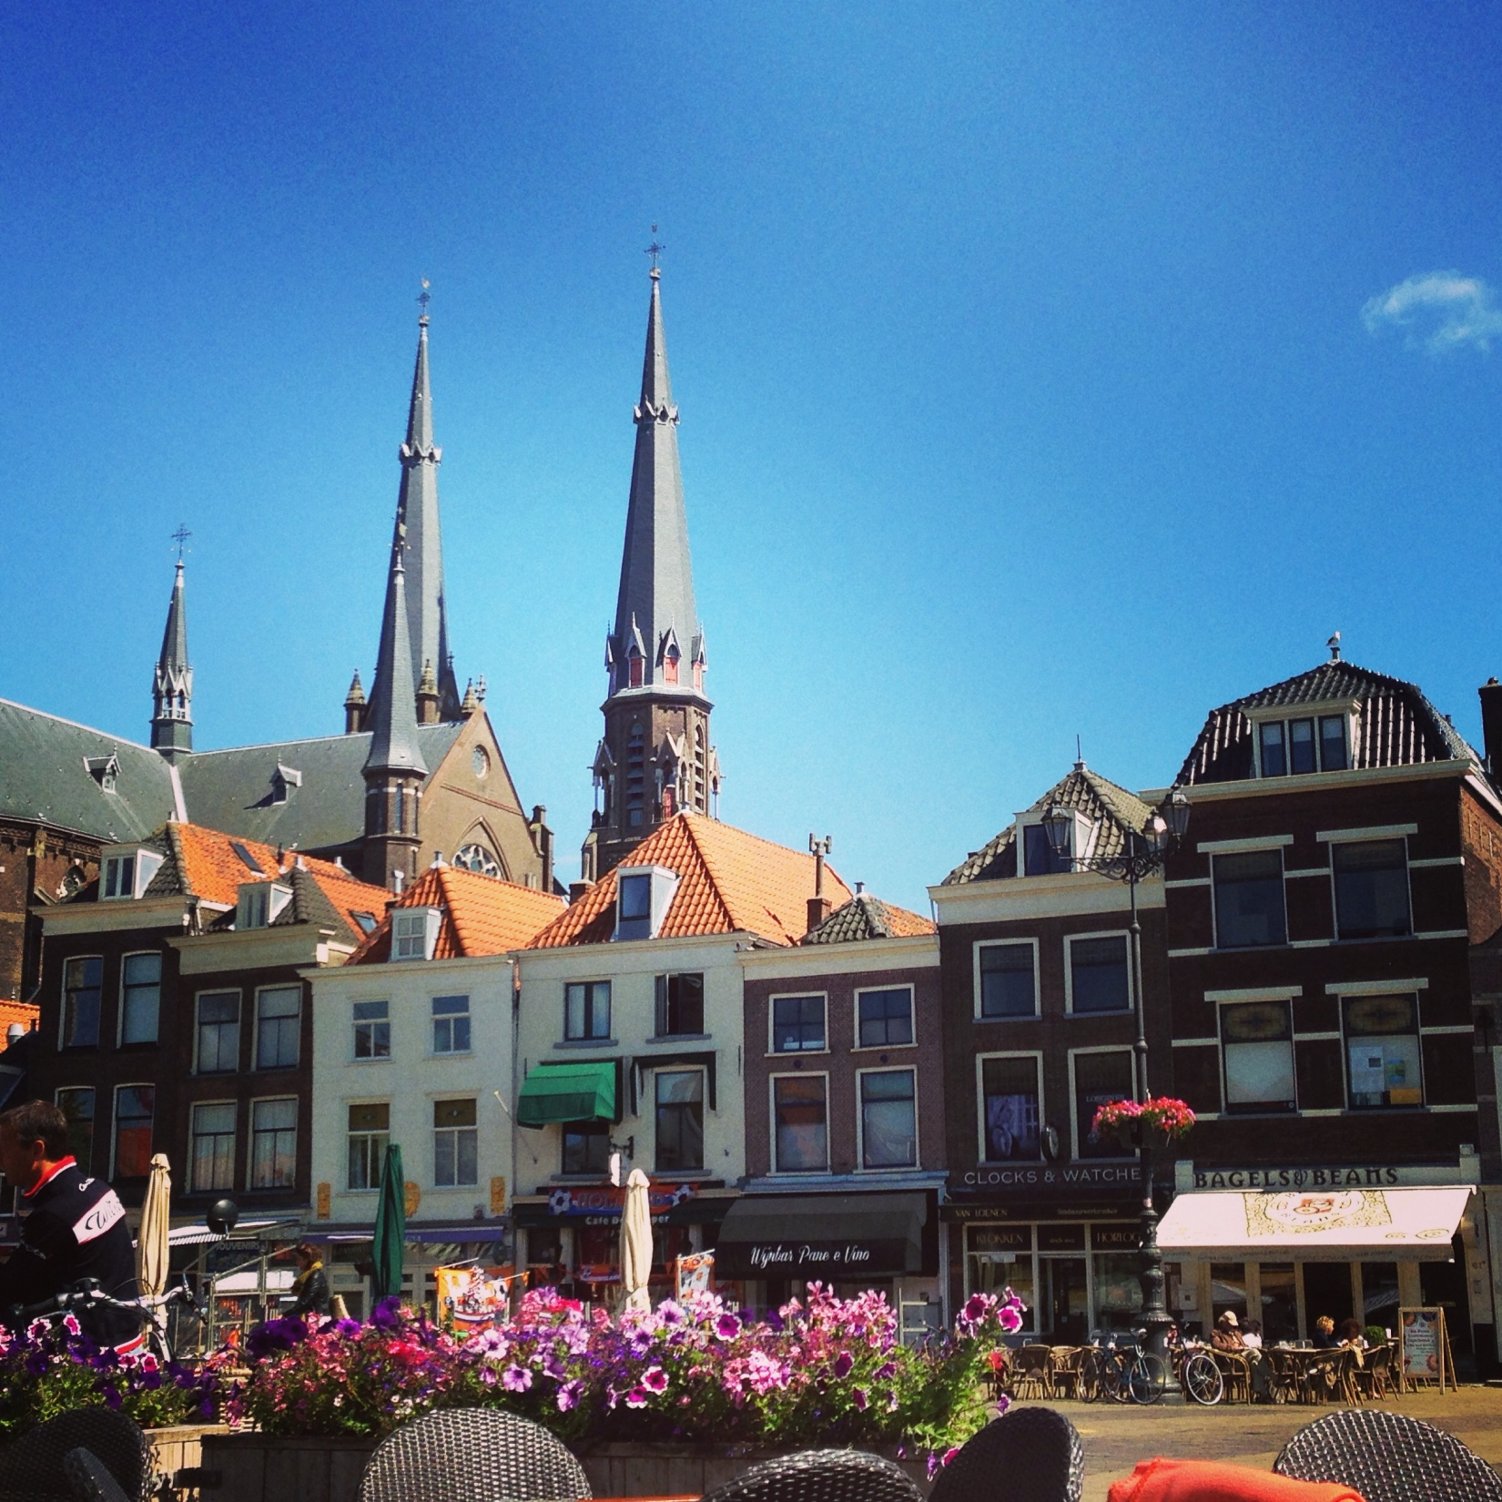
Delft

Slide 15
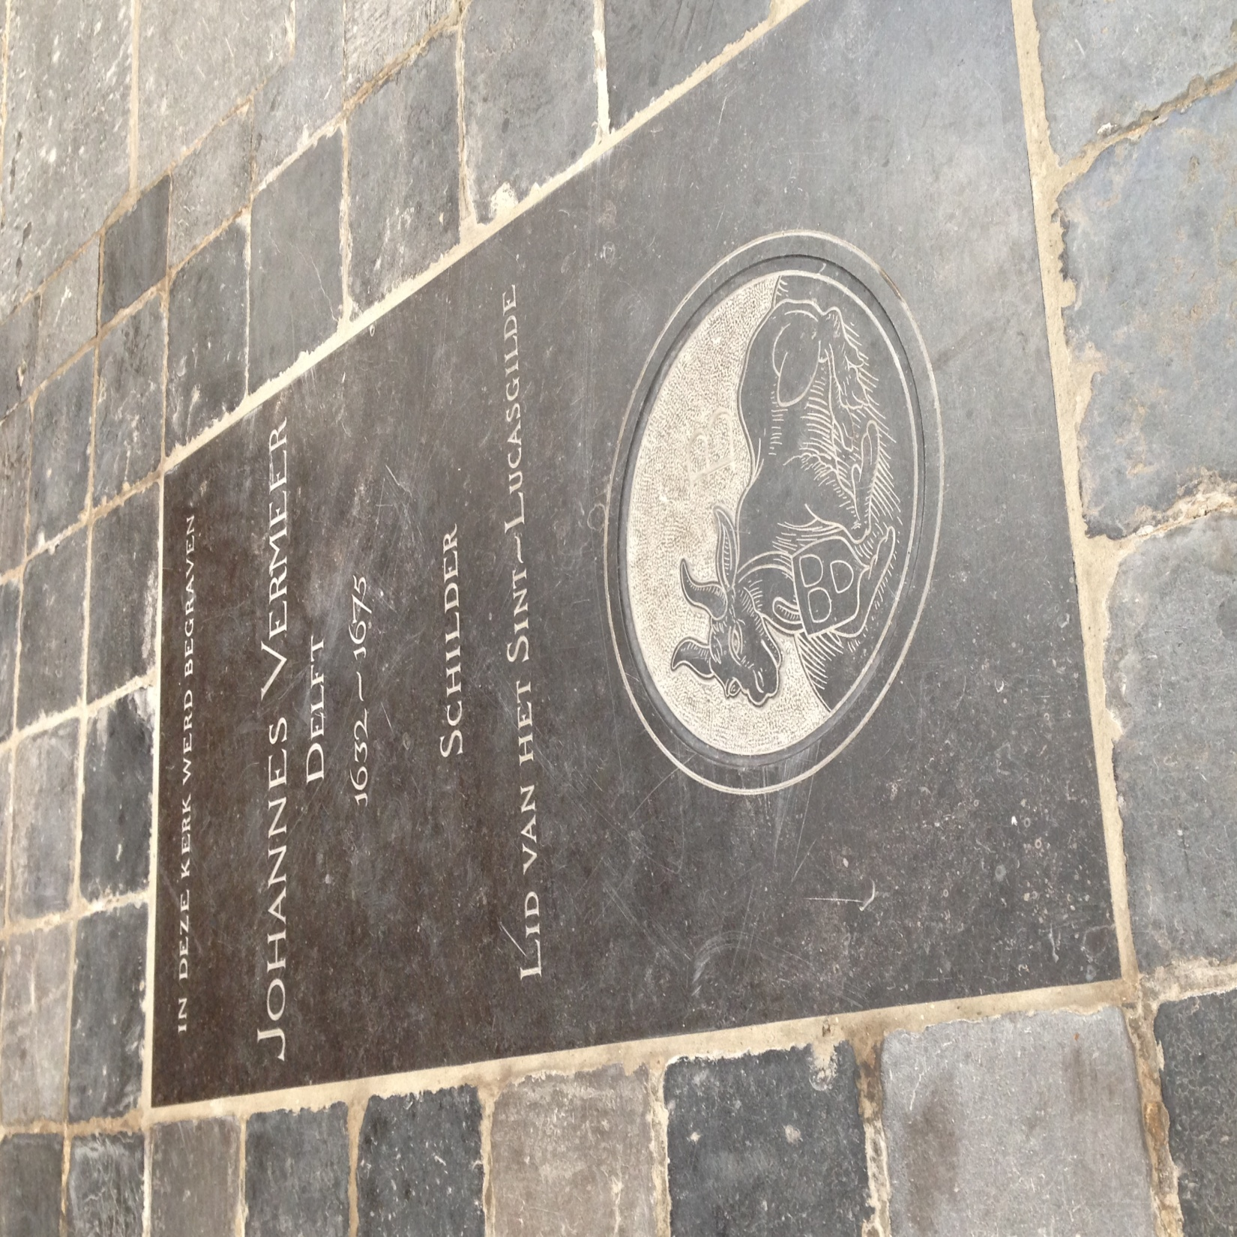

Slide 16
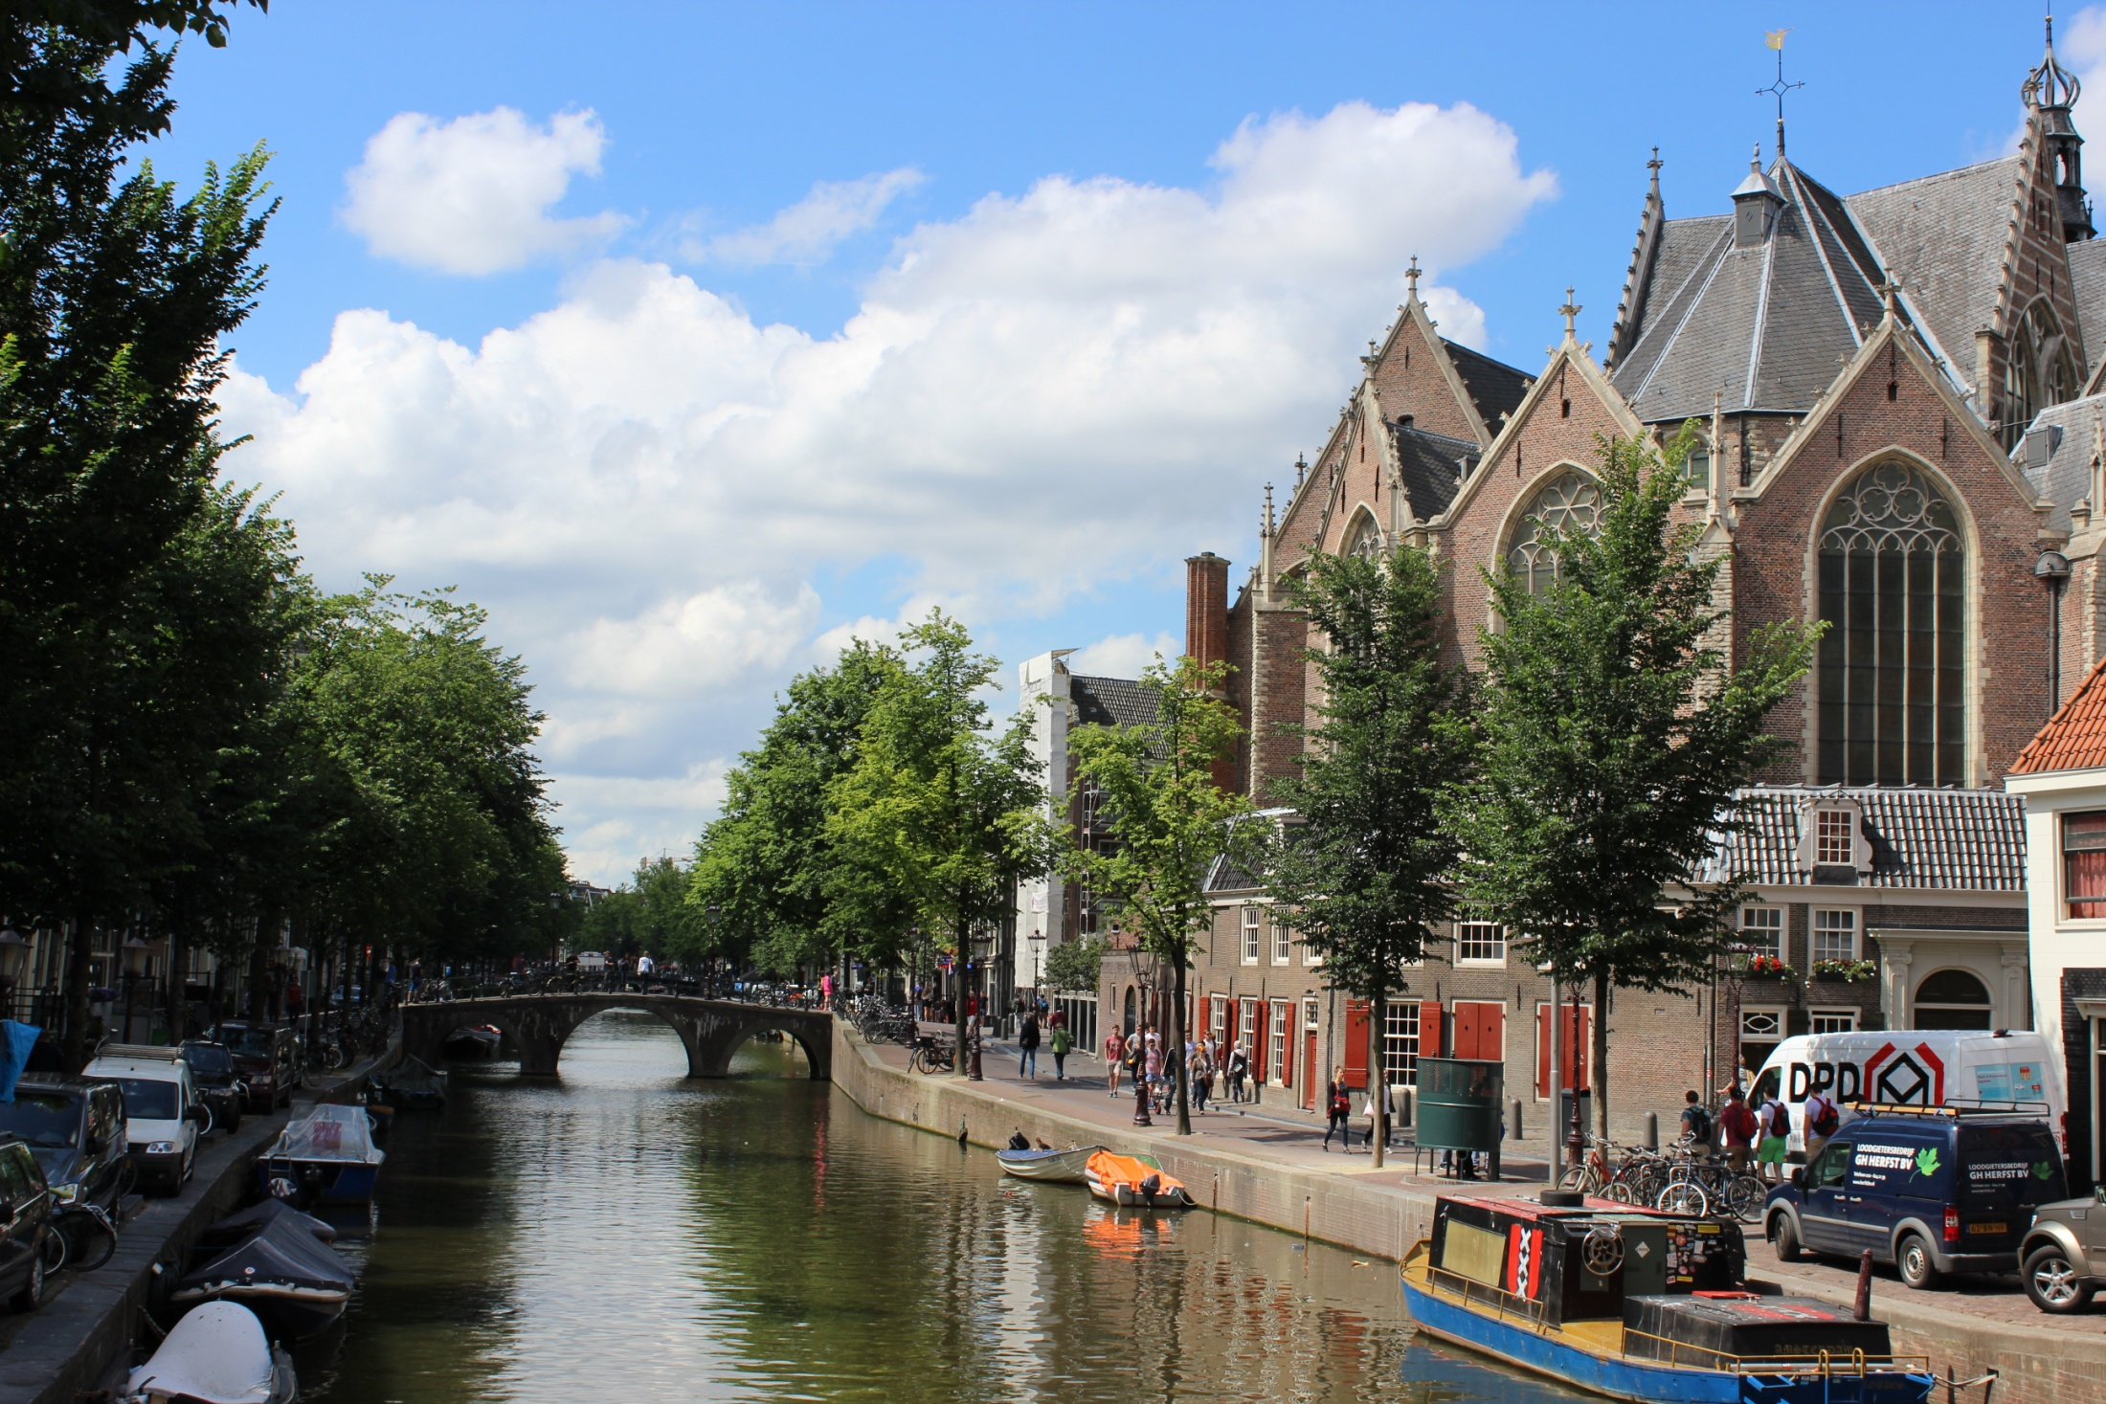
Delft

Slide 17
Complete the questions that correspond with
each video.
https://www.youtube.com/watch?v=40UwxKSMMbs
Stadtholders (start at 2:47)
https://www.youtube.com/watch?v=zPIhMJGWiM8
Dutch East India Company

