Slide 1
The Disintegration of Yugoslavia

Slide 2
Former Yugoslavia
Yugoslavia had a Communist government, but it had never been a Soviet satellite state.
Tito died in 1980
A government composed of representatives from the six republics and two provinces of Yugoslavia kept the country under Communist rule.
By 1990, new parties had emerged, and the Communist Party lost its power.
In 1990, the Yugoslav republics of Slovenia, Croatia, Bosnia-Herzegovina, and Macedonia began to push for independence.

Slide 3
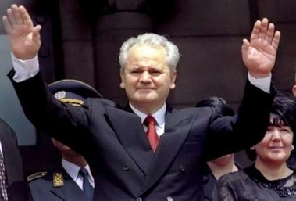
Slobodan Milosˇevic´
Became the leader of Serbia in 1987, was against their plans, because the republics included Serb minorities.
He wanted to redraw borders to include the Serb minorities in a new Greater Serbian state.

Slide 4
Conflict in the Balkans
June 1991- Slovenia and Croatia declared their independence.
September- Yugoslavian army began a full assault against Croatia.
Before a cease-fire was arranged, the Serbian forces captured one-third of Croatia’s territory.
In 1992, the Serbs began an assault against Bosnia-Herzegovina.
By mid- 1993, Serbian forces had acquired 70 percent of Bosnian territory.

Slide 5
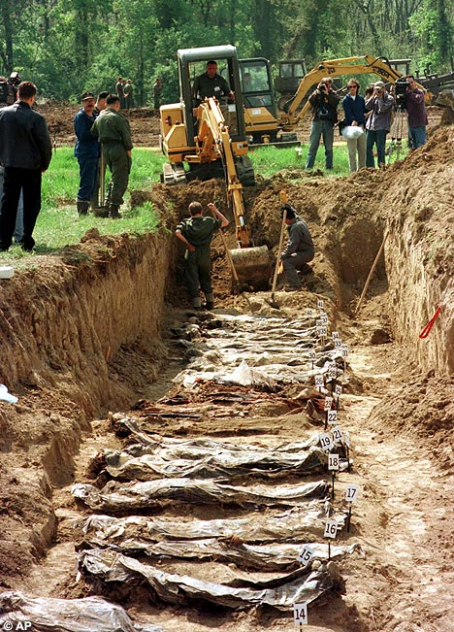
Ethnic Cleansing
Many Bosnians were Muslims. Toward them, the Serbs followed a policy they called ethnic cleansing (killing them or forcibly removing them from their lands).
1995, 250,000 Bosnians (mostly civilians) had been killed, and two million others were homeless.

Slide 6
NATO Involvement
1995, Bosnian and Croatian forces regained much of the territory that had been lost to Serbian forces.
NATO orders air strikes in retaliation for Serb attacks on civilians.
Attacks forced the Serbs to sign a peace treaty on December 14.
Agreement split Bosnia into a loose union of a Serb republic and a Muslim-Croat federation.
NATO sent a force of sixty thousand troops to monitor the area.

Slide 7
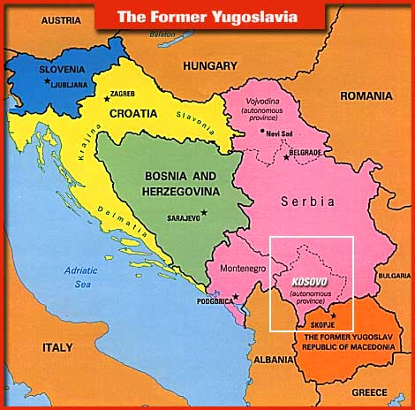
Kosovo
1974- Tito made Kosovo an autonomous (self-governing) province within Yugoslavia, inhabitants were mainly ethnic Albanians.
1989, Milosˇevic´ took Kosovo’s autonomous status away.
Ethnic Albanians formed the Kosovo Liberation Army in the mid-1990s in response to Serbian rule.

Slide 8
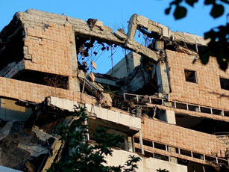
Kosovo
Serb forces began to massacre ethnic Albanians.
In 1999, Albanians in Kosovo gained autonomy within Serbia.
Milosˇevic´ objected and a NATO bombing campaign forced Yugoslav cooperation.

Slide 9
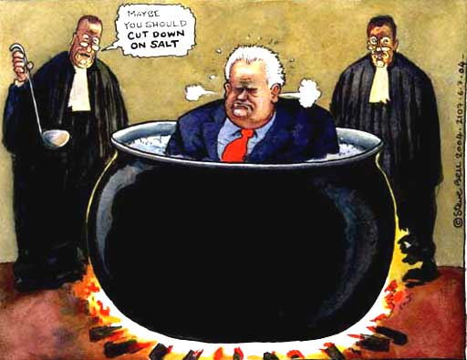
Serbia and Montenegro
Elections held in 2000 ended Milosˇevic´’s rule, and he was brought to trial for his role in the bloodshed in the Balkans.
In 2003, Serbia and Montenegro formed a republic.

Slide 10
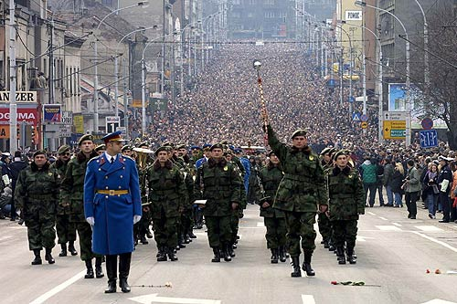
Serbia and Montenegro
The new prime minister, Zoran Djindic, promised to crack down on organized crime and on those who had committed war crimes.
Djindic was assassinated in March 2003.
Police believed the gang supporters of Milosˇevic´ played a role in the assassination.
On 11 March 2006, former Yugoslav president Slobodan Milošević died in his prison cell from a heart attack, while being tried for war crimes

Slide 11
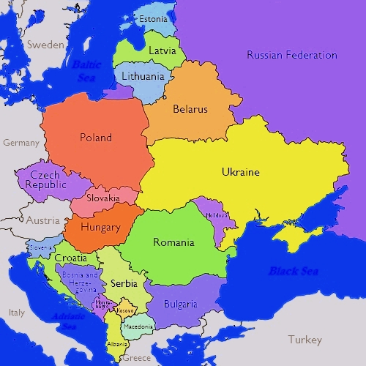

Slide 12
https://www.youtube.com/watch?v=Ae_cTGvxYG

