Slide 1
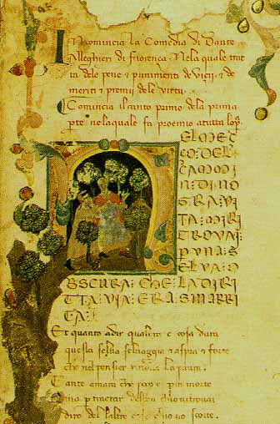
Chapter 12, Day 4: Vernacular Literature
Reading Quiz
Historical thinking skills activity: Causation
Middle Ages illustrated review assignment

Slide 2
Vernacular Lit
Dante Alighieri – Divine Comedy – allegorical Italian trilogy, secular and religious commentary
Geoffrey Chaucer – Canterbury Tales – English tales, comedic social commentary
Francois Villon – Lais, The Grand Testament – French stories, social commentary, celebration of the human condition
Christine de Pisan – The Book of the City of Ladies – rules for the behavior of courtly women

Slide 3
Historical Thinking Skills
Causation
Continuity and Change over Time (CCOT)
Analyzing Evidence
Interpretation
Comparison
Contextualization
Synthesis
Periodization
Argumentation

Slide 4
Historical Thinking Skills: Causation
Chronological Reasoning
Identify, analyze, and evaluate the relationships between historical causes and effects
Distinguish between long term and short proximity
Distinguish between causation and correlation
Historical events result from a variety of complex factors that come together in unpredictable ways and have unintended consequences

Slide 5
Animated Canterbury Tales
https://www.youtube.com/watch?v=E3zUoNG_P_0 (begin – 2:08)

