Slide 1
Chapter 12 – The Black Death
Reading Quiz
Black Death/Middle Ages Discussion/Notes
Primary Sources analysis
HW: outline “The Hundred Years War” and “Decline of Church Prestige” (p. 387 -395) + “Jan Hus” (last page of packet)

Slide 2
The Black Death: A Recipe for Plague
“Little Ice Age”
The Great Famine (1315 – 1317)
Inability to sustain growing population with agricultural methods used at the time
Upheaval to urban areas

Slide 3
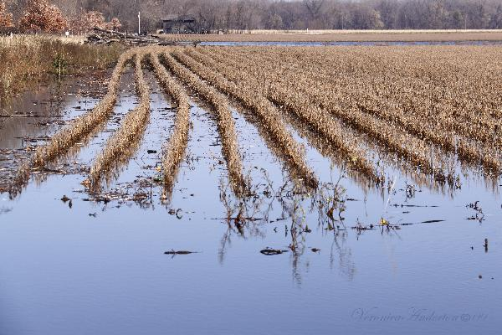
The Famine of 1315-1317
By the year 1300 Europeans were using almost all the possible land for farming
A population problem happened
Too many people, not enough land
Weather changes in Europe made three bad years for crops between 1315-17 because of too much rain.

Slide 4
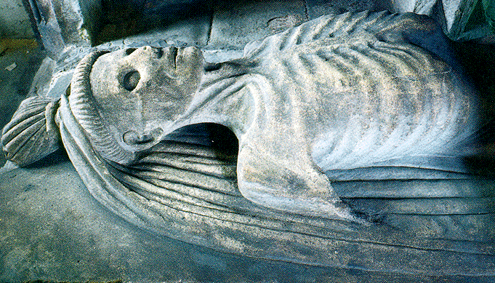
The Famine of 1315-1317
15% of the people in some English towns died because of no food (starvation)
Because the people were weak from starvation it was easy for them to get sick

Slide 5
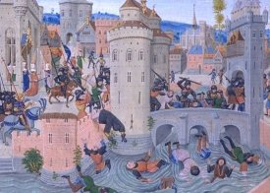
Economic Dislocation and Social Upheaval
Labor Shortage + Falling prices for agricultural products = Drop in aristocratic incomes
English Statute of Laborers (1351) : Limit Wages
Social Mobility
Peasant Revolts
Jacquerie in France (1358)
English Peasants’ Revolt (1381)
Revolts in the Cities
Ciompi Revolt in Florence (1378)
Jacquerie, 1358

Slide 6
The Black Death
Most devastating natural disaster in European History
Bubonic Plague
Rats and Fleas
Yersinia pestis
Originated in Asia
Arrived in Europe in 1347
Mortality reached 50 – 60 percent in some areas
Wiped out between 25 – 50 percent of European population (19 – 38 million dead in four years)
Plague returns in 1361 – 1362 and 1369

Slide 7
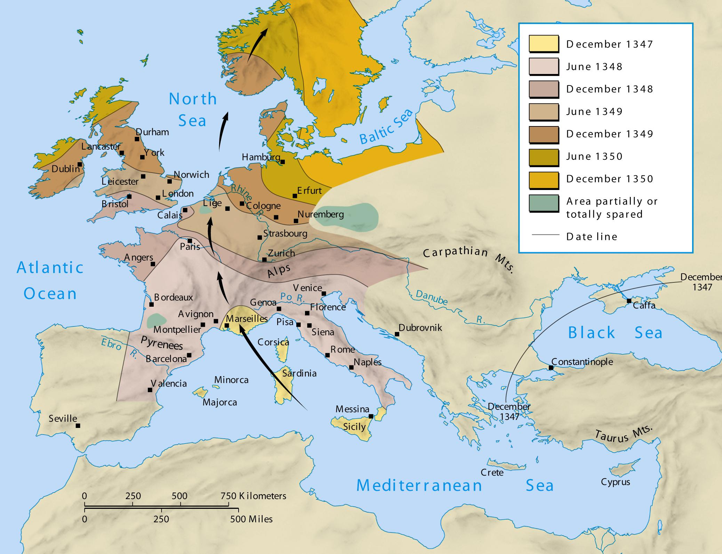
Spread of the Black Death
©2003 Wadsworth, a division of Thomson Learning, Inc. Thomson Learning™ is a trademark used herein under license.

Slide 8
The Disease Cycle
Flea drinks rat blood that carries the bacteria.
Bacteria
multiply in
flea’s stomach.
Human is infected!
Flea bites human and vomits blood from rat into human cut
Flea’s stomach blocked with bacteria.

Slide 9
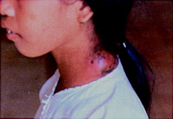
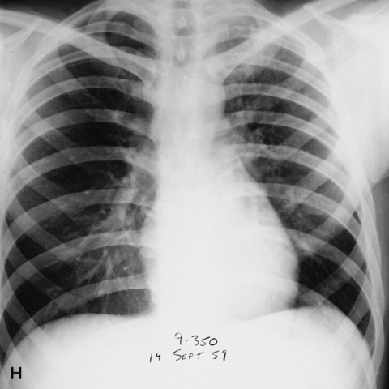
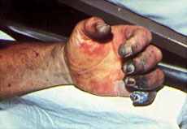
The Symptoms
Bulbous (Bubonic)
(Pneumonic) infected the lungs
(Septicemic) almost 100% of people die

Slide 10
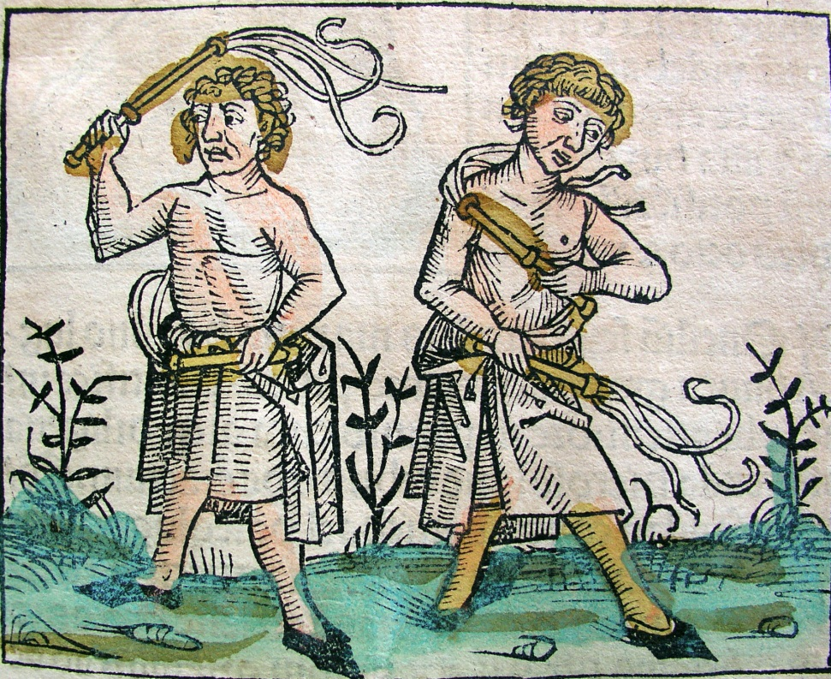
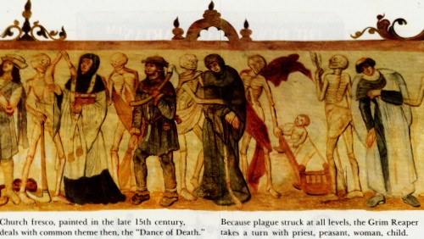
Life and Death: Reactions to the Plague
Whip
It!
Whip it good!
Plague as a punishment from God
The flagellants
Attacks against Jews - pogroms
Violence

Slide 11
Economic Effects
Extreme inflation
Trade was dangerous because of spread of disease, so the prices of both goods produced locally and those imported from afar skyrocketed.
Because of illness and death workers became scarce, so even peasants felt the effects of the new rise in wages
In general, wages outpaced prices and the standard of living was subsequently raised.

Slide 12
Social Effects
The fashions of the nobility became more extravagant in order to emphasize the social standing of the person wearing the clothing.
The peasants became slightly more empowered, and revolted when the aristocracy attempted to resist the changes brought about by the plague.
Faith in religion decreased after the plague, both because of the death of so many of the clergy and because of the failure of prayer to prevent sickness and death.

Slide 13
And just for your viewing pleasure….
https://www.youtube.com/watch?v=rZy6XilXDZQ

Slide 14
Primary Sources – The Black Death
In a pair or group of 3, read the primary sources and complete the components of analysis including what causes and effects of the Black Death are discussed in each account.
When you are finished, determine groups for the documents (either two or three groups) in the manner of a DBQ.

