Slide 1
Chapt. 15 – Changing Attitudes
Reading Quiz
Finish primary sources
Changing Attitudes / witch hunt video
HW: Start your explorer presentation (talk with partner about who is going to do which slides SAVE TO ONEDRIVE
TOMORROW: 4th – Mr. Logsdon’s room (5)
5th – Mr. Behler’s room (4)

Slide 2
Historical Thinking Skill – Analyzing Evidence
PRIMARY SOURCES
Content and Sourcing
Describe, select, and/or evaluate relevant evidence from diverse sources.
Types of sources: written documents, art, architecture, artifacts, oral tradition, etc.
Draw conclusions about the relevance to history.
Focus on the interplay between the content of a source, the author, point of view, audience, and format.
Assess the usefulness, reliability, and limitations of the source as evidence

Slide 3
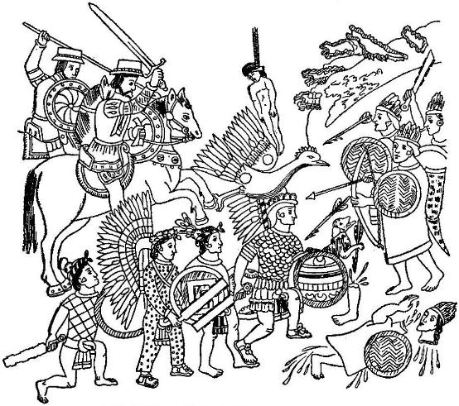
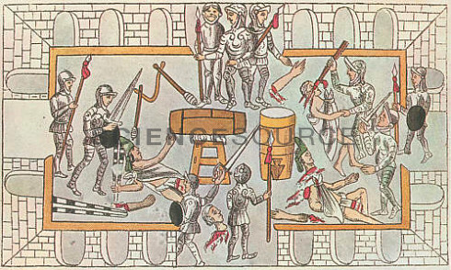

Slide 4
Changing Attitudes / Slavery
Status of women declined even more; marriage and the role of women in the home was stressed
Gender roles were laid out in pamphlets and manuals.
Witch hunts a result of increase in seeking out heresy; increase in Population of outsiders or vagrants post-religious wars
Accused Witches were typically older, single women (not under a man’s supervision)
Slave importation from African began after the fall of Constantinople to the Ottoman empire (cut off slave labor from the Black Sea region)
Cultivation of Sugar cane called for the development of slave importation to the New World from Africa
Attitudes toward black derived from two basic sources: Christian theological (“heathen” because they were not Christian) and speculation and Arab ideas (medieval Arab literature told of African primitivism) = all ridiculous myths

Slide 5
Witch Hunts – 16th, 17th centuries https://www.youtube.com/watch?v=BG4EH3FQjnI 19:58 – 29:

Slide 6
Chapt. 15 – Art & Lit
Mannerist & Baroque art
Carravaggio video (if time)
HW: outline – “Absolutism” (p. 532 – 546)

Slide 7
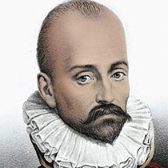
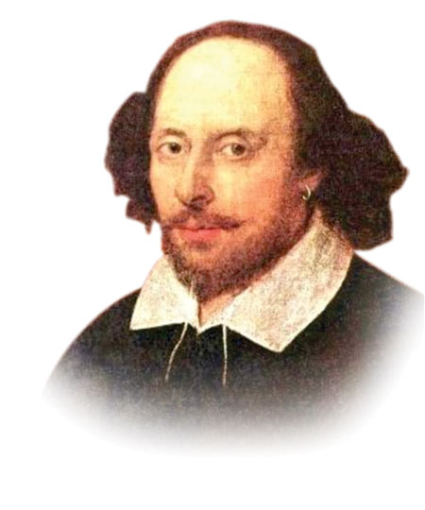
Literature
Michel de Montaigne – developed the “essay”(short work on a single subject) and Skepticism – an openness of mind and willingness to question everything. Skeptical of superiority of races.
“Of Cannibals” – in defense of the natives who were
Targeted as savages by the Europeans of the time.
William Shakespeare - Elizabethan and Jacobean playwright; helped edit the King James version of the bible; true Renaissance spirit in his analysis and understanding of human nature; history plays reflect English nationalism after the even of defeating the Spanish Armada; also wrote tragedies and comedies.

Slide 8
Mannerist & Baroque Visual Art

Slide 9
“Mannerism”
Late Renaissance [Pre-Baroque].
From the Italian de maneria.
A work of art done in the artist’s characteristic “touch” or recognizable “manner.”
Replace harmony with dissonance/dischord
Replace reason with emotion
Replace reality with imagination
Distorted figures; foggy or misty; lurid colors

Slide 10
“Mannerism”
The revival of religious values brought about by the Reformation moved artists to re-visit religious themes in art. Artists began to ignore renaissance techniques of balance, harmony, and proportion. Artists deliberately elongated figures, showed suffering, emotion and religious ecstasy.

Slide 11
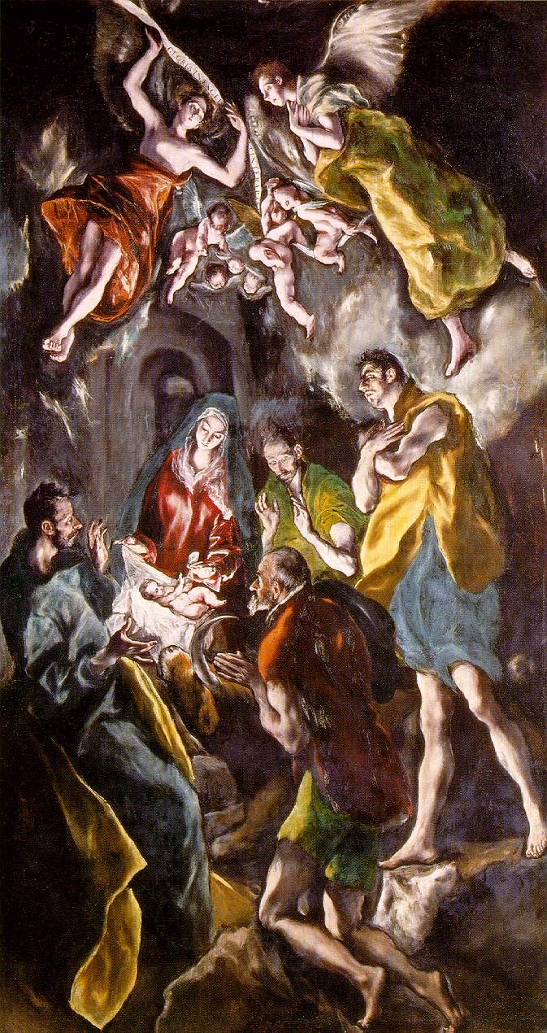
With Mannerism, there is an emphasis on the artist's imagination rather than the reproduction of nature.

Slide 12
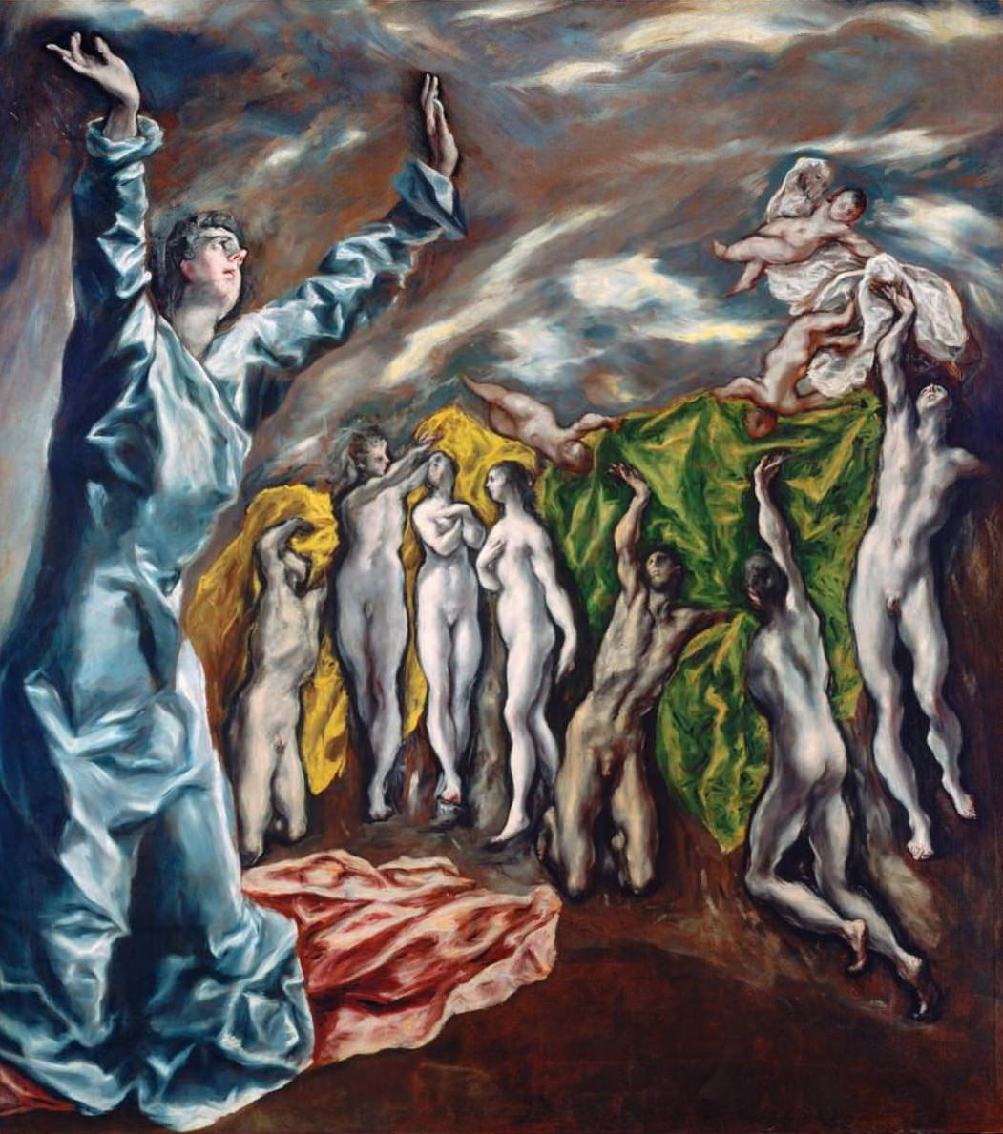
“The Opening of the Fifth Seal”
El Greco

Slide 13
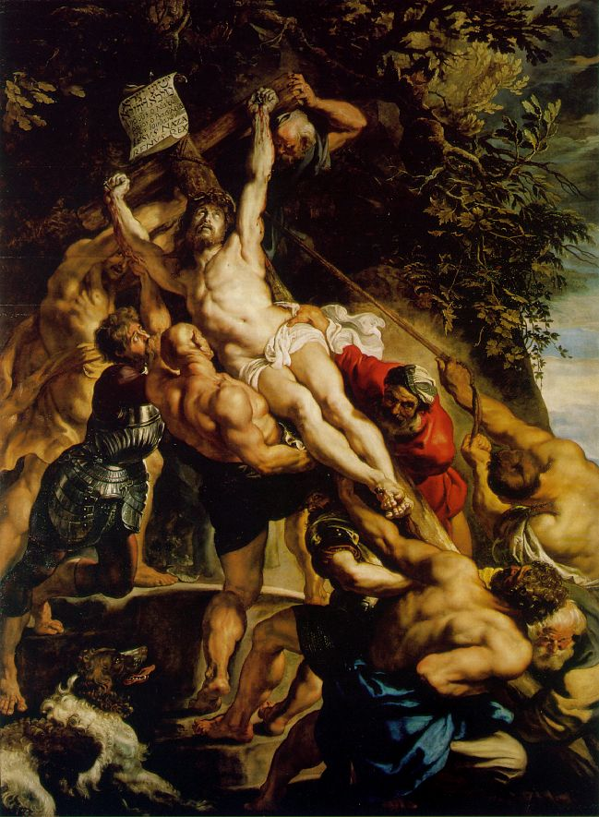
“The Elevation of the Cross” by Peter Paul Reubens 1610-11

Slide 14
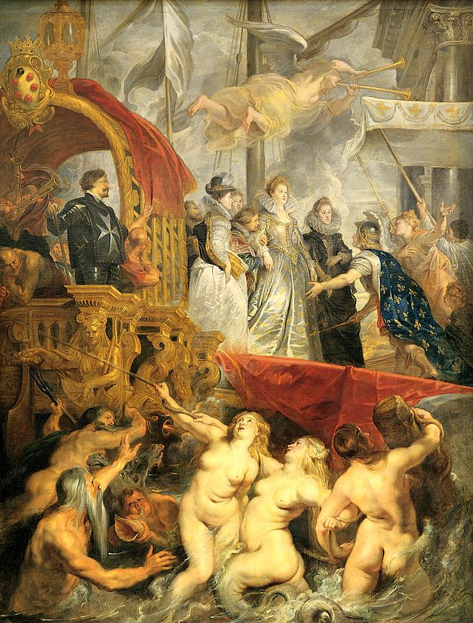
“Marie de' Medici's Arrival in Marseilles”
Peter Paul Rubens

Slide 15
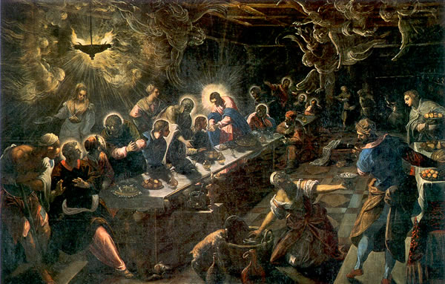
“The Last Supper” Tintoretto

Slide 16
“Baroque”
1600 – 1750.
From a Portuguese word “barocca”, meaning “a pearl of irregular shape.”
Implies strangeness, irregularity, and extravagance.
The more dramatic, the better!

Slide 17
Characteristics of Baroque Art & Architecture
Dramatic, emotional
Colors were brighter than bright; darks were darker than dark.
Counter-Reformation art.
Paintings & sculptures in church contexts should speak to the illiterate rather than to the well-informed.
Ecclesiastical art --> purpose was to appeal to emotions

Slide 18
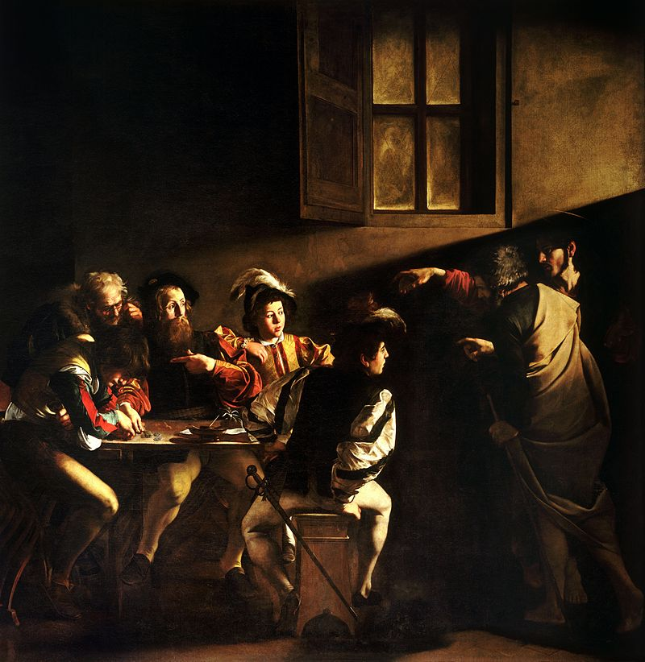
“The Calling of St. Matthew”
Michelangelo Merisi da Carravaggio

Slide 19
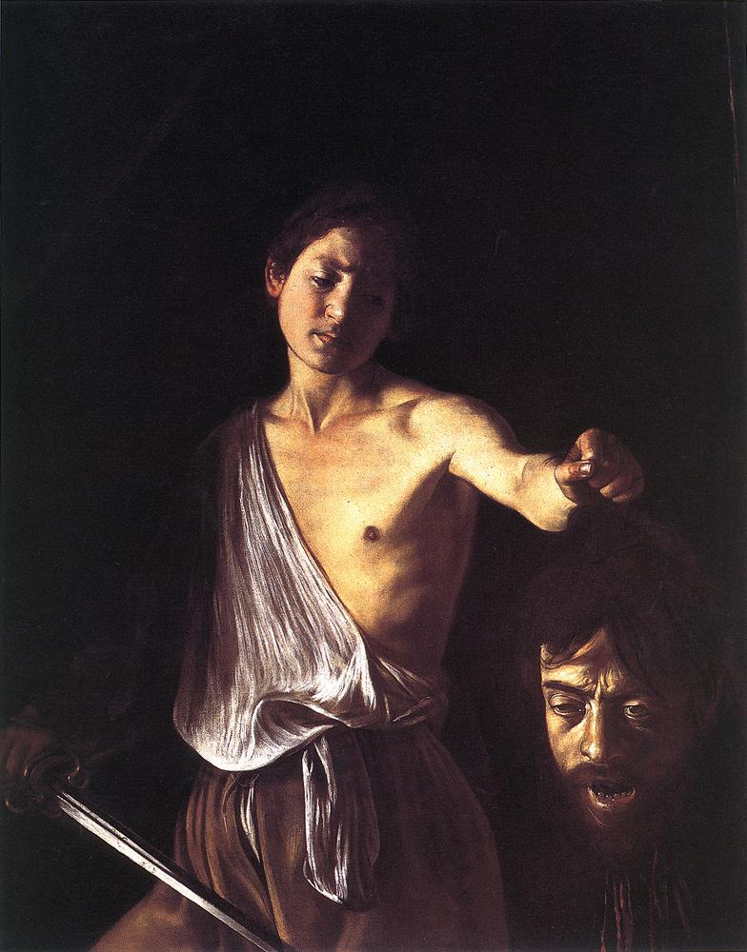
“David and Goliath”
Michelangelo Merisi da Carravaggio

Slide 20
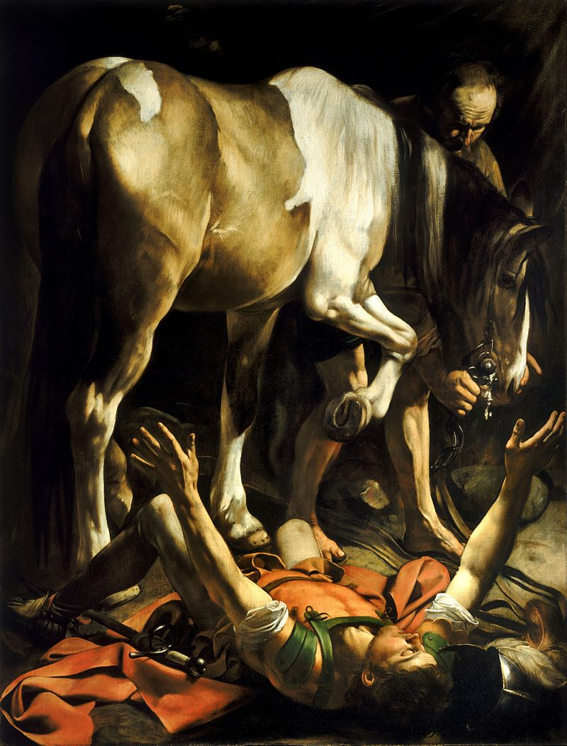
“The Conversion on the Way to Demascus”
Michelangelo Merisi da Carravaggio

Slide 21
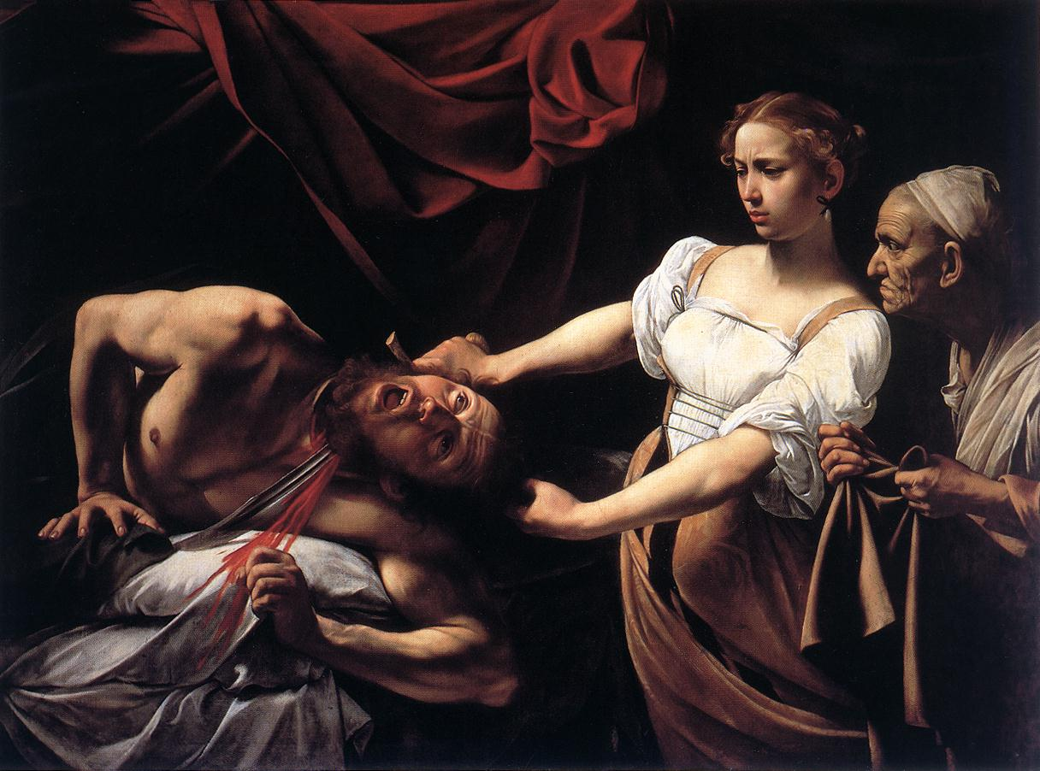
“Judith Beheading Holofernes”
Michelangelo Merisi da Carravaggio

Slide 22
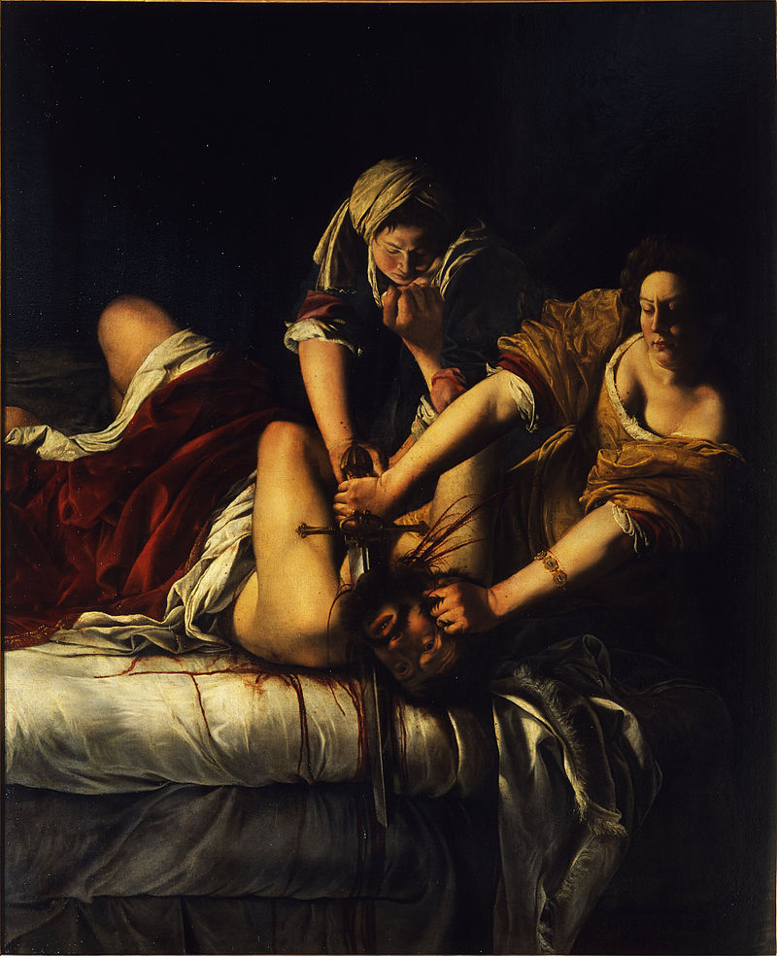
“Judith Slaying Holofernes,”
Artemesia Gentileschi

Slide 23
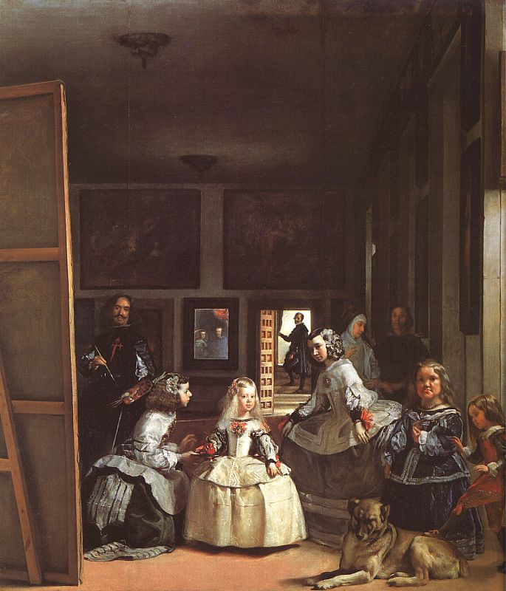
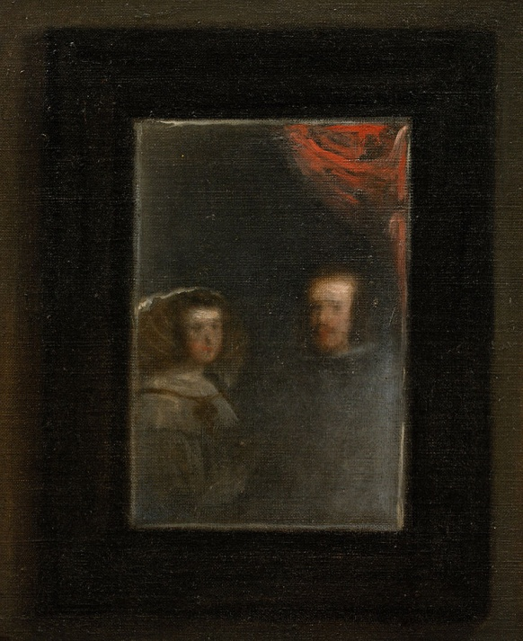
“Las Meninas” Diego Velázquez 1656

Slide 24
Dutch Baroque (“Dutch Golden Age”)
Real people portrayed as the primary subjects.
Very few religious scenes (art was forbade by Calvinism)
Sense of realism versus imaginary or elaborate
history painting
Portrait painting
genre painting or scenes of everyday life
landscape, including seascapes, battle scenes, cityscapes, and ruins.
still life

Slide 25
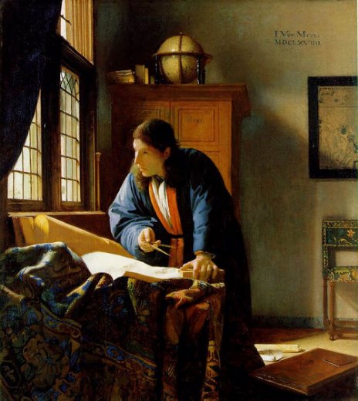
“The Geographer”
Johannes Vermeer

Slide 26
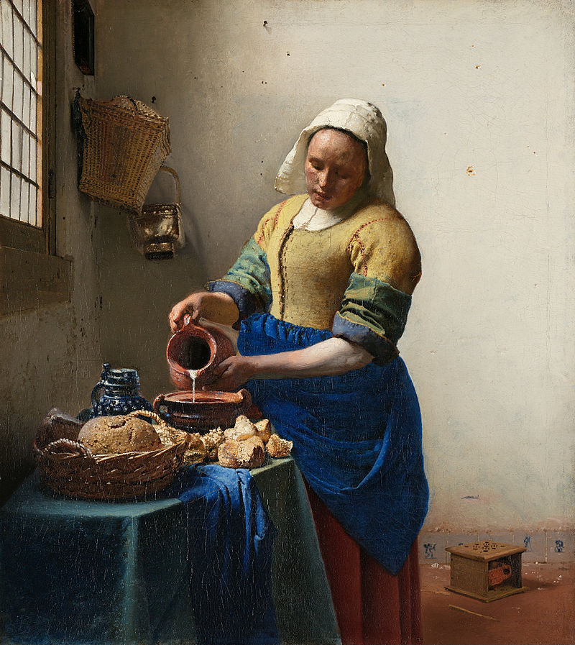
“The Milkmaid”
Johannes Vermeer

Slide 27
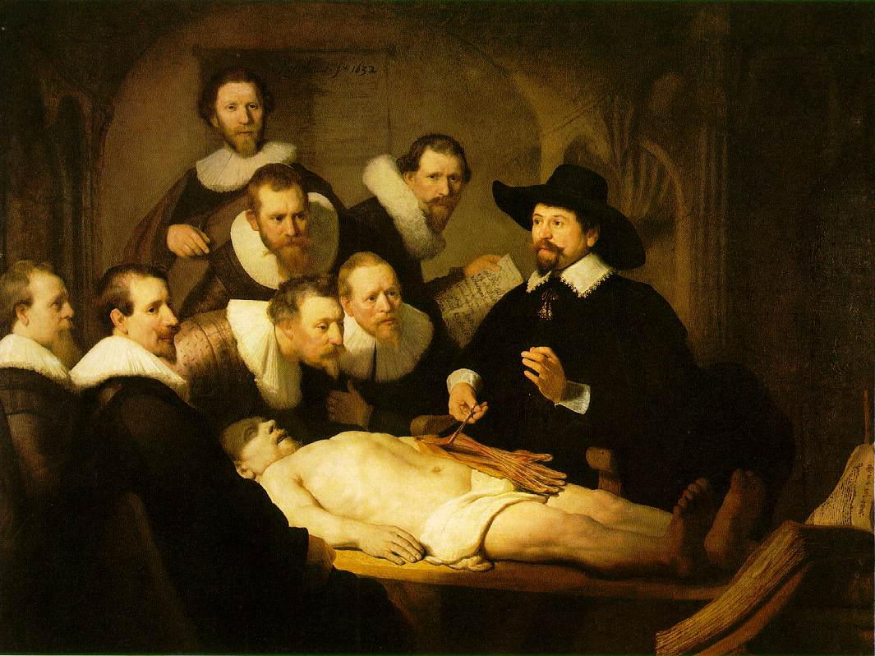
“The Anatomy Lesson of Dr. Tulp,” Rembrandt

Slide 28
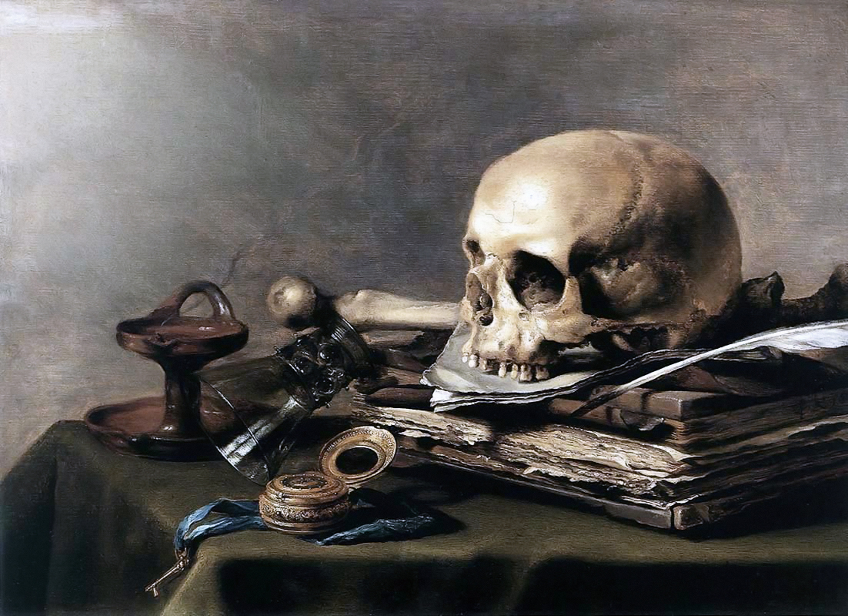
“Vanitas,” Pieter Claesz

Slide 29
Baroque Sculpture

Slide 30
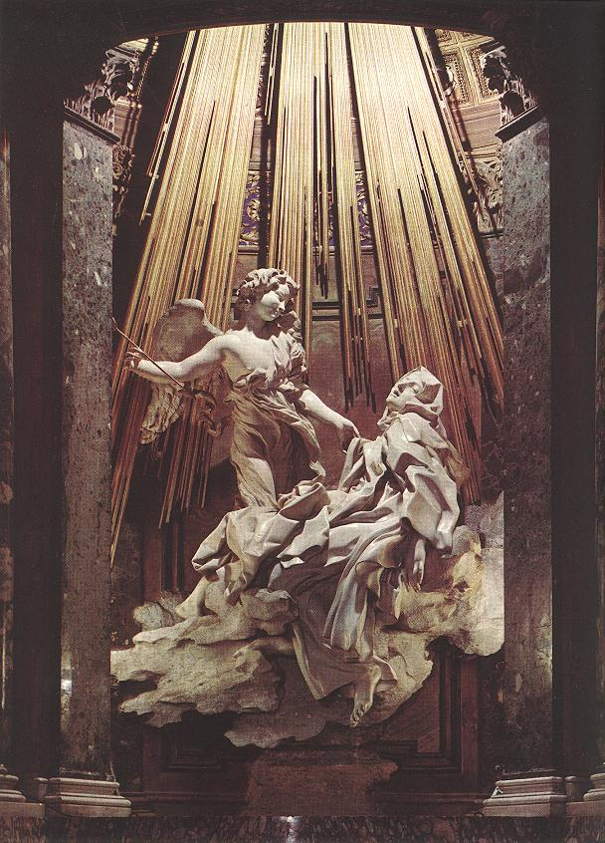
“The Ecstasy of St. Theresa of Avila” by Gianlorenzo Bernini 1647-52

Slide 31
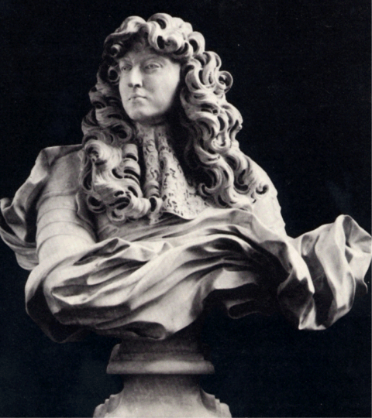
“A Bust of Louis XIV” by Bernini

Slide 32
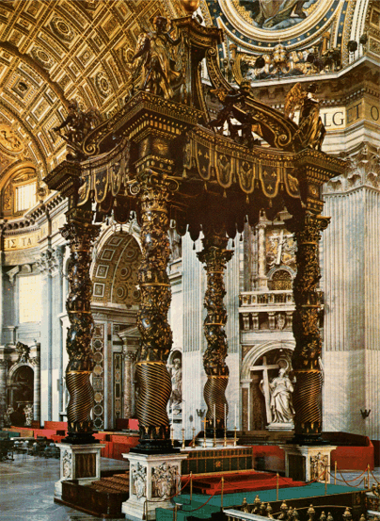
St. Peter’s Basilica, Vatican City by Gialorenzo Bernini

Slide 33
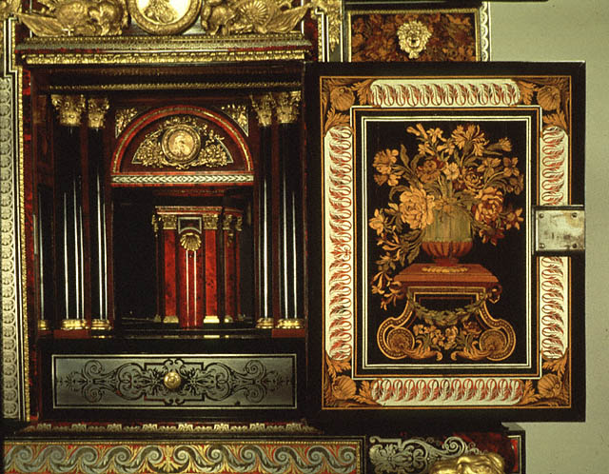
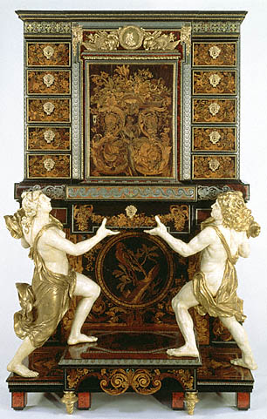
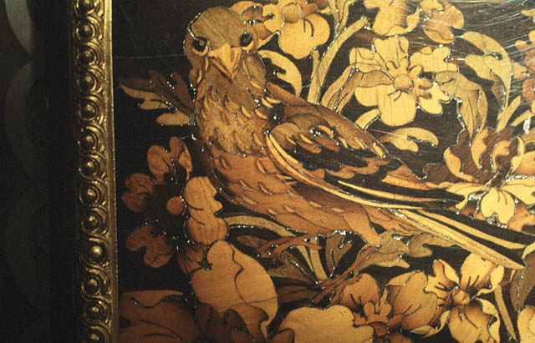
Baroque Furniture

